Slide 1
Blowing up Control Points
Algebric Geometry Applied to the
Perspective Three-Point Problem
Michael Q. Rieck, Drake University
Based in part on discussions with
Bo Wang (王波), Institute of Automation,
Chinese Academy of Sciences

Slide 2
Contents
Strongly and Weakly Related Points
Toroids
Applying Basic Algebraic Geometry
Counting and Finding Related Points
More Algebraic Geometry
Closing Questions

Slide 3
Strongly and Weakly Related Points
Only have time for a fast introduction to the P3P Problem
Fix three points A, B, C in three-dimensional real space (not collinear), and call these the control points
Let P denote an arbitrary point, other than A, B or C
Let α, β and γ be the angles between rays PB and PC, between rays PC and PA, and between rays PA and PB, respectively
Call α, β and γ, the view angles

Slide 4
Strongly and Weakly Related Points
Let c₁ = cos α, c₂ = cos β and c₃ = cos γ
Let r₁, r₂ and r₃ be the distance from P to the control points A, B and C, respectively (the unknowns in the P3P Problem)
Let d₁ be the distance between B and C, let d₂ be the distance between C and A, and let d₃ be the distance between A and B
Regard d₁ , d₂ and d₃ as the side lengths of the control points triangle ABC

Slide 5
Strongly and Weakly Related Points
Using the Law of Cosines, we obtain Grunert’s system of equations, where r₁ , r₂ and r₃ are the unknowns in the P3P Problem:
r₂² + r₃² – 2 c₁ r₂ r₃ = d₁²
r₃² + r₁² – 2 c₂ r₃ r₁ = d₂²
r₁² + r₂² – 2 c₃ r₁ r₂ = d₃²
When this is solved (multiple solutions), each solution for which the r’s
are positive real numbers, corresponds to a point in
space that has the correct view angles
{

Slide 6
Strongly and Weakly Related Points
Use a Cartesian coordinate system (respecting the physical angles), with coordinates x, y and z, is used so that the control points all lie on the unit circle in the xy-plane
Letting (x₁, y₁, 0), (x₂, y₂, 0) and (x₃, y₃, 0) be the Cartesian coordinates of A, B and C, respectively, it is further assumed that there are angles φ₁ , φ₂ and φ₃ for which x_{α} = cos φ_{α} and y_{α} = sin φ_{α} , for α = 1, 2, 3, and such that φ₁ + φ₂ + φ₃ = 0
Any reasonable coordinate system can be easily converted to a coordinate system of this sort

Slide 7
Strongly and Weakly Related Points
Two non-control points in xyz-space will be called strongly related if their Cartesian coordinates yield the same values for the c₁ , c₂ and c₃
Two non-control points in xyz-space will be called weakly related if their Cartesian coordinates yield the same values for the quantities c₁² , c₂², c₃² and c₁ c₂ c₃ ; in other words, they have the same values for |c₁|, |c₂| and |c₃|, and disagree in an even number (0 or 2) of the signs of the cosines
Important: strongly related implies weakly related

Slide 8
Strongly and Weakly Related Points
Consider two non-control points P and Q
P and Q are strongly related if and only if the configuration of three rays from P to a control points can be rigidly moved* to the corresponding configuration of rays from Q
P and Q are weakly related if and only if the configuration of the three lines through P and a control points can be rigidly moved* to the corresponding configuration of lines through Q
* Translated and/or rotated, but I should also
allow for a possible reflection here

Slide 9
Strongly and Weakly Related Points
For given values of c₁, c₂ and c₃, there can be up to eight points in real xyz-space with these cosine values (they are strongly related; they have the same view angles)
However, two points that are mirror images of each other, across the xy-plane, are strongly related, so in a sense, “eight” is double counting
Often, it is desirable to focus only on the points in the upper half-space (z > 0), and ignore their reflections in the lower half-space (z < 0)

Slide 10
Strongly and Weakly Related Points
Here are a few interesting and practical questions related to P3P:
Given the parameters d₁, d₂, d₃, c₁, c₂ and c₃, how many corresponding points in three-dimensional real space (xyz-space) are there?
Given a non-control point in xyz-space, how many strongly related points does it have?
Where are they located?
The answers to these questions have been mostly elusive until now!

Slide 11
Strongly and Weakly Related Points
In the past, there has been no interest in, or even discussion of, weakly related points, but as we will now see, the notion of “weakly related” exhibits better mathematical behavior than “strongly related,” from the standpoint of continuity
It will be helpful to consider particles (i.e. “moving points”), regarding a camera’s optical center and its weakly related points (including its strongly related points) as such

Slide 12
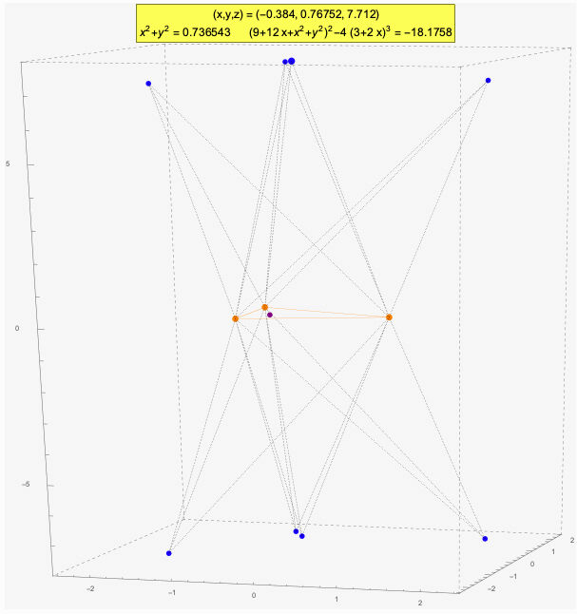
Strongly and Weakly Related Points
Related Particles
The orange dots are the control points
The purple dot is the orthocenter of the control points triangle
All of the blue dots are strongly related to each other
One of these, the biggest blue dot, is presumed to be a camera’s position, whose coodinates can be seen at the top
The green dots are only weakly related to the blue dots

Slide 13
Strongly and Weakly Related Points
As the camera’s optical center moves continuously around in xyz-space, its weak relatives (including its strong relatives) move around mostly without being impeded, though they often pass through control points
In passing through a control point, such a particle can switch between being strongly related and being merely weakly related to the continuously moving optical center
Also, at certain locations (to be discusses later) weakly related particles can come together and then disappear (due to complex solutions)

Slide 14
Toroids
The word “toroid” has multiple definitions, but here is the one that is useful for the P3P problem:
A toroid is the surface that results in three-dimensional (real) space, when an arc of a circle is rotated about the line through its endpoints
This surface is smooth, except at the two endpoints, where the surface is singular

Slide 15
Toroids
The circumcircle is the circle containing the three triangle vertices A, B and C
Let us now define the three basic toroids, as follow:
Toroid_{A} is generated from the circular arc through A whose endpoints are B and C , and similarly for Toroid_{B} and Toroid_{C}
We also need another toroid, Toroid_{π–A} , which is generated from the other arc on the circumcircle, connecting B and C, the arc that does not include A

Slide 16
Toroids
Similarly for Toroid_{π–B} and Toroid_{π–C}
The union of Toroid_{A} and Toroid_{π–A} will be called a basic double toroid, and denoted DToroid_{A}
It is the surface you get when you rotate the entire circumcircle about the line through B and C
Similarly for DToroid_{B} and DToroid_{C}

Slide 17
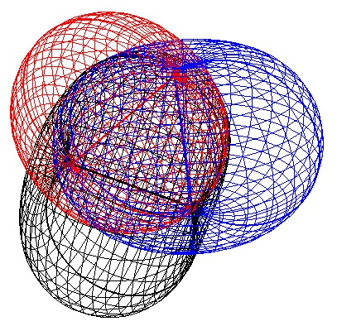
Toroids
The three basic toriods:
Toroid_{A} , Toroid_{B} and Toroid_{C}
When the camera’s optical center is outside of the union of Toroid_{A} , Toroid_{B} and Toroid_{C} , all of its weak relatives are outside too, and they are strongly related.
(image from Wang, B., Hu, H. and Zhang, C.)

Slide 18
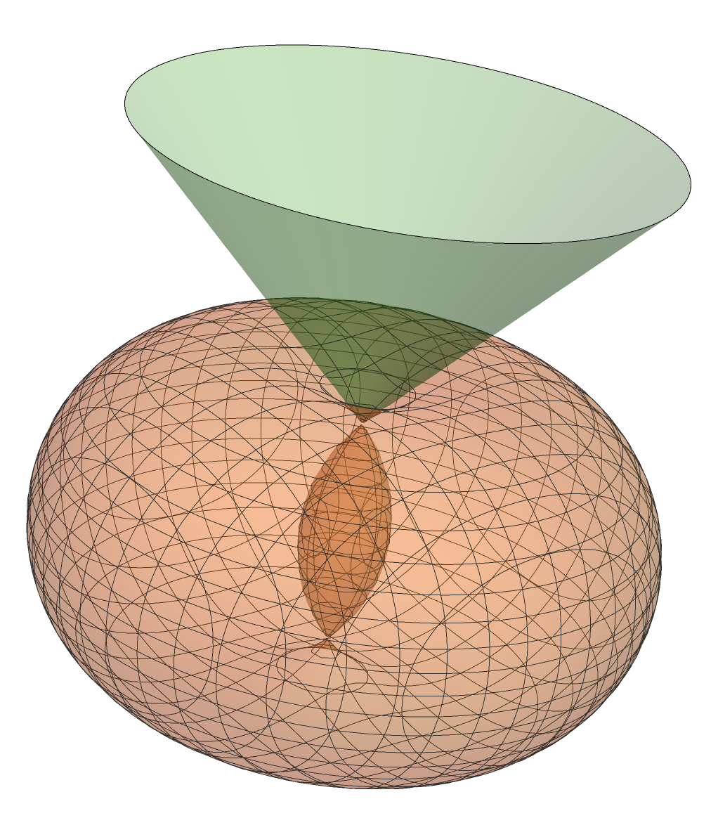
Toroids
A double toroid, and the tangent cone for its outer toroid at one of the singularities
Notice the inner toroid inside the outer toroid
The cone’s apex is of course one of the two singular points of the double toroid
Each ray on the cone, from its apex, is tangent to the outer toroid
The tangent cones allow us to determine several things about the toroids and their intersections
Cute fact: The angle, at any point on the outer toroid, between the rays from it to the toroid’s two singularities, is equal to the angle, at the cone’s apex, between the cone’s half-axis and any of its rays from the apex

Slide 19
Toroids
If the triangle ABC’s interior angle at C is acute, then Toroid_{C} uses the longer of the two circular arcs connecting A and B, forming an outer toroid that is outside the unit sphere
If instead the triangle ABC’s interior angle at C is obtuse, then Toroid_{C} uses the shorter of the two circular arcs connecting A and B, forming an inner toroid that is inside the unit sphere
Similarly for Toroid_{A} and Toroid_{B}

Slide 20
Toroids
Here is another crucial fact for analyzing related points:
If a smoothly moving particle travels through one of the three basic double toroids (in an ordinary way), then exactly one of its weak relatives in the upper half-space (and its reflection in the lower half-space) will pass through the corresponding control point
Moreover, whenever a particle travels though a control point, all of its weak relatives will pass through the corresponding basic double toroid

Slide 21
Toroids
Henceforth, assume that the control points triangle ABC is acute, so A < π/2, B < π/2 and C < π/2 (where A, B, C mean the interior angles here)
Three-dimensional real space (i.e. xyz-space) will be divided into regions, based on being outside Toroid_{A} , versus being inside Toroid_{π-A} , versus being between Toroid_{π-A} and Toroid_{A} , and similarly using B and C in place of A
In this way, we will speak of toroidal regions

Slide 22
Toroids
Specifically, we will speak of toroidal region abc, where each of a, b and c is either 0, 1 or 2, as follows:
Each digit concerns dividing space based on one of the basic double toroids, with a referring to DToroid_{A} , b referring to DToroid_{B} , c referring to DToroid_{C}
If a = 0, then the region is outside Toroid_{A} ; if a = 1, then the region is between Toroid_{π-A} and Toroid_{A} ; if a = 2, then the region is inside Toroid_{π-A}
Similarly for the digits b and c

Slide 23
Toroids
For instance, toroidal region 010 is outside both Toroid_{A} and Toroid_{C} , but between Toroid_{π-B} and Toroid_{B}
Observe that a toroidal region descriptor abc can never include a 0 and a 2, because a 0 implies being outside the unit sphere, while a 2 implies being inside the unit sphere
Also, 222 is not valid since Toroid_{π-A} , Toroid_{π-B} and Toroid_{π-C} intersect in a single point, i.e. the orthocenter, and there are no points in the interiors of all three of these toroids

Slide 24
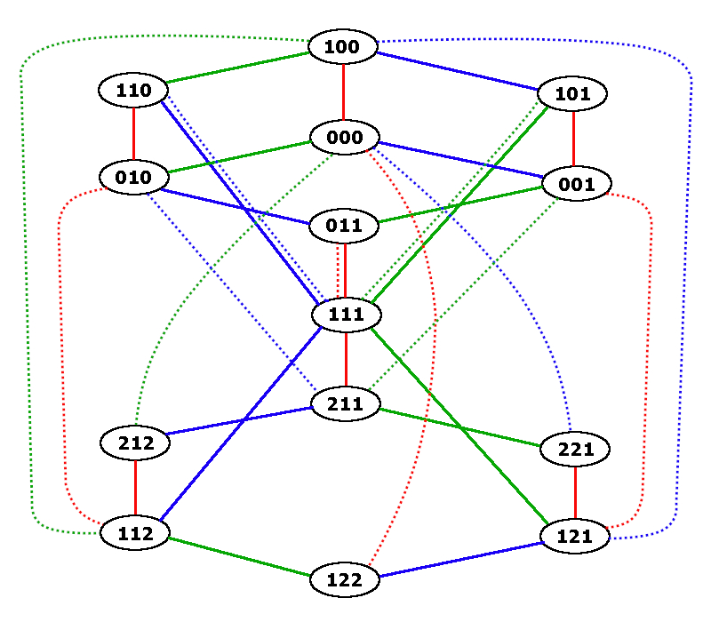
Toroids
The Toroidal Region Transition Graph
This graph describes all the ways that a smoothly moving particle can move between toroidal regions
A solid edge represents a transition caused when a particle crosses a basic double toroid in an ordinary way (red for DToroid_{A} , green for DToroid_{B} , and blue for DToroid_{C})
A dotted edge represents a transition caused by passing through a control point (red for A, green for B, and blue for C)
The details are pretty straightforward, and explained in a recently submitted paper
This graph is crucial to locating strong and weak relatives

Slide 25
Applying Basic Algebraic Geometry
Algebraic geometry is primarily focused on studying systems of polynomial equations in several variables, and the sets of points in space that satisfy such systems
We will here oversimplify this very important area of mathematics
The set of points is called a variety, but we may also refer to it as a “space"
A variety has an associated dimension, which is rather intuitive

Slide 26
Applying Basic Algebraic Geometry
As an example, for fixed parameters d₁, d₂, d₃, c₁, c₂, c₃, consider Grunert’s system of equations in the variables (unknowns) r₁, r₂ and r₃
The solutions are a finite number of isolated points in the 3D space of all possible triples (r₁, r_{2,} r₃), and so this variety has dimension zero

Slide 27
Applying Basic Algebraic Geometry
As another example, consider all of the points in xyz-space for which (9 + 12 x_{L} + x_{L}² + y_{L}²)² = 4 (3 + 2 x_{L})³ , where x_{L} and y_{L} are given by certain rational functions of x, y and z (that time does not allow me to explain)
After “clearing out denominators,” we get a single polynomial equation in x, y and z
The variety for this is the union of two surfaces, one called the danger cylinder and the other called the companion surface to the danger cylinder (CSDC)

Slide 28
Applying Basic Algebraic Geometry
The danger cylinder is just the circular cylinder that contains the circumcircle
It has long been recognized that any point on the danger cylinder corresponds to a repeated solution of Grunert’s system (using its cosine values for parameters)
So, if a particle travels onto the danger cylinder, then it will collide with a weak relative
Moreover, if a particle travels onto the CSDC, then two of its weak relatives will collide on the danger cylinder

Slide 29
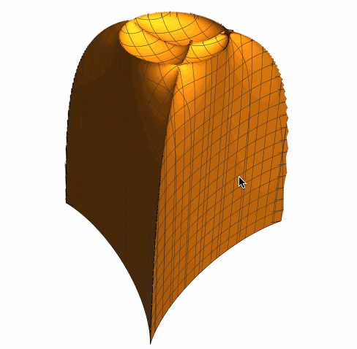
Applying Basic Algebraic Geometry
Half of the CSDC, in the case where the triangle ABC is acute, and so its orthocenter is inside its circumcircle
The other half is the reflection of this about the xy-plane
The vertices (A, B, C) can be seen here, as can the circumcircle, and inside this, the orthocenter H
(Ignore the gap near a vertex, which is a rendering issue)

Slide 30
Applying Basic Algebraic Geometry
Our basic double toroids are also examples of varieties of dimension two
Varieties often have non-smooth points called singularities
Each double toroid has two such singularities
Blowing up points is one standard way to tame singularities in algebraic geometry
(This is a photography metaphor, not a demolition metaphor)

Slide 31
Applying Basic Algebraic Geometry
The blowup of a point, say A, which we will denote Blowup_{A} , is technically just the set of all lines through A
Since we are working here in three-dimensional real space, this set of lines forms a projective plane
We want to think of the blowup of A, as representing tangent lines to smooth curves that pass through A, and so each such line describe the direction we are using when passing through the point A
Similarly for Blowup_{B} and Blowup_{C} , of course

Slide 32
Applying Basic Algebraic Geometry
We will actually also need a closely related and equally simple concept, as follows
Let DBlowup_{A} denote the set of all rays that originate at the point A, thinking of such a ray as indicating a direction from which A is being approached along a smooth curve
It is natural to model DBlowup_{A} as a tiny sphere around A, identifying each point on the sphere with the ray that passes through it

Slide 33
Applying Basic Algebraic Geometry
We will call DBlowup_{A} the double cover of Blowup_{A} due to the fact that elements of DBlowup_{A} naturally correspond to elements of Blowup_{A} in a two-to-one manner (two rays per line)
Think of an element of DBlowup_{A} as describing a point that is very close to A (infinitesimally close, really!)
It makes sense to speak about the view angles α, β and γ for such a point, but necessarily α = A (interior angle at A)

Slide 34
Applying Basic Algebraic Geometry
Treating the points (elements) of DBlowup_{A} as limiting points for ordinary points, and extending the quantities α, β and γ to these has proven to be very useful
The notions of weakly related and strongly related points are naturally extended to these limit points too
Obviously the situation is similar for DBlowup_{B} and DBlowup_{C}
In the next two slides, the intersection of DBlowup_{A} with the basic toroids and
with the CSDC are revealed

Slide 35
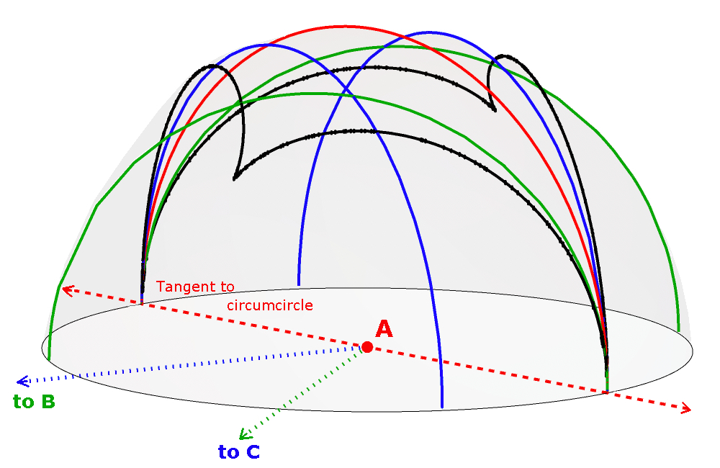
Applying Basic Algebraic Geometry
Intersecting DBlowup_{A} with other Surfaces
Only the top half of Blowup_{A} is seen here
Toroid_{A} cuts DBlowup_{A} into two halfs via a great circle (red), inside and outside Toroid_{A}
DToroid_{B} cuts DBlowup_{A} into three parts: outside Toroid_{B} , inside Toroid_{π-B} , and between Toroid_{π-B} and Toroid_{B} (green)
Similarly for DToroid_{C} (blue)
CSDC also cuts DBlowup_{A} into regions, inside and outside CSDC (black)

Slide 36
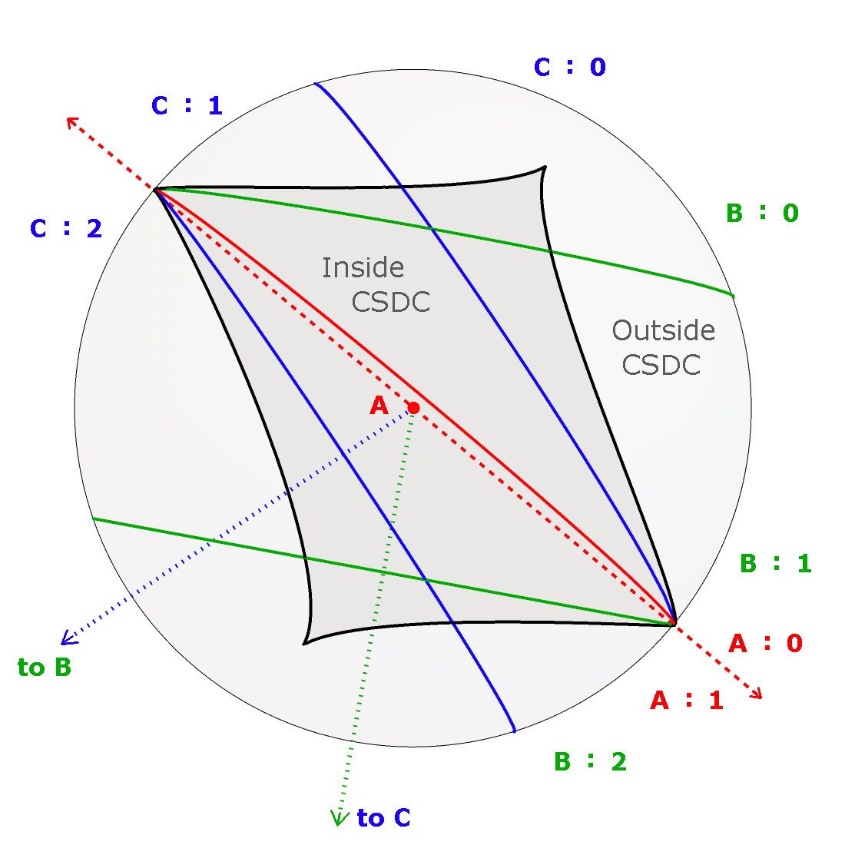
Applying Basic Algebraic Geometry
Top-Down View of DBlowup_{A}
Inside versus outside CSDC is easily seen
The half that is outside Toroid_{A} is labeled “A:0” , while the half that is inside Toroid_{A} is labeled “A:1”
DToroid_{B} cuts DBlowup_{A} into a portion outsideToroid_{B} (labeled “B:0”), etc.
Similarly for DToroid_{C}

Slide 37
Counting and Finding Related Points
Given a point in 3D real space, the problem of determining how many strongly related points it has, and where they are located, is really quite difficult
Steady headway has been made in the past couple decades, and the following presents state-of-the-art results
As hinted at earlier, smoothly moving particles are employed for this purpose

Slide 38
Counting and Finding Related Points
To avoid counting duplicates, i.e. reflections about the xy-plane, we will focus our attention solely on the upper half-space (z > 0)
Whenever a particle should pass smoothly through a control point, we can regard it instead as bouncing off (non-smoothly) the control point
Recall that strongly related points have the same view angle, and hence are always in the same toroidal region

Slide 39
Counting and Finding Related Points
What about the weak relatives?
The analysis of this begins with simple observations such as this: if a particle p is in region 110, then any weak relative q must be either in regions 110 or region 112
If p and q are both in region 110, then it is possible that all three of their view angles are the same, in which case, p and q are strongly related
But it is also conceivable for them to have supplementary values for angles α and β

Slide 40
Counting and Finding Related Points
A simple result to state, but somewhat tricky to prove is this:
If a particle is outside CSDC, then, in the upper half-space, it has exactly one weak relative, but when it is inside the CSDC, it has exactly three weak relatives
But a point on the danger cylinder counts twice here

Slide 41
Counting and Finding Related Points
Using the the transition graph and previous results, the following facts emerge
Inside the CSDC, four weakly related points in the upper half-space must be in one of the following combinations of regions: (000, 000, 000, 000) , (100, 100, 100, 122) , (110, 110, 112, 112) , (111, 111, 111, 111), or a quadruple obtained from these by permuting the entries in the triples together, and/or permuting the triples in a quadruple
An underlined 1 here means that the angle involved is supplementary to the angle corresponding to a non-underlined 1

Slide 42
Counting and Finding Related Points
Outside the CSDC, two weakly related points in the upper half-space must be in one of the following combinations of regions: (000, 000) , (100, 122) , (112, 112) , (110,110) , (111, 111) , or a pair obtained from these by permuting the entries in the triples together, and/or swapping the triples in a pair
The above results lead almost immediately to a proof of the following result, which was conjectured by Bo Wang:

Slide 43
Counting and Finding Related Points
Theorem
Assume the control points triangle is acute. Then,
Inside the CSDC: a point inside precisely 0, 1, 2, 3 of the basic toroids has precisely 3, 2, 1, 0 strongly related (real) points, respectively
Outside the CSDC: a point inside precisely 0, 1, 2, 3 of the basic toroids has precisely 1, 0, 1, 0 strongly related (real) points, respectively

Slide 44
More Algebraic Geometry
All of three-dimensional real space can be smoothly enlarged, by blowing up a point, say A, as follows
A standard way to blow up the point A is to consider the set of all ordered pairs (p, l ), where p is a point in 3D real space, and l is a line through p and A
This set of ordered pairs can naturally be given the structure of a variety (space)

Slide 45
More Algebraic Geometry
Each point p other than A corresponds to a unique pair (p, l )
But there are infinitely many pairs of the form (A, l ) because every line l through A is allowed here
In the new variety, A has been replaced with infinitely many new “points”
We have blown up the point A!

Slide 46
More Algebraic Geometry
For the purpose of better studying P3P, it is useful to blow up all three control points, A, B and C
This amounts to a straightforward embellishment of what we just did
Instead of all possible (p, l ), use the set of all possible (p, l _{A}, l _{B}, l _{C}), where l _{A} is a line through p and A, l _{B} is a line through p and B, and l _{C} is a line through p and C
In this manner, each of A, B and C gets replaced with infinitely
many new “points” (a whole projective plane)

Slide 47
More Algebraic Geometry
Let Blowup denote our new space (variety) of all suitable quadruples (p, l _{A}, l _{B}, l _{C}) , and refer to the quadruples as its “points”
Each point of the form (A, l _{A}, l _{B}, l _{C}) is only distinguished by l _{A} , which we visualize as specifying a tangent line when we travel through the point A in xyz-space, etc.
These points constitute a subvariety of Blowup that we will identify with Blowup_{A}
Similarly for Blowup_{B} and Blowup_{C}

Slide 48
More Algebraic Geometry
Next, for any variety V in 3D real space, such as one of our double toroids, we can obtain a corresponding variety in Blowup, as follow:
1. Each point of V, other than A, B or C, corresponds to a unique point in Blowup
2. Take all of these points in Blowup, and extend this set by including any of its
limit points (topological closure)
This will be a subvariety of Blowup, and any limit points that might get “tossed in” will come from the union of Blowup_{A} , Blowup_{B} and Blowup_{C}

Slide 49
More Algebraic Geometry
Here is one reason for using the variety Blowup in connection with P3P: the important quantities c₁², c₂² , c₃² and c₁c₂c₃ all extend naturally to all of the points of Blowup
There is a nice map from Blowup onto the variety V of all points (q, r, s, t) for which q² = rst that sets q = c₁c₂c₃ , r = c₁², s = c₂² and t = c₃²
Points of Blowup are weakly related if and only if they have the same image under this map from Blowup to V, so “weakly related” becomes an algebraic geometric concept
What about “strongly related?”

Slide 50
Unfortunately, c₂ and c₃ are not defined on Blowup_{A} , and so forth, and this is basically why on Blowup, we have continuity of “weakly related,” but not “strongly related”
One way to “correct” for this is a bit messy, and amounts to replacing the lines l _{A} , l _{B} and l _{C} in (P, l _{A}, l _{B}, l _{C}) with rays from P that either point towards or away from the corresponding control point
Of course, α, β and γ are then defined to be the angles between pairs of these rays, etc.
This means each ordinary point P in 3D real space gets replaced by eight points in the
new space of such quadruples (P, r_{A}, r_{B}, r_{C}) -- Ouch!
More Algebraic Geometry

Slide 51
We see that the variety Blowup* thus constructed is an 8-fold cover of Blowup
We can imagine obtaining this space from eight copies of xyz-space, by extracting tiny open balls around A, B and C, from each copy, and gluing these together appropriately along the spherical boundaries of the balls
The 8-fold cover can easily be reduced to a 4-fold cover by identifying each point (P, r_{A}, r_{B}, r_{C}) with the point (P, - r_{A}, - r_{B}, - r_{C}), where r_{A} and - r_{A} are oppositely directed rays, defining the same undirected line, and so forth
More Algebraic Geometry

Slide 52
Denoting this 4-fold cover by Blowup#, we have a variety on which the quantities c₁, c₂ and c₃ can be naturally defined (the same may be said of Blowup*)
These quantities vary continuously as a particle moves continuously around in Blowup#
There is a natural projection from Blowup# onto Blowup
A continuous open path in Blowup# may project onto a closed path in Blowup, thus showing that Blowup# is a non-trivial cover of Blowup, in the sense of homotopy
More Algebraic Geometry

Slide 53
More Algebraic Geometry
It can be shown that Blowup# contains four copies of the circumcircle on which α, β and γ are constant
By analogy with a 2D version of P3P (Maienschein and Rieck), it makes sense to collapse each of these circles to a single point (via a “blowdown,” the opposite of a blowup)
This yields four special points, and we will denote the resulting space Blowup†, and observe that (α, β, γ) and (c₁, c₂, c₃) are naturally defined here as well

Slide 54
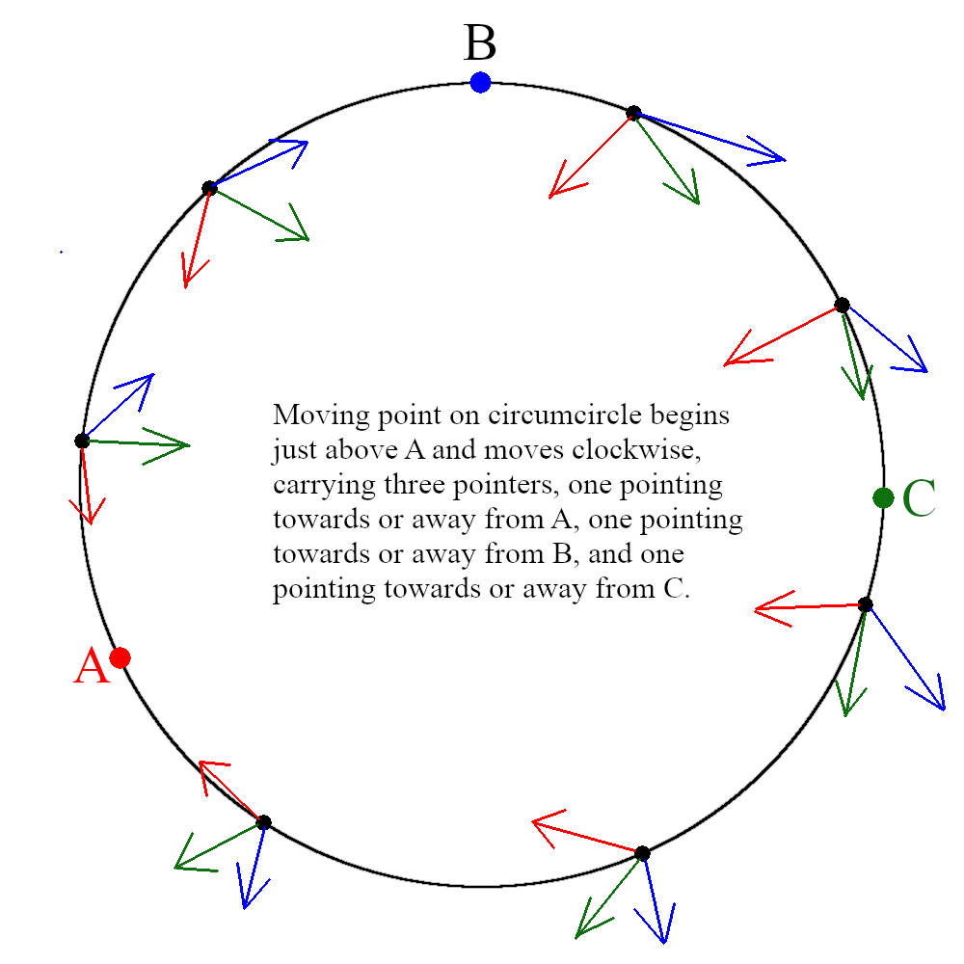
More Algebraic Geometry
Representing a lift of the circumcircle to Blowup* or Blowup#
When working in Blowup*, a lift of a moving particle on the circumcircle must go twice around the circle to return to its starting position
When working in Blowup# instead, only one trip around the circle is needed
The circumcircle thus lifts to a circle in Blowup#, in fact four such circles, which can be collapsed to make Blowup†

Slide 55
Closing Questions
Why does a deltoid curve occur in the limiting case as |z| goes to infinity?
Why does the deltoid formula occur in a nice compact way of writing the otherwise extremely messy discriminant formula for Grunert’s system of equations?
Is there a simple way to visualize the variety that results from blowing up the three control points, and related varieties?

Slide 56
References
Gao, X. S., Hou, X. R. and Tang, J. L., Complete solutions classification for the perspective-three-point problem, Pattern Anal. Mach. Intell. IEEE Trans., 25(8), 930-943 (2003)
Grunert, J. A., Das pothenotische problem in erweiterter gesalt nebst uber seine anwendungen in der geodasie, Grunerts Archiv fur Mathematik und Physik, 1, 238-248 (1841)
Haralick, R. M., Lee, C.-N., Ottenberg, K. and Nolle, N., Review and analysis of solutions of the three point perspective pose estimation problem, J. Computer Vision, 13(3), 331-356 (1994)
Hu, L., Wang, B. and Zhang, J., Singular points in the optical center distribution of P3P solutions, Mathematical Problems in Engineering, #147397 (2015)
Maienschein, T. D. and Rieck, M. Q., Angular coordinates and rational maps, J. Geom. & Graphics, 20(1), 41-62 (2016)
Rieck, M. Q., A fundamentally new view of the perspective 3-point pose problem, J. Math. Imaging and Vision, 48(3), 499-516 (2014)
Rieck, M. Q., Related solutions to the perspective three-point pose problem, J. Math. Imaging and Vision, 53(2), 225-232 (2015)
Rieck, M. Q., On the discriminant of Grunert's system of algebraic equations and related issues, J. Math. Imaging and Vision, 60(5), 737-762 (2018)
Rieck, M. Q. and Wang, B., Locating Perspective 3-Point Problem Solutions in Spacial Regions, J. Math. Imaging and Vision (submitted)
Wang, B., Hu, H. and Zhang, C., New insights on multi-solution distribution of the P3P problem, arXiv:1901.11464v1 (2019)
Wang, B., Hu, H. and Zhang, C., Companion surface of danger cylinder and its role in solution variation of P3P problem, arXiv:1906.08598v1 (2019)
Slides available at mqrieck.com/P3P/BlowingUpControlPoints.pptx , …_audio.pptx and ….pdf

Slide 57
Thank You
Questions?

