Slide 1
Blowing up Control Points
Algebric Geometry and Topology Applied
to the Perspective Three-Point Problem
by
Michael Q. Rieck, Drake University
and
Bo Wang (王波), Institute of Automation,
Chinese Academy of Sciences

Slide 2
Contents
An Introduction to the P3P Problem
Toroids
The Limiting Case of P3P
The Danger Cylinder and its Companion Surface
Intersecting Surfaces
Applying Basic Algebraic Geometry
A Family of Space Curves
A Curious Family of Birational Transformations
Some Closing Questions

Slide 3
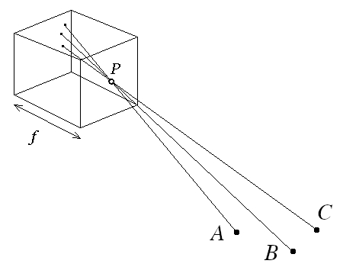
An Introduction to the P3P Problem
A pinhole camera, with pinhole (optical center; center of perspective) located at P, obtains an image showing three known points in space, A, B and C, called the control points
We assume that the angles between the rays PA, PB and PC are known, the distances between A, B and C are known, but the distances from P to A, B and C are unknown
?
?
?

Slide 4
An Introduction to the P3P Problem
The primary goal of the P3P problem is to determine the distances from the camera to the control points, and thereby determine the cameras position (in relation to A, B and C)
Let α, β and γ be the known angles between rays PB and PC, between rays PC and PA, and between rays PA and PB, respectively
We will call α, β and γ, the viewing angles

Slide 5
An Introduction to the P3P Problem
Let c₁ = cos α, c₂ = cos β and c₃ = cos γ
Let r₁, r₂ and r₃ be the unknown distance from P to the control points A, B and C, respectively
Let d₁ be the known distance between B and C, let d₂ be the known distance between C and A, and let d₃ be the known distance between A and B

Slide 6
An Introduction to the P3P Problem
Using the Law of Cosines, we obtain Grunert’s system of equations, where r₁ , r₂ and r₃ are the only unknowns:
r₂² + r₃² – 2 c₁ r₂ r₃ = d₁²
r₃² + r₁² – 2 c₂ r₃ r₁ = d₂²
r₁² + r₂² – 2 c₃ r₁ r₂ = d₃²
{

Slide 7
An Introduction to the P3P Problem
Over the years, this system has been solved in various ways, usually by eliminating two of the unknowns, so as to produce a fourth-degree (quartic) polynomial equation in some unknown quantity
Yet significant questions persist, even after many decades of study of P3P
In recent years, the analysis of P3P has benefited substantially from algebraic manipulation software, and from making a few harmless mathematical
assumptions, as follows

Slide 8
An Introduction to the P3P Problem
An xyz-coordinate system (respecting the actual angles) is used so that the control points all lie on the unit circle in the xy-plane
Letting (x₁, y₁, 0), (x₂, y₂, 0) and (x₃, y₃, 0) be the coordinates of A, B and C, respectively, assume further that there are angles φ₁ , φ₂ and φ₃ such that x_{i} = cos φ_{i} and y_{i} = sin φ_{i} , for i = 1, 2, 3, and such that φ₁ + φ₂ + φ₃ = 0
Any coordinate system that respects the angles in physical space can be
easily transformed to produce a suitable coordinate system

Slide 9
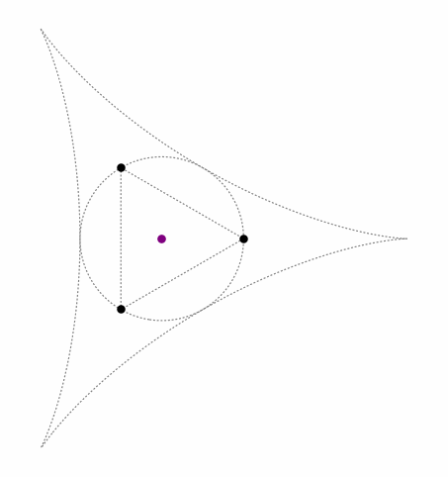
An Introduction to the P3P Problem
(Wait for animation)
It is henceforth assumed that the control points are on the unit circle in the xy-plane, with a particular orientation, as prescribed in the previous slide
Consider the control points to be the vertices of a triangle
The triangle’s orthocenter (purple dot) stays inside a particular deltoid curve
When the triangle is acute, the orthocenter will be inside the triangle
When the triangle is obtuse, the orthocenter will be outside the triangle’s circumcircle (i.e. the unit circle)
Despite the animation, the control points are assumed to be fixed points in space

Slide 10
An Introduction to the P3P Problem
Each point P in space, having Cartesian coordinates (x, y, z), except for the control points, is such that if the camera’s pinhole happens to be at P, then the angles α, β, γ, and the cosines c₁ , c₂ , c₃ can easily be expressed in terms of x, y and z
In this way, it is often useful to regard α, β, γ, c₁ , c₂ and c₃ as being given by functions of the Cartesian coordinates, x, y and z, for analytic purposes, even though x, y and z are unknown in the P3P Problem

Slide 11
An Introduction to the P3P Problem
Two non-control points in xyz-space will be called strongly related if their Cartesian coordinates yield the same values for the c₁ , c₂ and c₃
Two non-control points in xyz-space will be called weakly related if their Cartesian coordinates yield the same values for the quantities c₁² , c₂², c₃² and c₁ c₂ c₃ ; in other words, they have the same values for |c₁|, |c₂| and |c₃|, and disagree in an even number (0 or 2) of the signs of the cosines
Strict weakly related means weakly related but not strongly related
Important: strongly related implies weakly related

Slide 12
An Introduction to the P3P Problem
For given values of its parameters d₁, d₂, d₃, c₁, c₂ and c₃, Grunert’s system has multiple solutions, yielding up to eight solution points in real xyz-space
These solution points are strongly related, and the reflection of each solution point about the xy-plane is also a solution point
Often, it is desirable to focus only on the solutions in the upper half-space (z > 0), and ignore their reflections in the lower half-space (z < 0)

Slide 13
An Introduction to the P3P Problem
Here are a few interesting, and to different degrees, still outstanding, questions concerning P3P:
Given the P3P parameters d₁, d₂, d₃, c₁, c₂ and c₃, how many (real) solution points does Grunert’s system yield?
Given a non-control point in xyz-space, how many strongly related points does it have (i.e. other solution points for the same P3P parameters)?
Where are they located?
This last question has been particularly elusive!

Slide 14
An Introduction to the P3P Problem
As a practical matter, strongly related points are of importance to real world problems, like camera tracking
Until recently, there has been no interest in, or even discussion of, weakly related points, but as we will now see, the notion of “weakly related” exhibits better mathematical behavior, from the standpoint of continuity
The following animation shows the movement of a camera in space (the big
blue dot), along with its related points (the other moving dots)

Slide 15
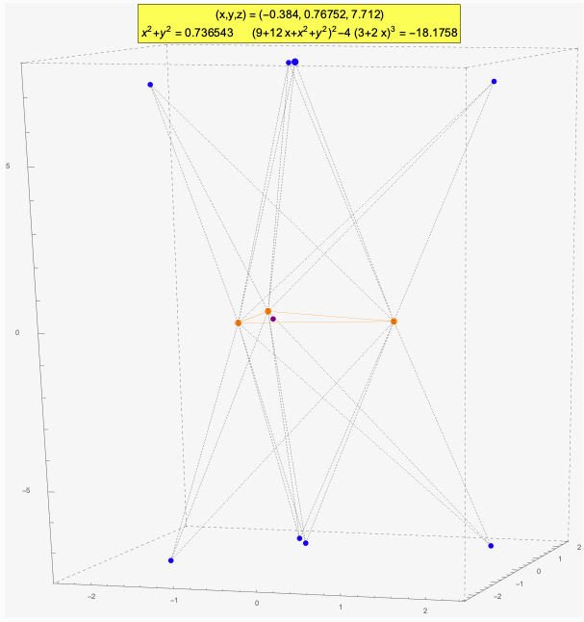
An Introduction to the P3P Problem
Related P3P Solution Points
(Wait for animation)
The orange dots are control points
The purple dot is the orthocenter
All of the blue dots are strongly related to each other
One of these, the biggest blue dot, is presumed to be the camera pinhole’s position, whose coodinates can be seen at the top
The green dots are only weakly related to the blue dots

Slide 16
An Introduction to the P3P Problem
As the camera’s pinhole moves continuously around in xyz-space, its weakly related points (including its strongly related points) move around mostly without being impeded, though they might pass through control points
In passing through a control point, such a point can switch between being strongly related and being strict weakly related (to the pinhole)
However, at certain locations (to be discusses later) weakly related points can come together and then disappear together (due to complex solutions)

Slide 17
An Introduction to the P3P Problem
At the moment that one of the camera pinhole’s weakly related points moves to a control point, it is technically not correct to say that the two moving points are still related, since only one of c₁ , c₂ and c₃ is even defined at a control point
We will later use some algebraic geometry that corrects for this deficiency
Also, as seen in the next animation, if the camera’s pinhole moves around, even slightly, in the vicinity of a control point, then this can cause substantial movement of the points that are weakly related to the camera’s pinhole

Slide 18
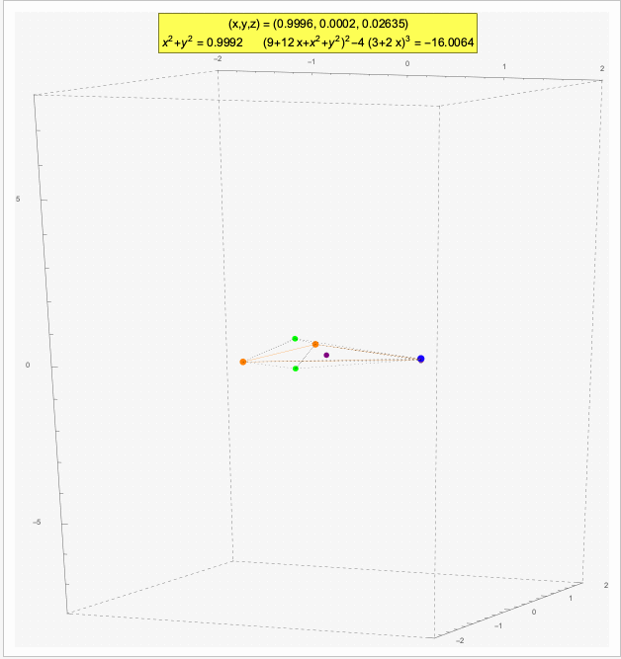
An Introduction to the P3P Problem
Camera Pinhole Very Close to a Control Point
(Wait for animation)
When the camera’s pinhole is close to one of the control points, even small movements of this pinhole will dramatically influence the weakly related points
Notice the camera pinhole’s coordinates, at the top, which are very close to the coordinates of a control point, namely (1, 0, 0), most of the time

Slide 19
Toroids
The word “toroid” has multiple definitions, but here is the one that is useful for the P3P problem
A toroid is the surface that results in 3D (real) space, when an arc of a circle is rotated about the line through its endpoints
This surface is smooth, except at the two endpoints, where the surface is singular

Slide 20
Toroids
Actually, the only toroids that will be useful for P3P always have two of the three control points as their endpoints
For example, take some point P in space, other that A or B, and consider the circular arc that passes through P, and that has A and B as its endpoints
Rotate this arc about the line AB to produce a toroid containing P

Slide 21
Toroids
Question: Which points in space have the same γ value as P? (I.e. the angle between the two rays from the point, to A and to B, must be the same as at P)
Answer: The points on the toroid just described, except for A and B
The Inscribed Angle Theorem ensures that all of the points along the circular arc between A and B, and passing through P, have the same γ value as P
Rotating this arc about the line AB clearly does not affect the value of γ

Slide 22
Toroids
The toroid we just constructed will be denoted Toroid_{γ}(P), or simply Toroid_{γ} when the point P is implied
Similarly, we define Toroid_{α}(P) and Toroid_{β}(P)
If instead of the arc through P, we use the other arc connecting A and B, on the same circle, the one that does not go through P, then we obtain the complementary toroid, CToroid_{γ}(P)
Similarly for CToroid_{α}(P) and CToroid_{β}(P)

Slide 23
Toroids
The union of Toroid_{γ}(P) and CToroid_{γ}(P) is of course the surface obtained by rotating the entire circle ABP about the line AB
We will call this a double toroid, and denote it as DToroid_{γ}(P)
Similarly for DToroid_{α}(P) and DToroid_{β}(P)
We will now see that Toroid_{α}(P), Toroid_{β}(P) and Toroid_{γ}(P) are closely associated with the concept of “strongly related,” and later that DToroid_{α}(P), DToroid_{β}(P) and DToroid_{γ}(P) are
somewhat similarly associated with “weakly related”

Slide 24
Toroids
The following are equivalent for points P and Q:
P and Q are strongly related (i.e. have the same c₁, c₂ and c₃ values)
P and Q have the same values of α, β and γ
Q is in the intersection of Toroid_{α}(P), Toroid_{β}(P) and Toroid_{γ}(P)
P is in the intersection of Toroid_{α}(Q), Toroid_{β}(Q) and Toroid_{γ}(Q)

Slide 25
Toroids
Letting γ denote the angle at P between the rays to A and B, it is straightforward to check that the points on CToroid_{γ}(P) are the points at which the angle between the rays to A and B is π – γ (whose cosine is of course – cos γ)
The points on DToroid_{γ}(P) are the points that have the same value of c₃² (i.e. same value of |c₃|) as P
Similarly for CToroid_{α}(P), CToroid_{β}(P), DToroid_{α}(P) and DToroid_{β}(P)

Slide 26
Toroids
The intersection of DToroid_{α}(P), DToroid_{β}(P) and DToroid_{γ}(P) thus consists of points that have the same values of c₁², c₂² and c₃² as P
There are only finitely many such points
However, in order for a point to be weakly related to P, it must also have the same value of c₁ c₂ c₃ as P
This means it must be on an odd number of Toroid_{α}(P), Toroid_{β}(P) and Toroid_{γ}(P)

Slide 27
Toroids
Toroids and double toroids of particular interest occur when P is A, B or C
Let us define Toroid_{A} = Toroid_{α}(A), Toroid_{B} = Toroid_{β}(B) and Toroid_{C} = Toroid_{γ}(C)
Likewise, define CToroid_{A} = CToroid_{α}(A), CToroid_{B} = CToroid_{β}(B), CToroid_{C} = CToroid_{γ}(C), DToroid_{A} = DToroid_{α}(A), DToroid_{B} = DToroid_{β}(B) and DToroid_{C} = DToroid_{γ}(C)

Slide 28
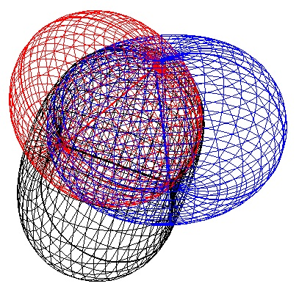
Toroids
The three special toriods:
Toroid_{A} , Toroid_{B} and Toroid_{C}
When the camera’s pinhole is outside of the union of Toroid_{A} , Toroid_{B} and Toroid_{C} , no strict weakly related solution points exists; that is, all of its weakly related solution points are strongly related.
When the camera’s pinhole passes through one of the three special toroids, Toroid_{A} , Toroid_{B} or Toroid_{C} , one of its weakly related solution points passes through the corresponding vertex, and changes how it is related to the camera’s pinhole

Slide 29
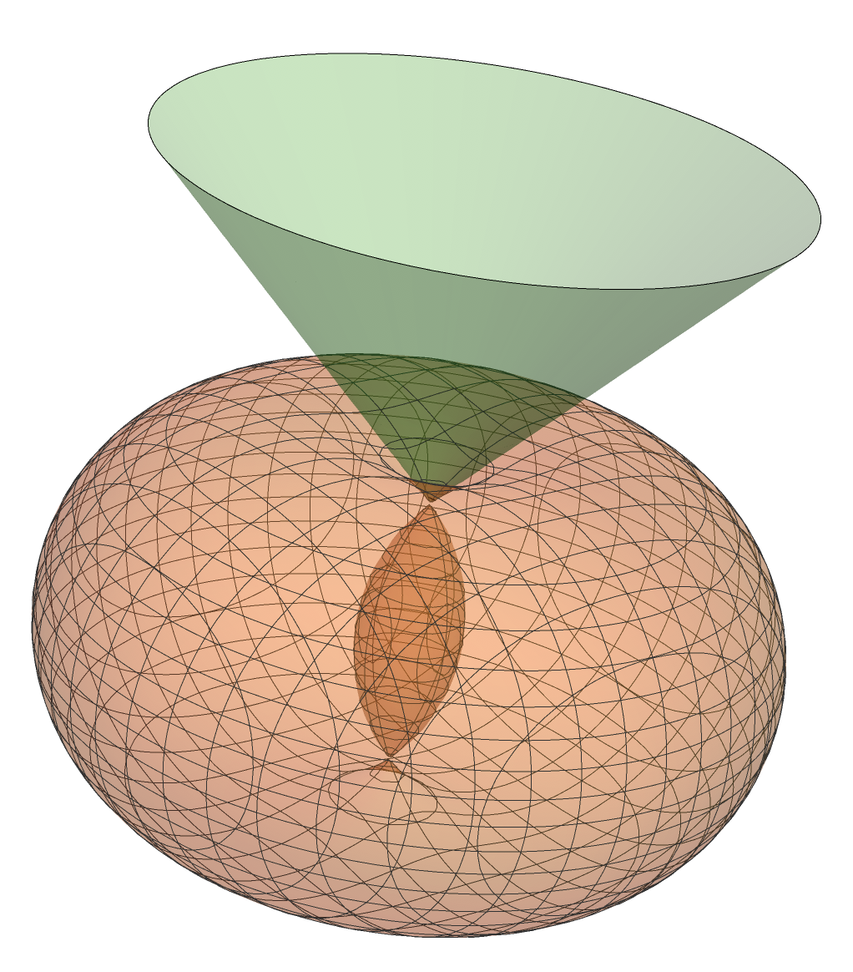
Toroids
A double toroid, and the tangent cone for its outer toroid at one of the singularities
Notice the inner toroid inside the outer toroid
The cone’s apex is of course one of the two singular points of the double toroid
Each half-line on the cone, from its apex, is tangent to the outer toroid
Cute fact: The angle, at any point on the outer toroid, between the rays from it to the toroid’s two singularities, is equal to the angle, at the cone’s apex, between the cone’s half-axis and any of its half-lines from the apex
This can be reasoned using the next figure

Slide 30
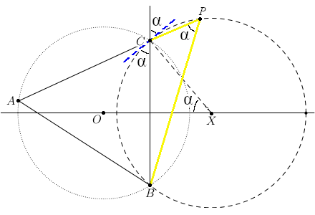
Toroids
We are looking here at half of the intersection of a double toroid DToroid_{α} and the xy-plane, specifically the dashed circle in the figure
By the Inscribed Angle Theorem, the viewing angle α for Τoroid_{α} , at P for instance, is congruent to the angle at the center X of the dashed circle, between the segments XC and XO, where O is the circumcenter of triangle ΔABC
By other theorems in planar geometry (with a little calculus?), this angle is also congruent to the other two angles in the figure labeled “α”
But one of these is the angle at the apex of the tangent cone, between any of its half-lines from the apex, and its half-axis
The angle labeled α at the point P in the figure is one of the three classical angular coordinates for P (investigated by Maienschein and Rieck in connection with other planar and algebraic geometry concepts)
(Altered version of Danny Maienschein’s figure)

Slide 31
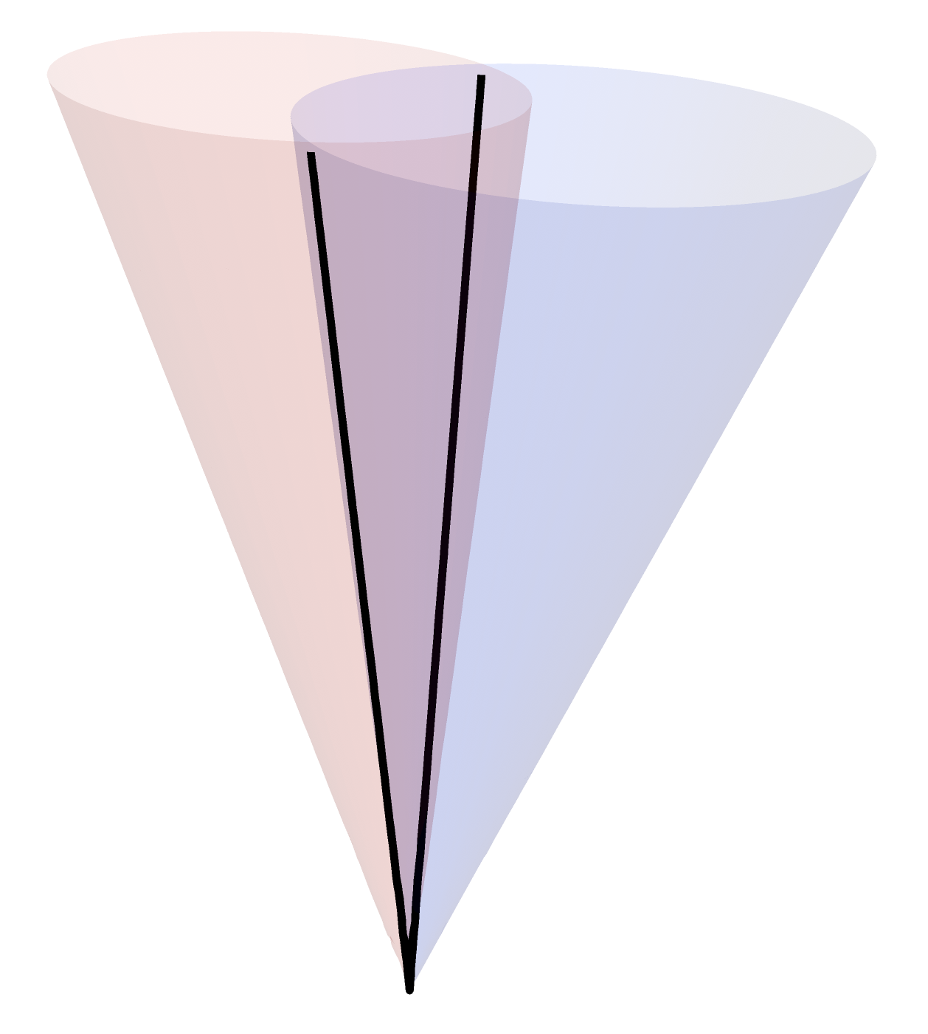
Toroids
When they intersect, two circular cones with the same apex typically intersect in a pair of half-lines whose ends are at the apex
Of course, when the two cones are tangent to each other, they intersect in just one such half-line
This is of use for P3P when dealing with the tangent cones of the toroids that occur in P3P
Such cone intersections tell us something about the intersections of toroids that have a common singularity

Slide 32
Toroids
Lemma
If Toroid_{C} uses the longer of the two circular arcs connecting A and B, then none of it is inside the unit sphere, but if instead it uses the shorter of the two circular arcs connecting A and B, then none of it is outside the unit sphere
Similarly for Toroid_{A} and Toroid_{B}
The next three slides outline a proof of this lemma

Slide 33
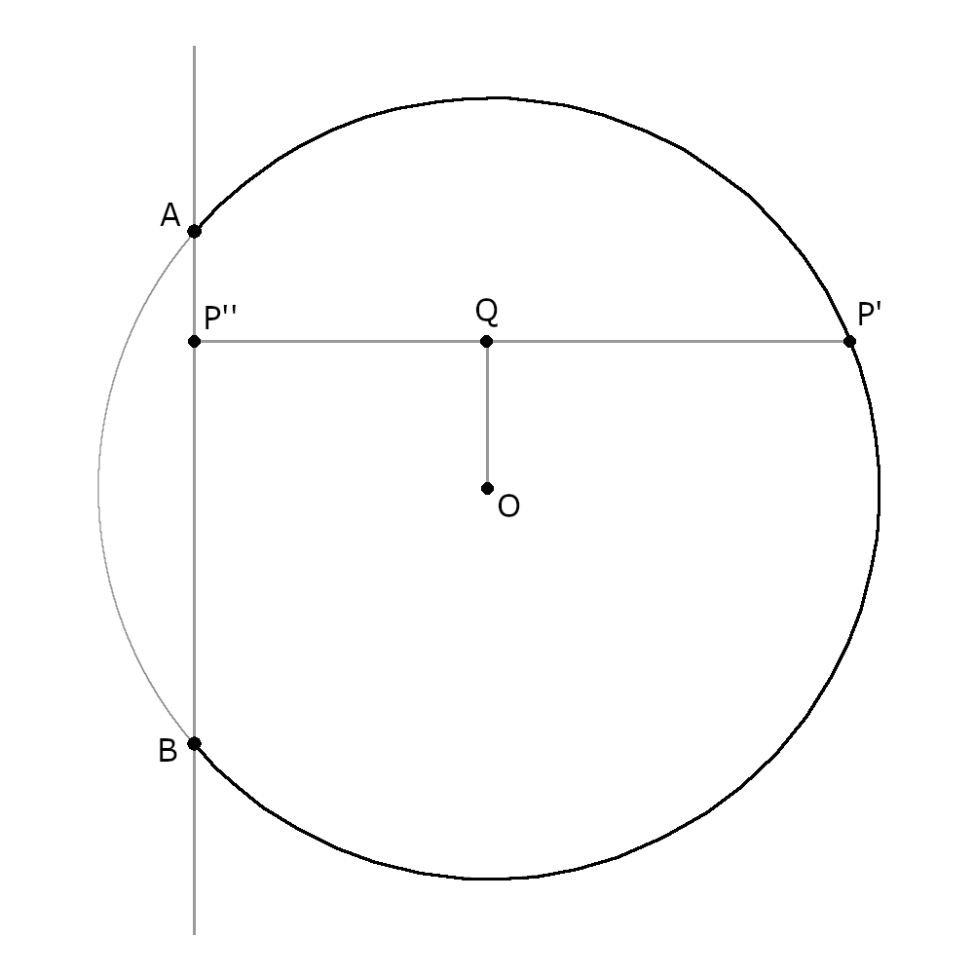
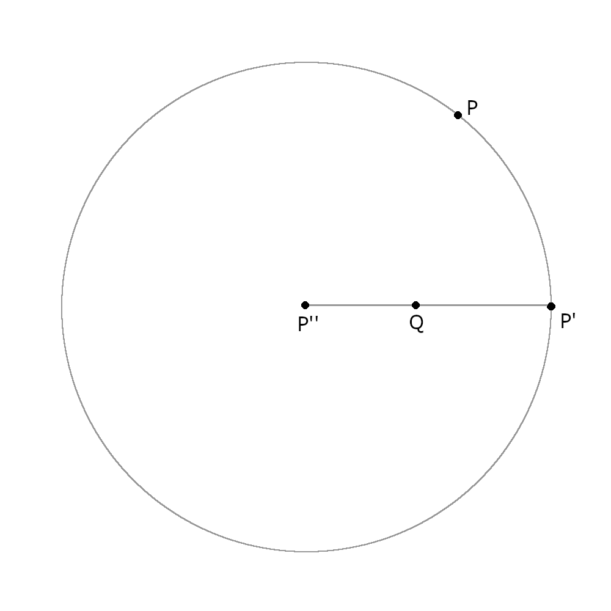
Toroids
Assume first that the longer arc is used to generate the toroid
Any point P on the toroid is gotten by rotating a point P’ on the arc
Consider the line through the circumcenter O that is also parallel to the sideline AB
Assume first that P’ is not on the side of this line that contains A and B
Let P’’ be the orthogonal projection P’ onto the sideline AB
Let Q be the orthogonal projection of O onto the line P’P’’
Looking at the “side view” on the right, it is clear that d(Q, P) ≥ d(Q, P’)
So d(O, P)² = d(O, Q)² + d(Q, P)² ≥ d(O, Q)² + d(Q, P’)² = d(O, P’)² = 1
So d(O, P) ≥ 1, and we see that the toroid never goes inside the unit sphere

Slide 34
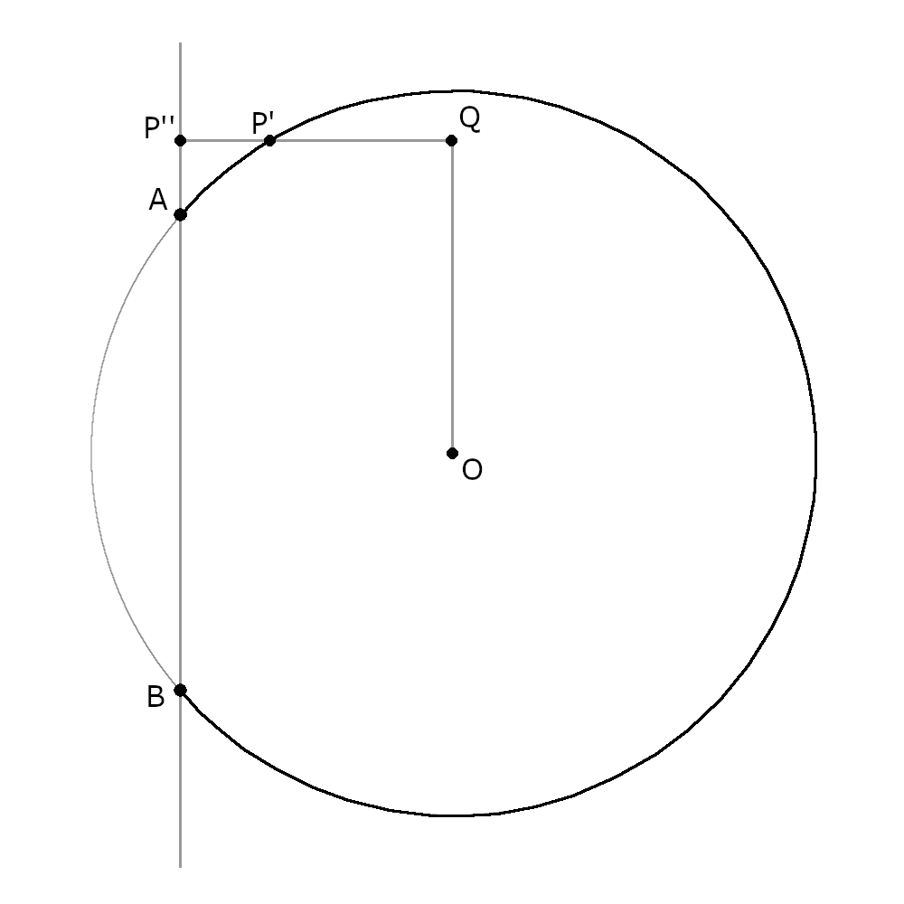
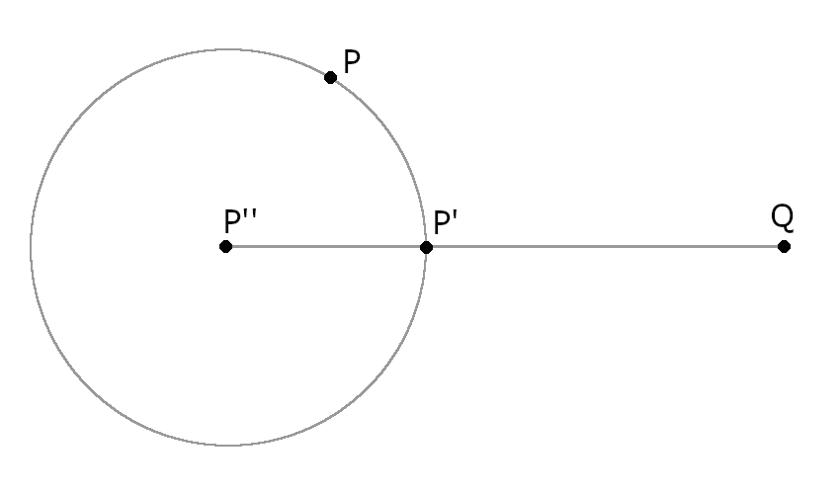
Toroids
Let us now alter the previous situation only by assuming that A, B and P’ are on the same side of the line through O that is parallel to the sideline AB
This alters the “side view” as seen in the following figure
Nevertheless, we still have d(Q, P) ≥ d(Q, P’)
We are the lead to the same conclusion as before, in exactly the same way `

Slide 35
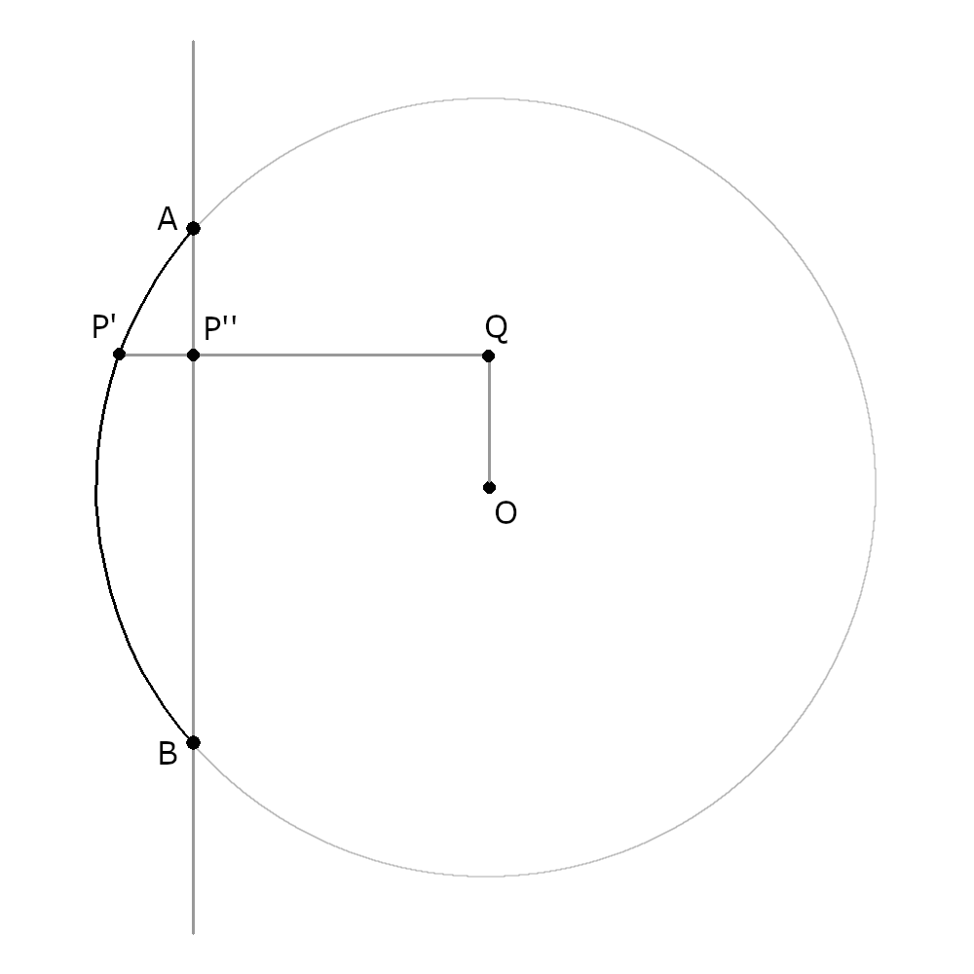
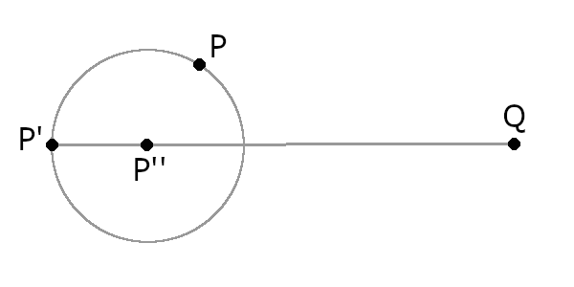
Toroids
Now, if we instead start over using the shorter arc instead of the longer arc, things completely change
The “side view” now reveals that d(Q, P) ≤ d(Q, P’)
We are then easily lead to conclude that d(O, P) ≤ 1
Thus we see that the toroid never goes outside the unit sphere

Slide 36
Toroids
Definitions (Categories of strict weakly related points)
α-strict weakly related points: same sign for c₁ , but not c₂ and c₃
β-strict weakly related points: same sign for c₂ , but not c₃ and c₁
γ-strict weakly related points: same sign for c₃ , but not c₁ and c₂

Slide 37
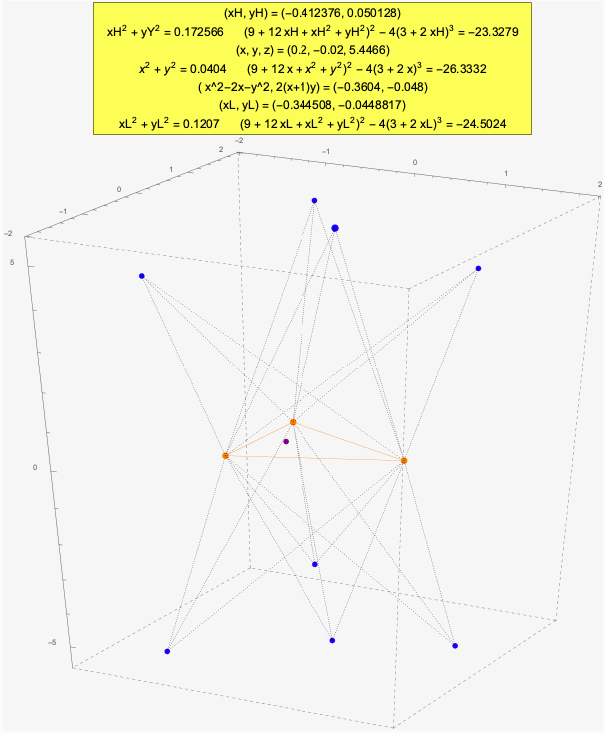
Toroids
(Wait for animation)
Here we see the three different types of strict weakly related points (relative to the camera’s pinhole), using three different colors (cyan, green and gray)
When passing through a control point, a strongly related point will switch to a strict weakly related point of the type associated with that control point, and vice versa
When a strict weakly related point passes through a control point, and has a type not associated with that control point, it switches to the other type not associated with that control point
For instance, passing through the control point on the left switches a moving point between blue (strongly related) and cyan (weakly related), and also between gray and green (both weakly related)

Slide 38
Toroids
Definitions (THE REST OF THIS SECTION IS UNDER DEVELOPMENT )
Cone_{A, β} : the tangent cone at A, with line AC as axis, and with viewing angle β
Ray_{A, β, γ} : one of the rays in the intersection of Cone_{A, β} and Cone_{A, γ}
Normal_{A, ΔABC} : the normal of the circumcircle of triangle ΔABC, at point A
Angle_{A, β, γ} : the included angle of Ray_{A, β, γ} with Normal_{A, ΔABC}

Slide 39
Toroids
The β and γ values of a moving point P, when moving into Toroid_{A} , are such that Angle_{A, β, γ} determines exactly how the related point passing through A changes
If Angle_{A, β, γ} < π/2, the related solution change from strongly related to strict weakly related
If Angle_{A, β, γ} > π/2, the related solution change from strict weakly related to strongly related

Slide 40
The Limiting Case of P3P
In general, given a camera pinhole position (x₀, y₀, z₀) in space, it is quite difficult to describe where its related points are located
However, when we consider the limiting case for which |z₀| becomes large without bound, but x₀ and y₀ stay bounded, the situation can be very eligently described

Slide 41
The Limiting Case of P3P
As the camera pinhole’s z-coordinate goes to infinity, its weakly related points in the upper half-space are strongly related, and have z-coordinates that also go to infinity
The projections, in the limit as |z₀| goes to infinity, of all these points onto the xy-plane are at the intersections of the following two rectangular hyperbolas:
y² – (x-1)² = y₀² – (x₀-1)² and 2(x+1)y = 2(x₀+1)y₀

Slide 42
The Limiting Case of P3P
Generally speaking, these two hyperbolas intersect in either two or four points
Whether there are two or four intersection points depends on the sign of the following quantity: (9 + 12 x₀ + x₀² + y₀²)² – 4(3+2x₀)³
The curve given by the equation (9 + 12 x + x² + y²)² = 4(3+2x)³ is well-known, and is called the (standard) deltoid curve

Slide 43
The Limiting Case of P3P
When the two rectangular hyperbolas intersect in two points, these are outside the deltoid curve
When the two rectangular hyperbolas intersect in four points, these are inside the deltoid curve, and one is inside the unit circle
These four points form an orthocentric system, meaning that the line through any two of the four points is perpendicular to the line through the other two points

Slide 44
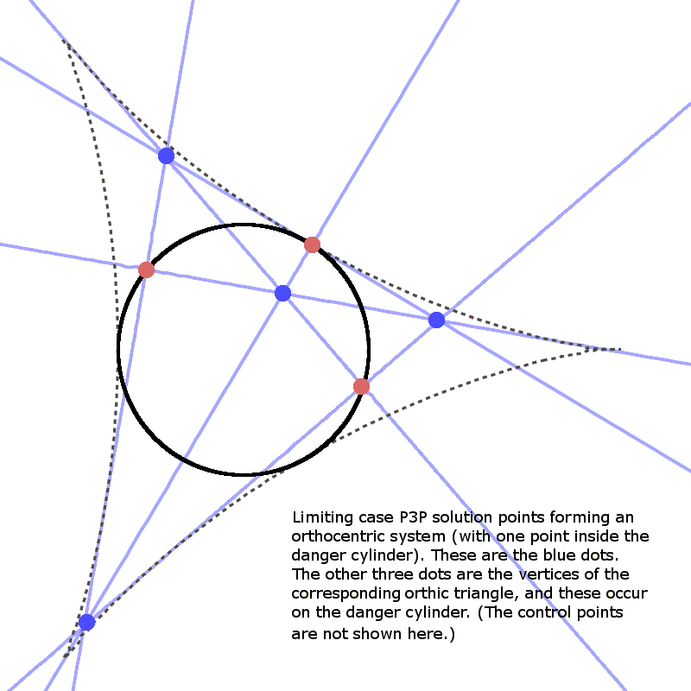
The Limiting Case of P3P
Here the camera is vertically very far away from the control points, but not horizonally far away
Since the camera’s pinhole is inside the deltoid curve, so are all of its (strongly) related points (blue dots)
They form an orthocentric system
One blue dot is inside the unit circle
(Ignore the reddish dots)

Slide 45
The Danger Cylinder and its Companion Surface
We will henceforth regard the control points as the vertices of a triangle, and make routine mention of its circumcircle, orthocenter, interior angles, and so forth
It has long been recognized that the circular cylinder obtained by extending the circumcircle perpendicular to the plane containing the control points, plays a special role in the P3P problem, and it was long ago named the danger cylinder (DC)
If the camera’s pinhole is infinitesimally close to a point on the danger cylinder, then
one of its strongly related points will be infinitesimally nearby
The DC is where related points come together and
then disappear (due to complex solutions)

Slide 46
The Danger Cylinder and its Companion Surface
We can say that if Grunert’s system (with given parameters) has a solution point on the danger cylinder, then this is actually a repeated solution point, and all repeated solution points are thus
Whether or not Grunert’s system has a repeated solution point (on the danger cylinder) is determined by whether or not
(9 + 12 x_{L} + x_{L}² + y_{L}²)² = 4 (3+2x_{L})³
where

Slide 47
The Danger Cylinder and its Companion Surface
x_{L} = [ -3 + 2(x₁²+x₂²+x₃²) + (1-2x₁-2x₁²) c₁² + (1-2x₂-2x₂²) c₂² + (1-2x₃-2x₃²) c₃²
+ 2 (x₁+x₂+x₃) c₁c₂c₃ ] / [ 1 - c₁² - c₂² - c₃² + 2c₁c₂c₃ ]
and
y_{L} = [ 2(x₁y₁+ x₂y₂+ x₃y₃) + 2(1-x₁)y₁ c₁² + 2(1-x₂)y₂ c₂² + 2(1-x₃)y₃ c₃²
- 2 (y₁+y₂+y₃) c₁c₂c₃ ] / [ 1 - c₁² - c₂² - c₃² + 2c₁c₂c₃ ]
(c₁, c₂, c₃, x₁, x₂, x₃, y₁, y₂, y₃ are all presumed to be known)

Slide 48
The Danger Cylinder and its Companion Surface
To discover which points in space are solutions to Grunert’s system, when this system has a repeated solution, one can express c₁ , c₂ , c₃ , x_{L} and y_{L} in terms of x, y and z, and then rely on algebraic manipulation software
It turns out that all such points lie either on the danger cylinder or else on a surface that we call the companion surface to the danger cylinder (CSDC) (though it has also been previously called the “deltoidal surface” by one of us)
The above equation could reasonably be called the discriminant of Grunert’s
system of equations since its vanishing is necessary and
sufficient for having a repeated solution

Slide 49
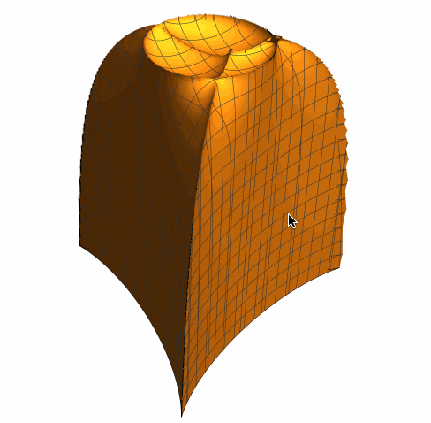
The Danger Cylinder and its Companion Surface
(Wait for animation)
Half of the CSDC, in the case where the triangle ΔABC is acute, and so its orthocenter is inside its circumcircle
The other half is the reflection of this about the xy-plane
The vertices (A, B, C) can be seen here, as can the circumcircle, and inside this, the orthocenter H
(Ignore the gap near a vertex, which is a rendering issue)

Slide 50
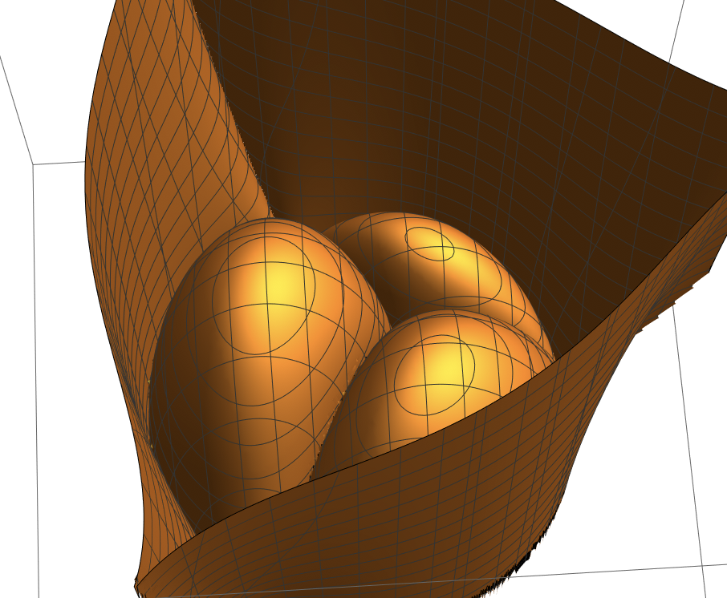
The Danger Cylinder and its Companion Surface
The three mounds inside the CSDC
When both halves of the CSDC are put together, there is a 3D region between a mound and its reflection about the xy-plane, which we call a chamber

Slide 51
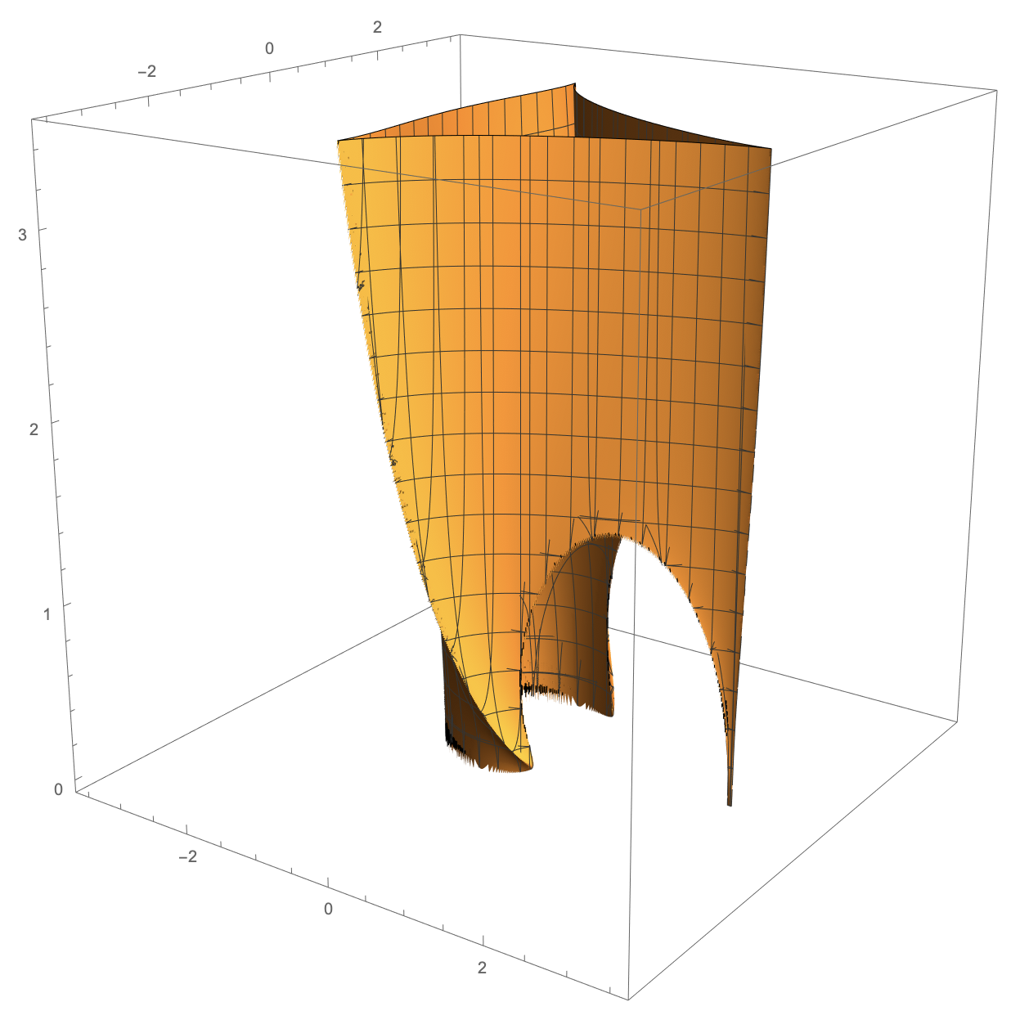
The Danger Cylinder and its Companion Surface
When the triangle ΔABC is obtuse, and so its orthocenter is outside the circumcircle, the CSDC looks quite different!
This case is harder to analyze, and has been largely ignored by us

Slide 52
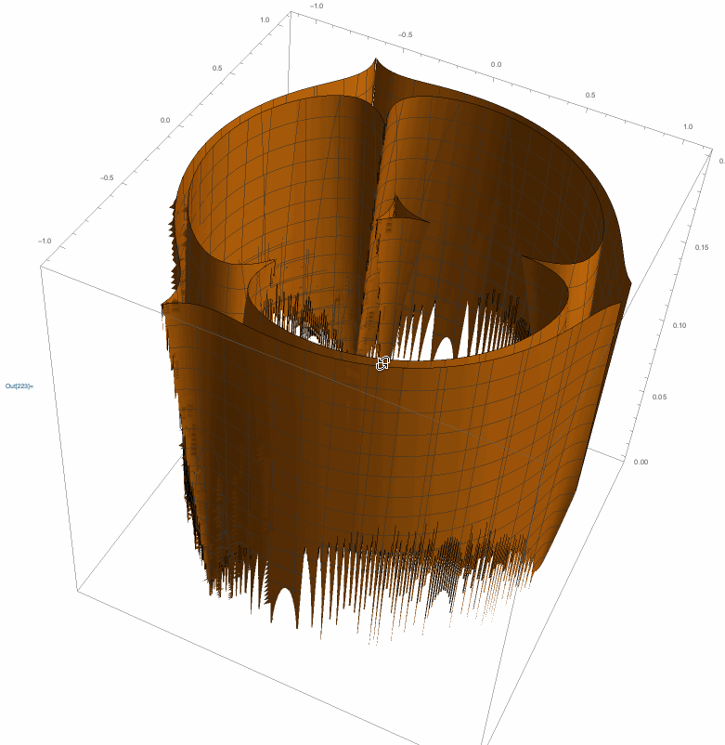
The Danger Cylinder and its Companion Surface
(Wait for animation)
Here is what the CSDC looks like close to the xy-plane (the plane containing A, B and C), in the case where the triangle ΔABC is equilateral
(Ignore the terrible rendering issue very close to the xy-plane)

Slide 53
The Danger Cylinder and its Companion Surface
While the equation for the CSDC, in its “raw form,” is very complicated, it can be rather nicely expresses as a twelfth degree equation in x, y and z with fairly simple coefficients expressed in terms of the coordinates (x_{H}, y_{H}) of the orthocenter H of the control points triangle ΔABC
By the way, it turns out that x_{H} = x₁ + x₂ + x₃ and y_{H} = y₁ + y₂ + y₃

Slide 54
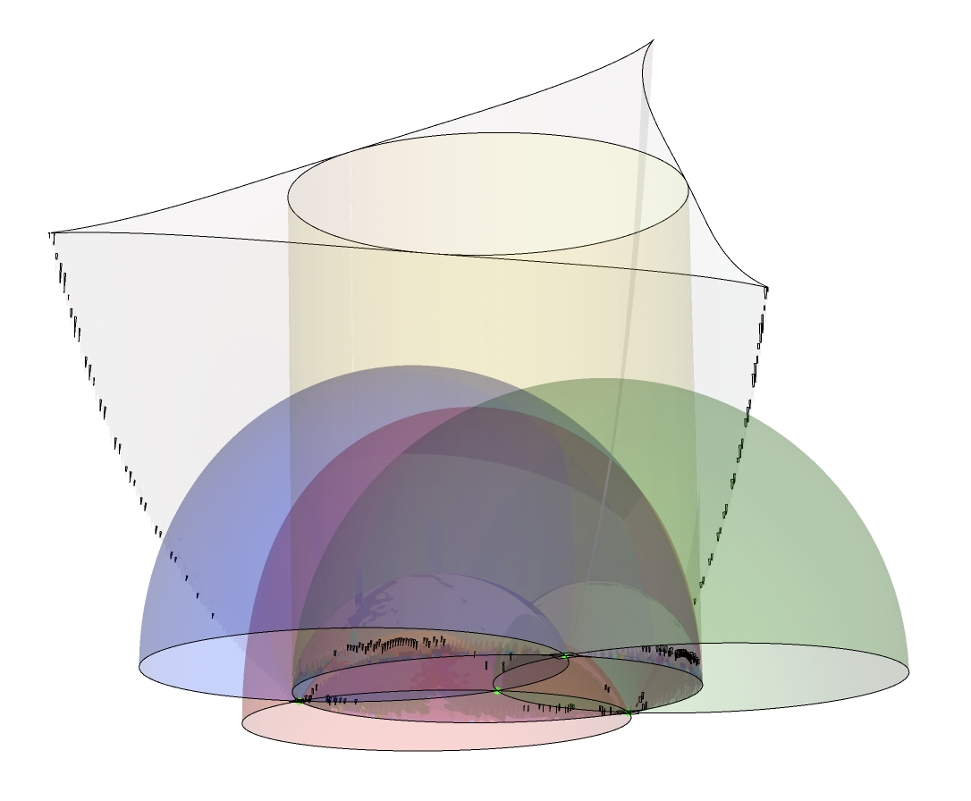
Intersecting Surfaces
Here is an image, for the equilateral triangle case, that shows five surfaces of importance to the P3P problem: the DC, the CSDC, DToroid_{A} , DToroid_{B} and DToroid_{C}
This figure only shows the upper half-space (z ≥ 0)
Also, we are interested in more general acute triangles, going forward

Slide 55
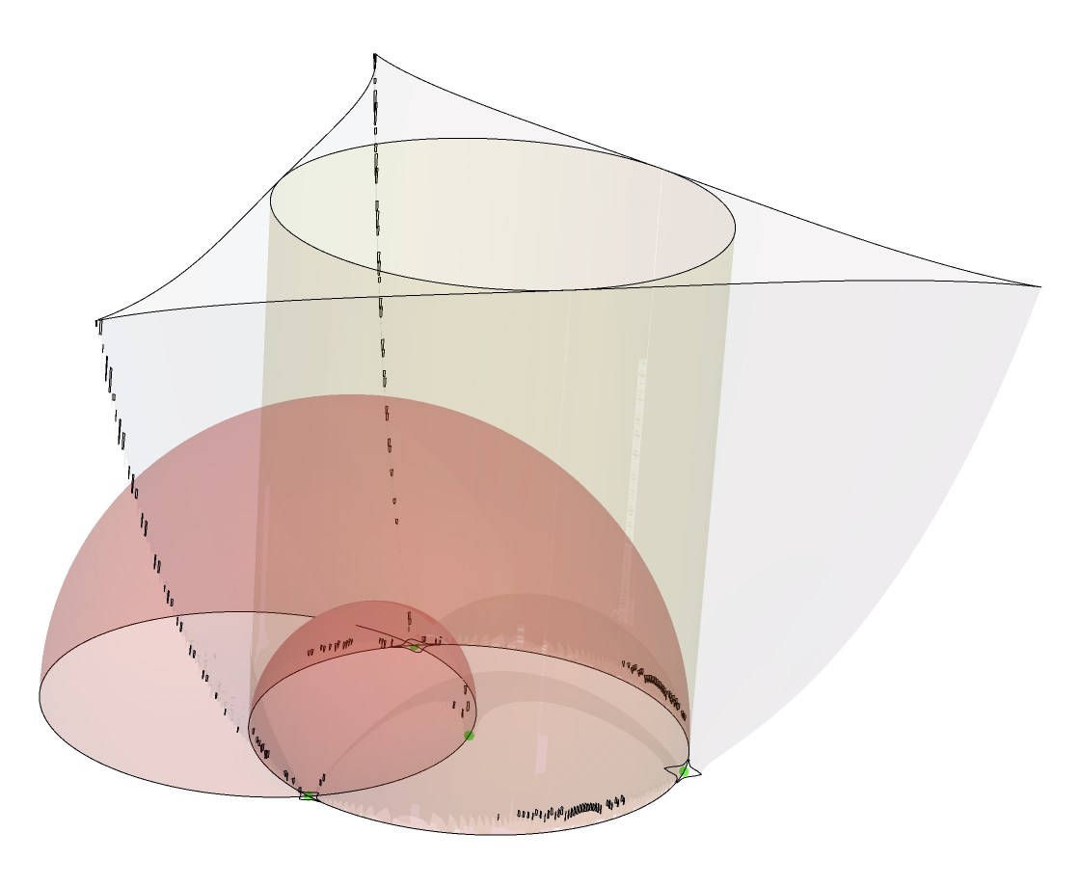
Intersecting Surfaces
Here is an image showing one of the double toroid, the DC and the CSDC
It is barely possible to see the mounds that are part of the CSDC

Slide 56
The Danger Cylinder and its Companion Surface
In an effort to answer questions about strongly and weakly related points, it is desirable to understand how the various surfaces involved are interconnected
Some things are pretty easy, like the fact that the danger cylinder is basically inside the CSDC, and these intersect along three vertical lines that are equidistant from each other

Slide 57
The Danger Cylinder and its Companion Surface
Next, we will consider the intersection of the various double toroids that arise in P3P, namely, DToroid_{α}(P), DToroid_{β}(P) and DToroid_{γ}(P)
The way that two of our inner toroids (which are similar to American footballs) intersect each other is easily described based on how their tangent cones intersect
Other toroid intersections are a bit more complicated
Here are three examples of intersecting double toroids:

Slide 58
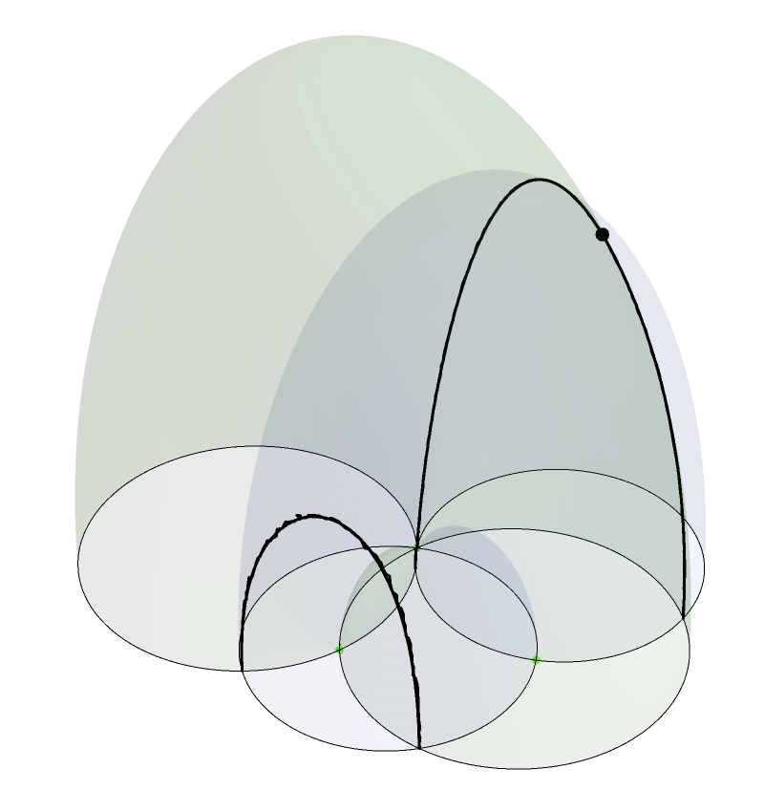
Intersecting Surfaces
The intersection of two of the double toroids, for some camera’s pinhole position
Only the two outer toroids are involved in this example
(Again, only the upper half-space is shown here)

Slide 59
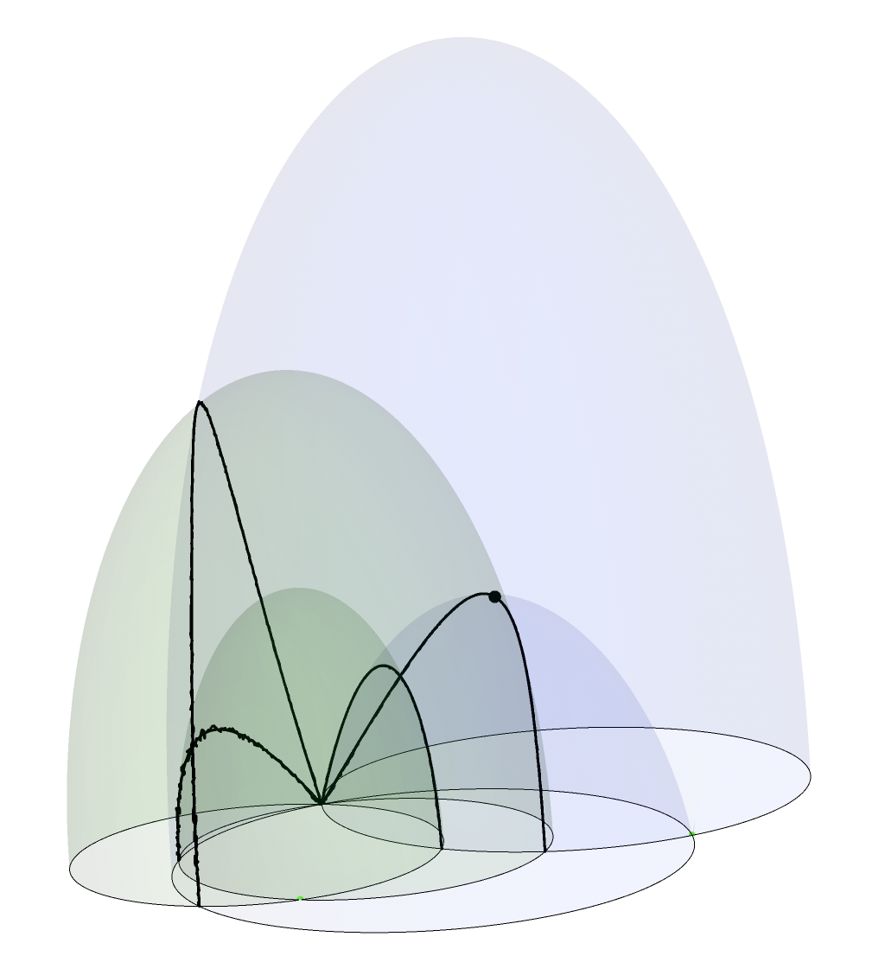
Intersecting Surfaces
A more complicated intersection of two double toroids
Here the inner toroids get involved
Each of the two toroids that make up the green double toroid intersects each of the two toroids that make up the blue double toroid, in a closed curve

Slide 60
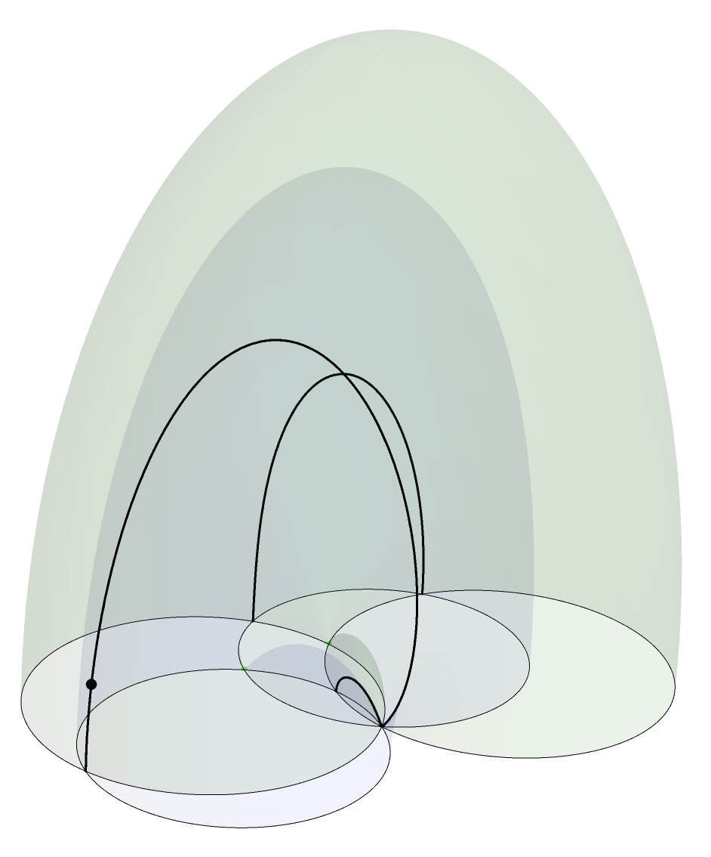
Intersecting Surfaces
Another example of intersecting double toroids
This one is similar to the first example, except that now the two inner toroids intersect in a (small) closed curve

Slide 61
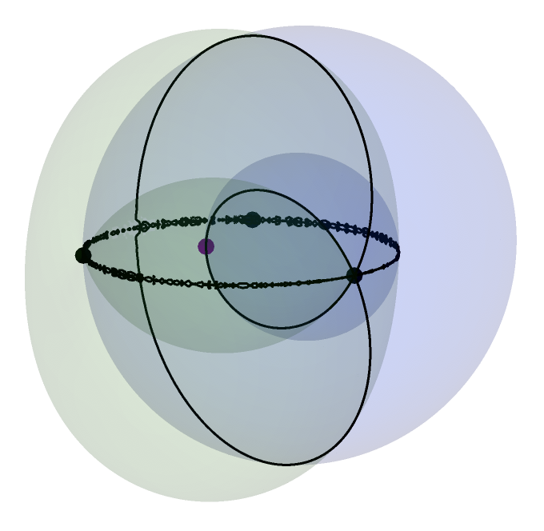
Intersecting Surfaces
Here we see the intersection of two of the three special double toroids, DToroid_{A}, DToroid_{B}, and DToroid_{C}, for an acute triangle
Ignoring the circumcircle (poorly rendered here), the special double toroids seem to always intersect in this simple “double loop” way, at least for acute triangles
All three of the special toroids intersect at the orthocenter (purple dot)

Slide 62
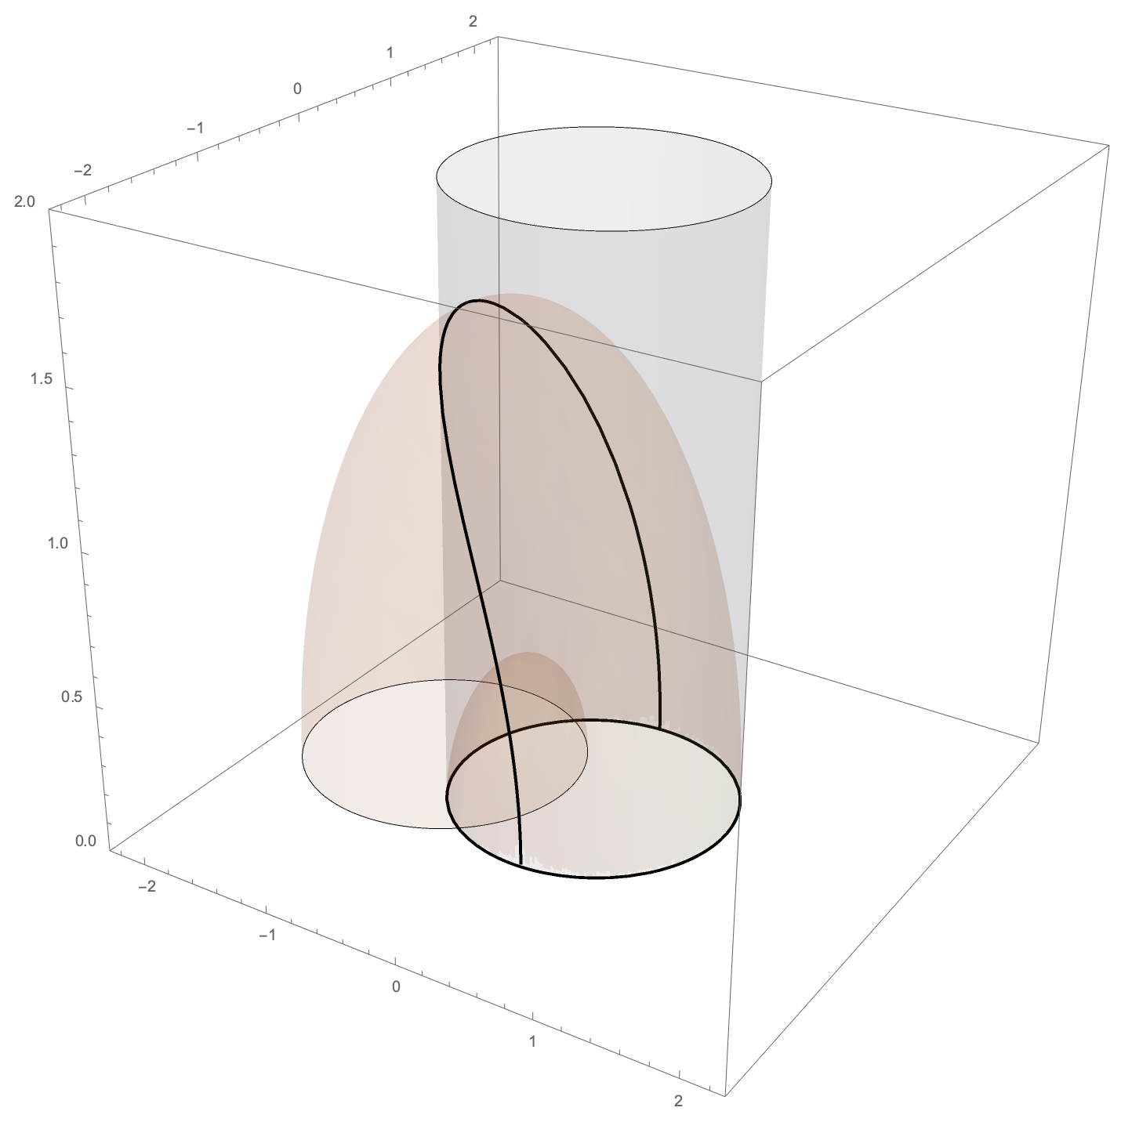
Intersecting Surfaces
The way in which the danger cylinder intersects one of our special double toroids is rather simple
Here is the danger cylinder together with the double toroid DToroid_{C} (obtained by rotating the triangle ΔABC’s circumcircle about its sideline AB)
The intersection of these two surfaces is the circumcircle and a curve that wraps around the outer toroid, and which is rational as a curve in xyZ-space (Z = z²)
(Only upper half-space shown)

Slide 63
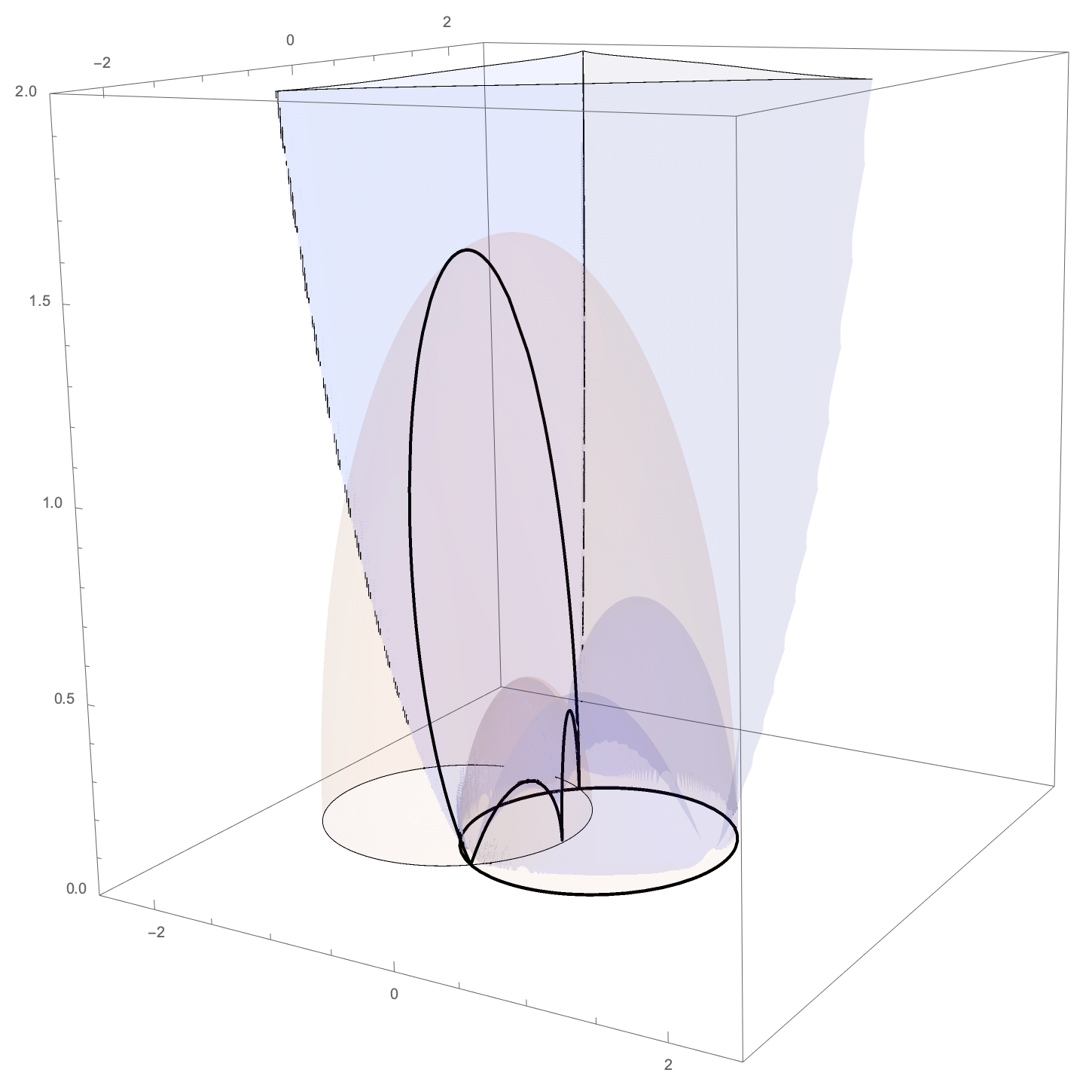
Intersecting Surfaces
The intersection of DToroid_{C} and CSDC is considerably more complicated than the intersection of DToroid_{C} and DC
However, it too involved the unit circle, plus another close curve that is rational as a curve in xyZ-space
(Only upper half-space shown)

Slide 64
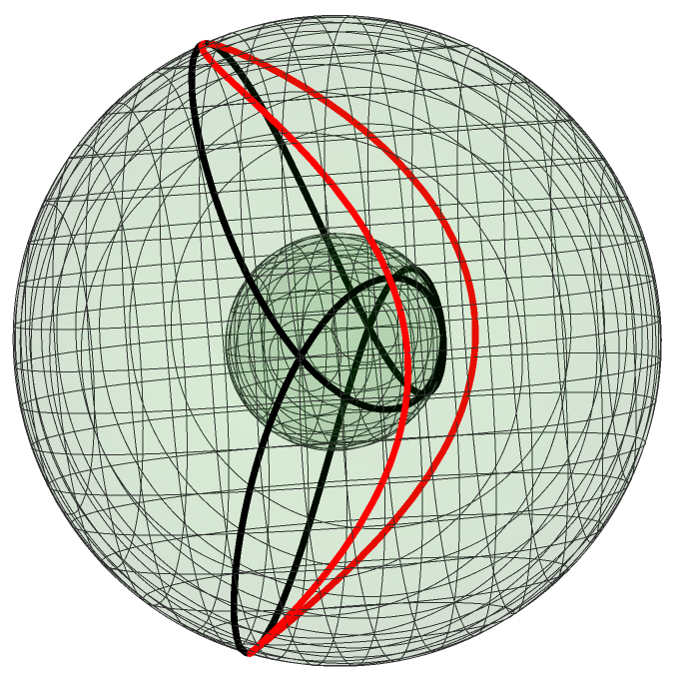
Intersecting Surfaces
For the equilateral triangle case, here is
DToroid_{C} , its intersection with the
danger cylinder (red curve), and its
intersection with the CSDC (black curve)

Slide 65
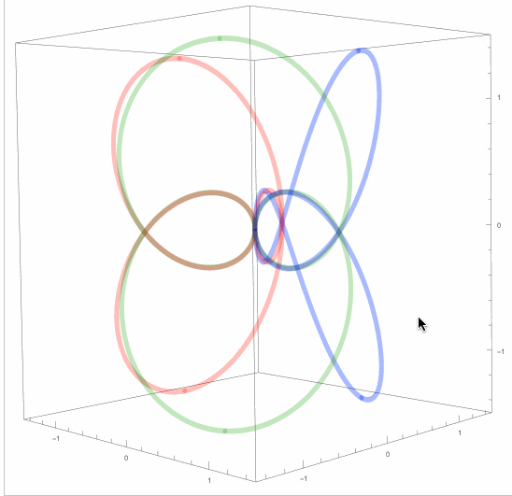
Intersecting Surfaces
CSDC ∩ (DToroid_{A} ∪ DToroid_{B} ∪ DToroid_{C} ) in the equilateral triangle case
(Wait for animation)
The curves CSDC ∩ DToroid_{X} and CSDC ∩ DToroid_{Y} get very near each other inside the unit sphere, for each pair {X, Y} ⊂ {A, B, C}
It seems hopelessly messy inside the unit sphere, even for the equilateral triangle case!
This phenomenon will be seen again later in connection with a certain vector field

Slide 66
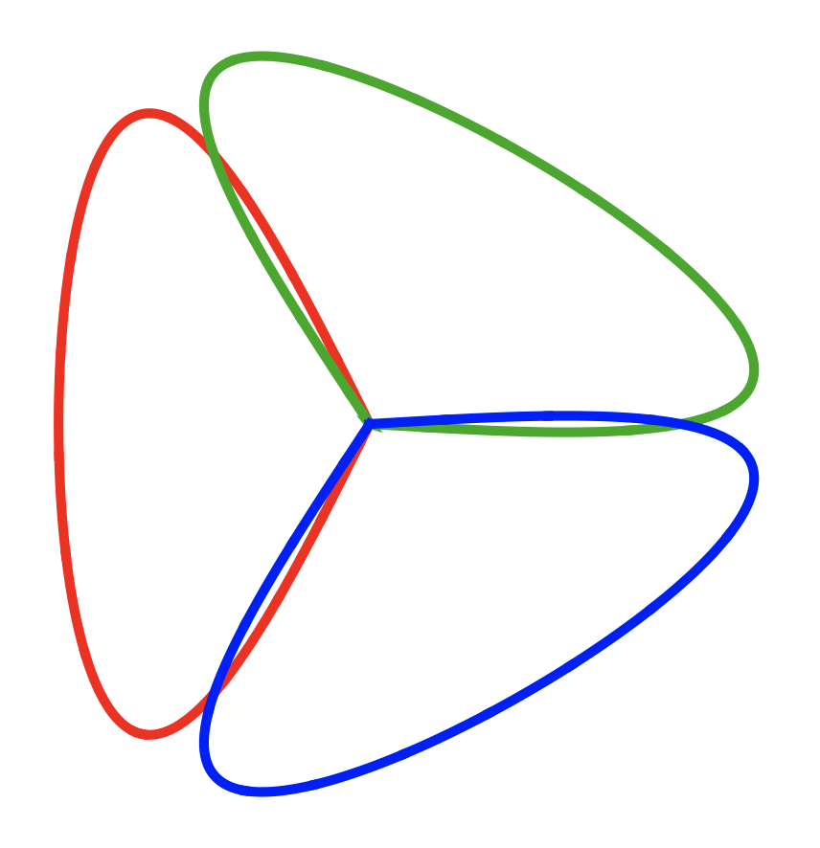
Intersecting Surfaces
The top-down view of the space curves on the previous slide is remarkably simple, as seen in the image on the left
One of the space curves (CSDC ∩ DToroid_{X}) has this parameterization:
( x , ±2x √(1-x²) , ±(1+2x) √(x²-x) )
where the ±’s are independents
The other two are just rotations of it

Slide 67
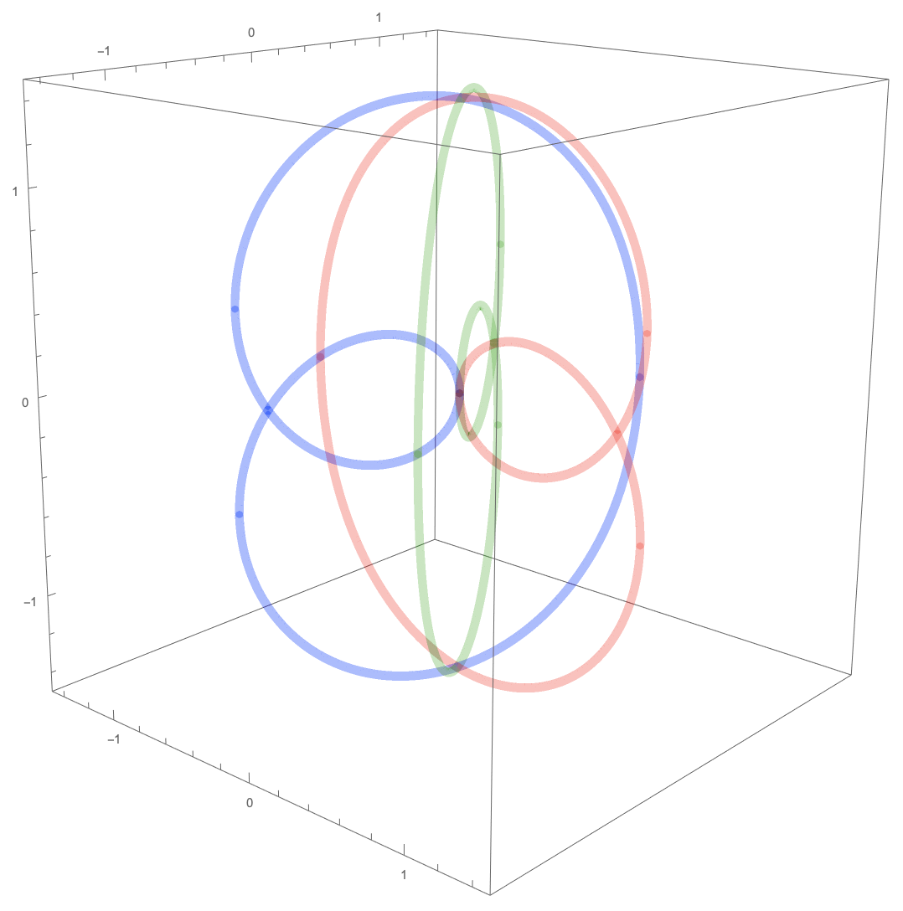
Intersecting Surfaces
Pairwise intersections of DToroid_{A} , DToroid_{B} and DToroid_{C} , in the equilateral triangle case
These intersection are easily understood and visualized, even inside the unit sphere
One of these intersection curves has this parameterization:
( x, 0, ± √[ (2 + x - 2x² ± √(4-3x²)) / 2 ] )
where the ±’s are independent
The other two are just rotations of it

Slide 68
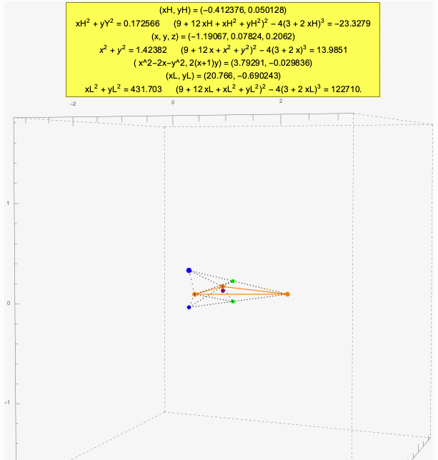
Intersecting Surfaces
Moving the camera’s pinhole around fairly close to the control points
(Wait for animation)
Due largely to all the significant and intersecting surfaces that are fairly close to the control points, when the camera moves around in this region, things get a bit crazy!

Slide 69
Applying Basic Algebraic Geometry
Algebraic geometry is primarily focused on studying systems of polynomial equations in several variables, and the sets of points in space that satisfy such systems
We will here oversimplify this very important area of mathematics
The set of points is called a variety, but we may also refer to it as a “space"
A variety has an associated dimension

Slide 70
Applying Basic Algebraic Geometry
As an example, for fixed parameters d₁, d₂, d₂, c₁, c₂, c₃, consider Grunert’s system of equations in the variables (unknowns) r₁, r₂ and r₃
The solutions are a finite number of isolated points in the 3D-space of all possible triples (r₁, r_{2,} r₃), and so this variety has dimension zero

Slide 71
Applying Basic Algebraic Geometry
As another example, consider all of the points in xyz-space for which (9 + 12 x_{L} + x_{L}² + y_{L}²)² = 4 (3 + 2 x_{L})³ , where x_{L} and y_{L} are given by certain rational functions of x, y and z (as suggested earlier)
After “clearing out denominators,” this yields a single polynomial equation in x, y and z
The variety for this is CS ⋃ CSDC, i.e. the union of the danger cylinder and the CSDC, which is a surface, and so its dimension is two

Slide 72
Applying Basic Algebraic Geometry
Our double toroids are also examples of varieties of dimension two
Varieties often have non-smooth points called singularities
Each double toroid has two such singularities
Blowing up points is one standard way to tame singularities in algebraic geometry
(This is a photography metaphor, not a demolition metaphor)

Slide 73
Applying Basic Algebraic Geometry
The idea is that a (singular) point gets “magically” replaced with some higher dimension variety
For instance, the standard way to blowup the point A in xyz-space is to consider the set of all ordered pairs (p, l ), where p is a point in xyz-space (3D real space), and l is a line through p and A

Slide 74
Applying Basic Algebraic Geometry
This set of ordered pairs can naturally be given the structure of a variety (space)
Each point p other than A corresponds to a unique pair (p, l )
But there are infinitely many pairs of the form (A, l ) because every line l through A is allowed here
In the new variety, A has been replaced with infinitely many new “points”
We have blown up A!

Slide 75
Applying Basic Algebraic Geometry
Blowing up A can also be visualized this way:
From xyz-space, remove a tiny open ball centered at A, leaving a spherical boundary
Take a copy of real projective 3D space (more about it in a moment) and remove a corresponding open ball from it, leaving a spherical boundary
Glue the two spherical boundaries together to form a 3D space without a boundary
This is homeomorphic (topologically equivalent) to the 3D space obtained by blowing up A via the preceding procedure

Slide 76
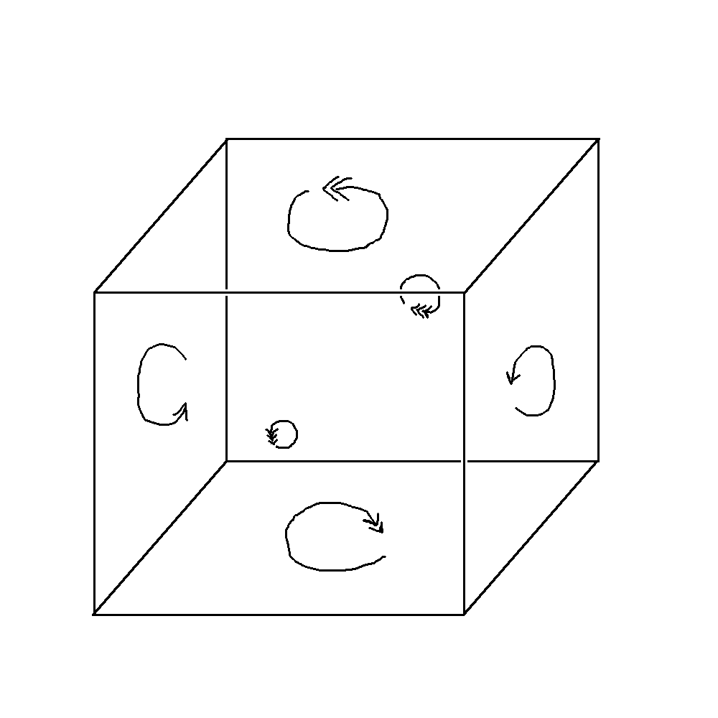
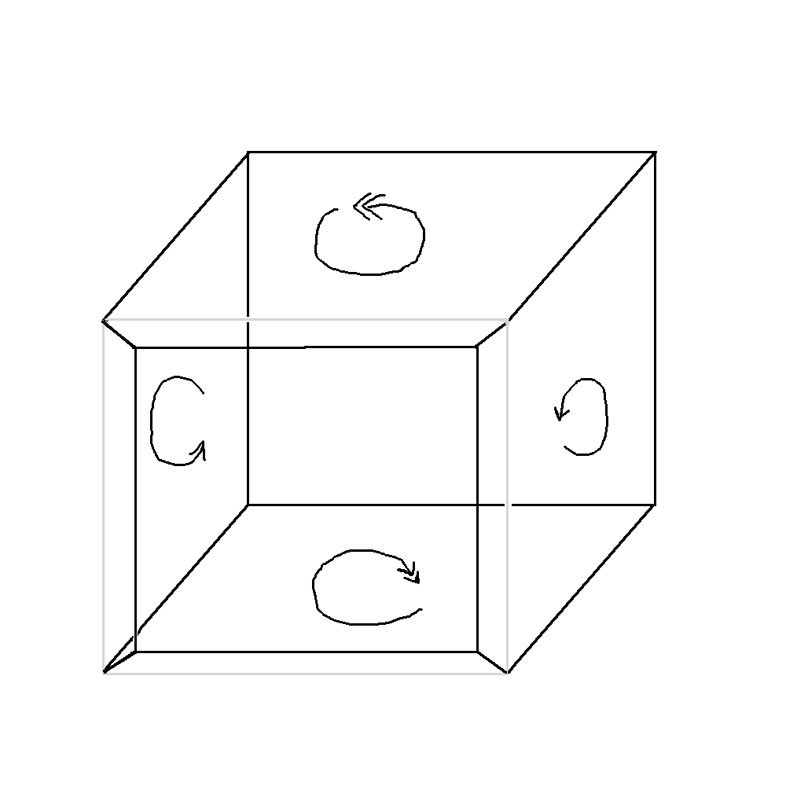
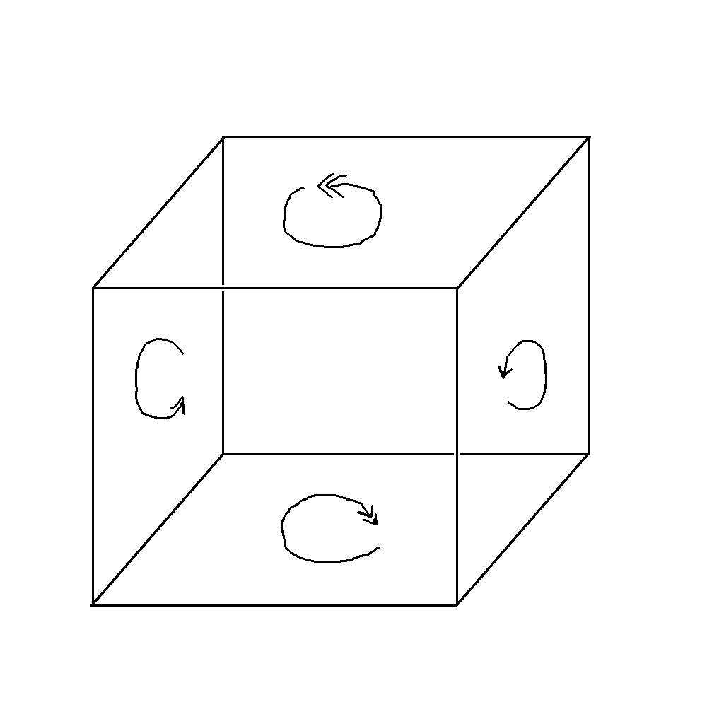
Applying Basic Algebraic Geometry
Projective 3D space can be viewed (topologically) as a solid cube but with points on opposite faces identified in a 180◦-rotated manner (this is equivalent to a solid sphere with antipodal points on its spherical boundary identified)
Instead of removing an open ball, we can remove an open solid trapezoidal prism, one that shares the front face of the original solid cube
The result can be deformed to a solid cube, with pairs of points identified as before, except for the front and back faces, which are glued together along edges (rotated) to form a surface that is topologically a sphere

Slide 77
Applying Basic Algebraic Geometry
The space just obtained by essentially removing an open ball from real projective 3D space can be further deformed to produce a finite solid cylinder but with the points on the cylindrical part of its surface identified (in pairs) in a “flipped” manner
The two disc parts of the surface are glued together along their circular boundaries, but in a rotated manner, to form a sphere, which is the boundary of this space
The above 3D space is somehow a 3D analogue of a mobius strip, and its spherical boundary can be glued to the spherical boundary of xyz-space with an open ball
around A removed

Slide 78
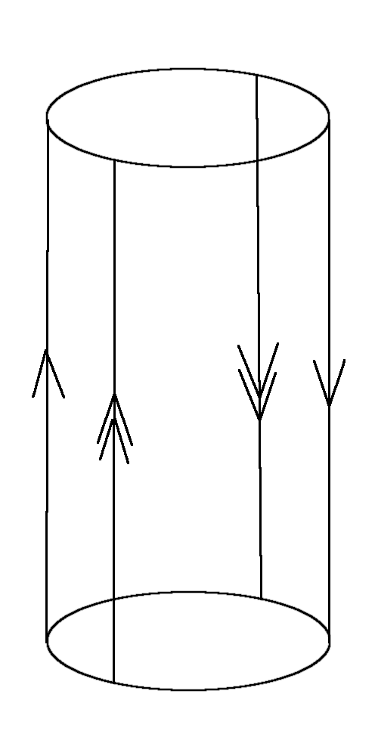
Applying Basic Algebraic Geometry
Here is a picture of the model of 3D projective space with an open ball removed, as described in the preceding slide
Each vertical line segment along the cylindrical part of this is identified with the line segment on the opposite side, but flipped
The top and bottom discs thus get glued together, but rotated
Topologically, they form a sphere

Slide 79
Applying Basic Algebraic Geometry
For the purpose of better studying P3P, we will need to blow up all three control points, A, B and C
This amounts to a straightforward embellishment of what we did earlier
Instead of all possible (p, l ), use the set of all possible (p, l _{A}, l _{B}, l _{C}), where l _{A} is a line through p and A, l _{B} is a line through p and B, and l _{C} is a line through p and C
In this manner, each of A, B and C gets replaced with infinitely
many new “points”

Slide 80
Applying Basic Algebraic Geometry
Let Blowup denote our new space (variety) of all suitable quadruples (p, l _{A}, l _{B}, l _{C}) , and refer to the quadruples as its “points”
Each point of the form (A, l _{A}, l _{B}, l _{C}) is only distinguished by l _{A} , which we visualize as specifying a tangent line when we travel through the point A in xyz-space
These points constitute a subvariety of Blowup that we will denote Blowup_{A}
Similarly for Blowup_{B} and Blowup_{C}

Slide 81
Applying Basic Algebraic Geometry
Next, for any variety V in xyz-space, such as one of our double toroids, we can obtain a corresponding variety in Blowup, as follow:
1. Each point of V, other than A, B and C (if part of V), corresponds to a unique
point in Blowup
2. Take all of these points in Blowup, and extend this set by including any of its
limit points (topological closure)
This will be a subvariety of Blowup, and any limit points that might get “tossed in” will come from the union of Blowup_{A} , Blowup_{B} and Blowup_{C}

Slide 82
Applying Basic Algebraic Geometry
When this technique is applied to one of our double toroids, the resulting subvariety of Blowup is a torus, which of course is non-singular everywhere
As seen in earlier animations, the surface CSDC has one-dimensional singularites (like the creases along its sides), and these are not “resolved” by simply switching to the corresponding surface in Blowup
Yet, it is useful to look at this surface in Blowup, and in particular, the Blowup_{A} , Blowup_{B}
and Blowup_{C} parts
Here is what it looks like at one of these:

Slide 83
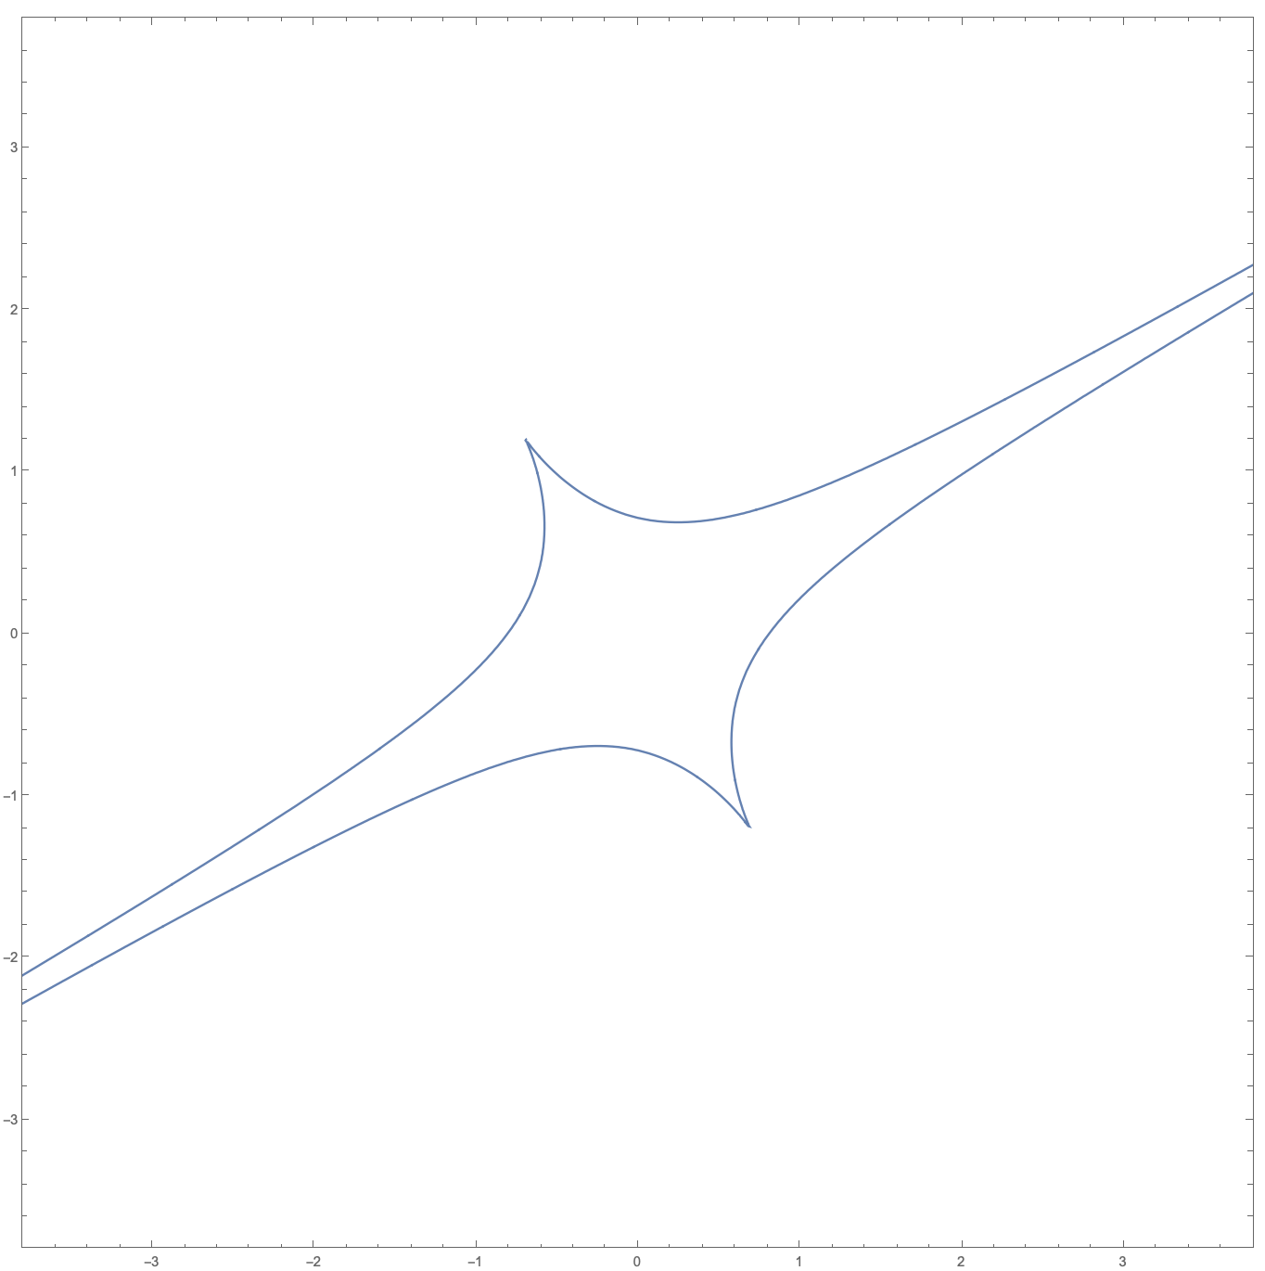
Applying Basic Algebraic Geometry
The intersection of Blowup_{C} and “CSDC” in Blowup
Blowup_{C} can be thought of as a space whose points correspond to the lines (in 3D space) through C
Blowup_{C} is therefore a real projective plane, a variety that can also be visualized as an ordinary (affine) plane with a projective line of extra points added “at infinity”

Slide 84
Applying Basic Algebraic Geometry
Here is one reason for using the variety Blowup in connection with P3P: The quantities c₁², c₂² , c₃² and c₁c₂c₃ all extend naturally to all of the points of Blowup
Moreover, there is a map from Blowup onto the variety V of all points (q, r, s, t) for which q² = rst that sets q = c₁c₂c₃ , r = c₁², s = c₂² and t = c₃²
Points of Blowup are weakly related if and only if they have the same image under this map from Blowup to V, so we may regard “weakly related” as an algebraic geometric
concept

Slide 85
Applying Basic Algebraic Geometry
Maienschein and Rieck, working on the 2D version of the P3P Problem, and related issues, discovered that by blowing up A, B and C, in the plane, and then contracting the circumcircle to a point, while also adding one point at infinity, one obtains a (real) torus
This was realized via a birational map, and proves a theorem of W. von Dyck
For this, Maienschein analyzed the situation in terms of directed angles, modulo π
It has been an ongoing frustration that this work has not easily extended to 3D P3P, but
let us now attempt such an extension anyway

Slide 86
Applying Basic Algebraic Geometry
Back to the 3D P3P Problem now
Because c₁², c₂² , c₃² and c₁c₂c₃ are constant on the circumcircle, one is inclined to wonder what happens to Blowup if the circumcircle is again contracted to a point
Perhaps the resulting space might turn out to have a nicer description that can be more easily visualized
That is basically all there is to say for now concerning “weakly related”

Slide 87
What about “strongly related?”
Unfortunately, c₁ and c₂ are not defined on Blowup_{C} , and so forth, and this is basically why on Blowup, we have continuity of “weakly related,” but not “strongly related”
One way to “correct” for this is a bit messy, and amounts to replacing the lines l _{A} , l _{B} and l _{C} in (P, l _{A}, l _{B}, l _{C}) with directed lines, defining α, β and γ to be the angles between pairs of these directed lines, and letting c₁, c₂ and c₃ be the corresponding cosines
This means each ordinary point P in xyz-space gets replaced by eight points in the
new space of such quadruples (P, l _{A}, l _{B}, l _{C}) -- Ouch!
Applying Basic Algebraic Geometry

Slide 88
We say that the variety Blowup* thus constructed is an 8-fold cover of Blowup
We can imagine obtaining this space from eight copies of xyz-space, by extracting tiny open balls around A, B and C, from each copy, and gluing these together appropriately along the spherical boundaries of the balls
The 8-fold cover can easily be reduced to a 4-fold cover by identifying each point (P, l _{A}, l _{B}, l _{C}) with the point (P, -l _{A}, -l _{B}, -l _{C}), where l _{A} and -l _{A} are oppositely oriented directed lines based on the same undirected line, and so forth
Applying Basic Algebraic Geometry

Slide 89
Denoting this 4-fold cover by Blowup#, we have a variety on which the quantities c₁, c₂ and c₃ can be naturally defined (the same may be said of Blowup*)
These quantities vary continuously as a point moves continuously around in Blowup#
There is a natural projection of the points in Blowup# to the points in Blowup
However, a continuous open path in Blowup# may project onto a closed path in Blowup, thus showing that Blowup# is a non-trivial cover of Blowup, in the sense of homotopy
Applying Basic Algebraic Geometry

Slide 90
Applying Basic Algebraic Geometry
By analogy with classical planar geometry, we regard that each point of Blowup* has three angular coordinates (α, β, γ), where again, α is the angle between the directed lines l _{B} and l _{C} , and so forth (0 ≤ α ≤ π, 0 ≤ β ≤ π and 0 ≤ γ ≤ π)
We continue to take c₁ = cos α , c₂ = cos β and c₃ = cos γ
Near a general point, (α, β, γ) and (c₁, c₂, c₃) serve as local coordinate systems
We may similar discuss these things for the points of Blowup#

Slide 91
Applying Basic Algebraic Geometry
It can be shown that Blowup# contains four copies of the circumcircle on which the angular coordinates are constant
By analogy with the 2D work, it would seem to make sense to collapse each of these circles to a single point (via a “blowdown,” the opposite of a blowup)
This yields four special points, and we will denote the resulting space by Blowup†, and observe that (α, β, γ) and (c₁, c₂, c₃) are naturally defined here as well

Slide 92
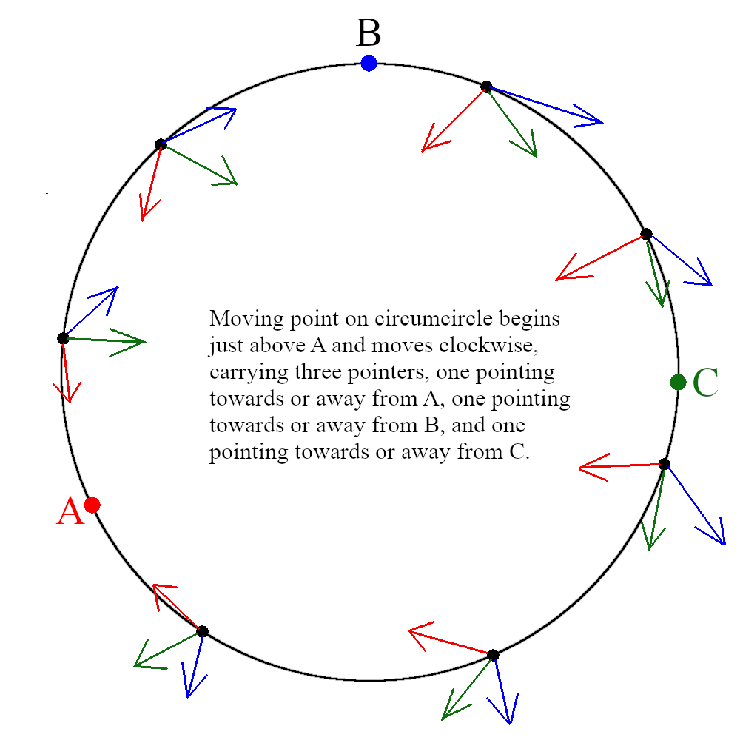
Applying Basic Algebraic Geometry
Representing a lift of the circumcircle to Blowup* or Blowup#
When working in Blowup*, a lift of a moving point on the circumcircle must go twice around the circle to return to its starting position
When working in Blowup# instead, only need one trip around the circle
The circumcircle thus lifts to a circle in Blowup#, in fact four such circles, which can be collapsed to make Blowup†

Slide 93
Applying Basic Algebraic Geometry
Extending our terminology, two points of Blowup† are “strongly related” if they have the same values for (α, β, γ), or equivalently, the same values for (c₁, c₂, c₃)
Similarly we can define “weakly related”
The four new special points are only weakly related to each other, but each of these points is strongly related to one of the four lifts of the orthocenter H to Blowup†

Slide 94
Applying Basic Algebraic Geometry
Before attempting to visualize the 3D-space Blowup†, it might make sense to first try to visualize its intersection with the xy-plane, calling this Blowup_{xy}†
We can imagine beginning with four copies of the xy-plane, removing tiny open discs (of the same size) from around A, B and C, and gluing the circular boundaries of corresponding discs appropriately to obtain Blowup_{xy}# , the intersection of Blowup# with the xy-plane

Slide 95
Applying Basic Algebraic Geometry
Each point on the circular boundary of each tiny disc corresponds to a directed line through a vertex (A, B or C), but directed differently on the different sheets (copies of the xy-plane), and this suggests how to glue the sheets together
To be specific, let P₀, P₁, P₂ and P₃ be the four sheets, and regard that at a general point p on P₀ , the three lines through p are all directed towards their vertices, or equivalently, all directed away from their vertices; and that at a general point p on P₁ (resp. P₂ , P₃), the line through p and A (resp. B, C) is directed differently than the other two lines through p

Slide 96
Applying Basic Algebraic Geometry
Near A, after removing the tiny open discs, the boundary circles on P₀ and P₁ are joined, but antipodally, and likewise the boundary circles on P₂ and P₃ are joined
Near B, the boundary circles on P₀ and P₂ are likewise joined, and the boundary circles on P₁ and P₃ are likewise joined
Near C, the boundary circles on P₀ and P₃ are likewise joined, and the boundary circles on P₁ and P₂ are likewise joined
This allows us to somewhat visualize Blowup_{xy}#
Maybe ☺

Slide 97
Applying Basic Algebraic Geometry
The four lifts of the circumcircle mentioned earlier weave in between the different sheets, each of these being a circle involving only three out of the four sheets
This makes for a somewhat complicated but interesting picture
To obtain Blowup_{xy}† we must collapse each of these four circles to a point
Will this surface turn out to be nearly as nice as the simple real torus obtained by Maienschein and Rieck?
Don’t know yet

Slide 98
Applying Basic Algebraic Geometry
We can also consider the complexified version of Blowup† where complex numbers are used instead of real numbers; call this Blowup_{ℂ}†
By means of Grunert’s system, we still have well-defined local coordinates (c₁, c₂, c₃), and we may still speak of “strongly related” and “weakly related” points in Blowup_{ℂ}†
Alas, visualizing either Blowup† or Blowup_{ℂ}† might not be so easy
That’s enough of this for now

Slide 99
A Family of Space Curves
One tool that has proven to be quite helpful in exploring the features that arise in studying the P3P problem, especially the CSDC, are certain curves in xyz-space
Recall the quantities x_{L} and y_{L} that were introduced earlier, and which can be expressed as rational functions of x, y and z²
The set of points that have a specified value of x_{L} , or a specified value of y_{L} , form an algebraic surface (variety of dimension two) in xyz-space

Slide 100
A Family of Space Curves
The points that have a specified value of x_{L} and a specified value of y_{L} form an algebraic curve (variety of dimension one) in xyz-space
We say “curve” here though this variety need not be connected in xyz-space
These are the special space curves that have been helpful in analzing P3P
The union of the space curves for which (9 + 12 x_{L} + x_{L}² + y_{L}²)² = 4 (3+2x_{L})³
is just the surface DC ⋃ CSDC

Slide 101
A Family of Space Curves
Ignoring the circumcircle, we would be inclined to say that we see several black “curves” in this image
However, though they are not connected, together with their reflections in the xy-plane, these “curves” constitute a single algebraic curve (one-dimensional variety)
The colored surfaces here are contours for certain linear combinations of x_{L} and y_{L} that arise naturally

Slide 102
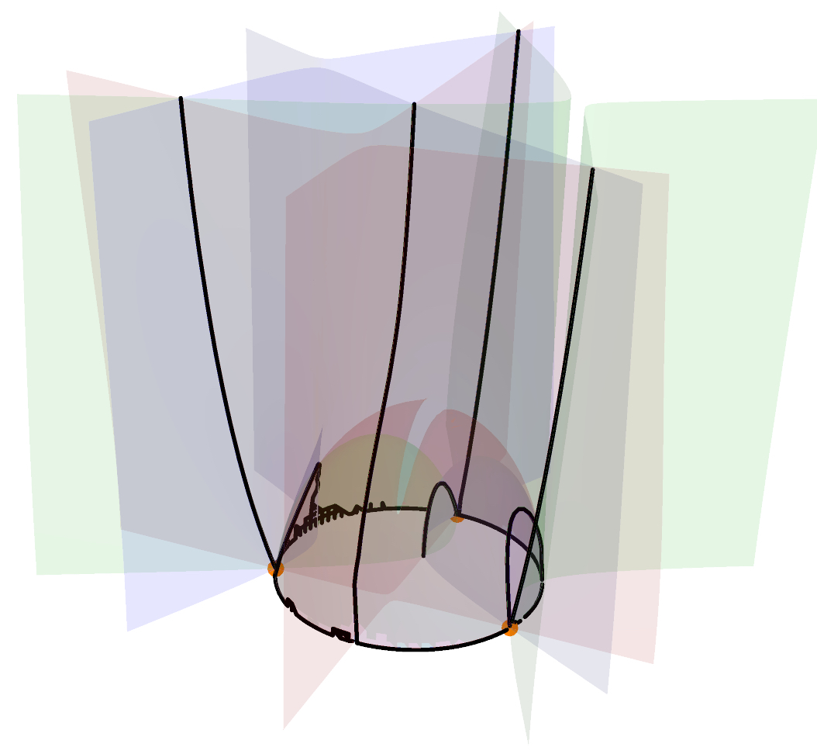
A Family of Space Curves
Some claims concerning the intersection of any special space curve and the xy-plane:
Can pass through a vertex (control point) from any direction
Can go through other points on the circumcircle, but will always be tangent to a tangent plane of the danger cylinder (typically does this one or three times)
Always passes through the orthocenter exactly one time and always vertically (different curvatures)
No other possible intersections with the xy-plane
(ignore a rendering issue near circumcircle)

Slide 103
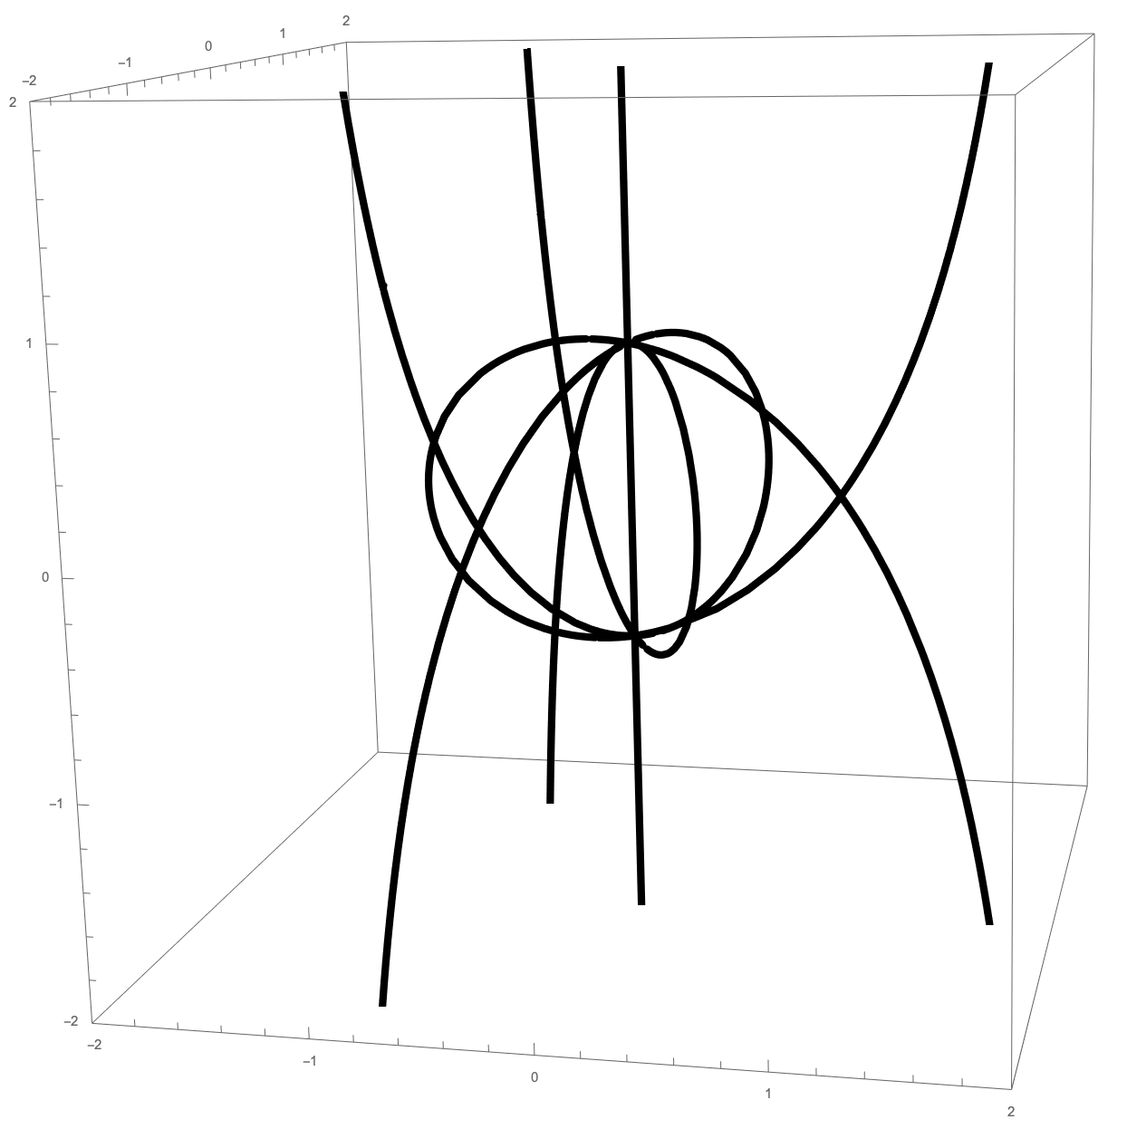
A Family of Space Curves
In a sense, the example here is the simplest of all the non-trivial special space curves
It is for the equilateral triangle case, i.e. when x_{H} = y_{H} = 0
It also uses parameter values x_{L} = y_{L} = 0
There are four connected components for this curve, including the z-axis
The limiting points as |z| goes to infinity project onto these points in the xy-plane:
(0, 0), (2, 0) , (-1, √3) , (-1, -√3)

Slide 104
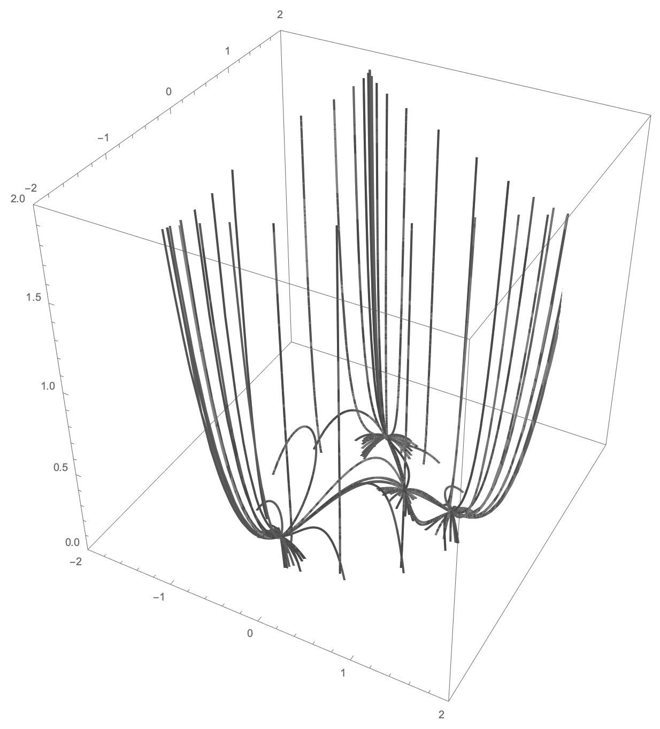
A Family of Space Curves
This figure gives some sense of the claim that CS ⋃ CSDC can be decomposed as a disjoint union of some of the special space curves
The DC portion of these curves are just vertical lines along the DC, but these are not shown in this figure

Slide 105
A Family of Space Curves
Alright, the points along any of the special space curves share the same values of x_{L} and y_{L} , but what does this mean geometrically; how do we characterize these points geometrically?
It is not yet clear
Now, the projections of the special space curves onto the xy-plane are quite interesting and straightforward to describe

Slide 106
A Family of Space Curves
It turns out that the natural (algebraic) extension of each such planar curve is given by a cubic polynomial in x and y, whose coefficients are simple polynomials in x_{H}, y_{H}, x_{L} and y_{L}
These cubic curves pass through each of the three triangle vertices (A, B, C) and also through the triangle’s orthocenter H; we call these the circum-cubic curves
They also have asymptotes that are parallel to the triangle’s altitude lines
Why should there things be so?
It is not yet clear

Slide 107
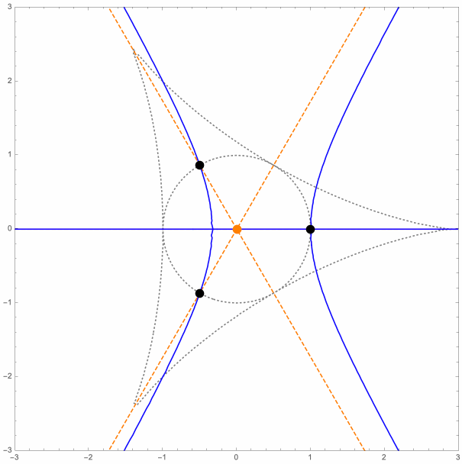
A Family of Space Curves
Various Examples of the Circum-cubic Curves for Various Control Point Positions
(Wait for animation)
The blue curve is the natural extension of the projection of one of the special space curves onto the xy-plane (the plane containing A, B and C)
This curve is given by a third-degree polynomial in x any y
The curve always passes through the triangle’s vertices (black dots), its orthocenter (orange dot), and three points at infinity corresponding to the directions of the triangle’s altitude lines (orange dashed lines)
This leaves two degrees of freedom in the possible curves, corresponding to the choices of x_{L} and y_{L}

Slide 108
A Family of Space Curves
It has also been helpful to realize the special space curves as the integral curves of a vector field that is well behaved outside of the unit sphere, but rather irratic inside the unit sphere
The next slide is an animation that shows the tangents for this vector field, but not the magnitudes and directions, which are irrelevant
This is followed by a slide that shows what the vector field looks like in the xy-plane

Slide 109
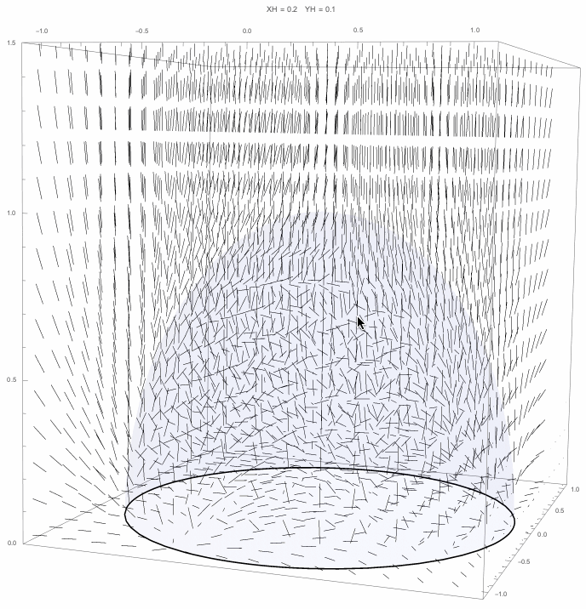
A Family of Space Curves
A normalized vector field
This vector field is obtained by normalizing the cross product of the gradient fields of x_{L} and y_{L}
The integral curves of this field are the special space curves on which x_{L} and y_{L} are constant
The sphere for which the circumcircle of ΔABC is a diameter (i.e. the unit sphere in the xyz-coordinate system) is such that the vector field is quite well behaved outside this sphere
Not so inside the sphere!
We call the sphere the turbulence sphere due to the irratic behavior of the vector field and the special space curves inside the sphere

Slide 110
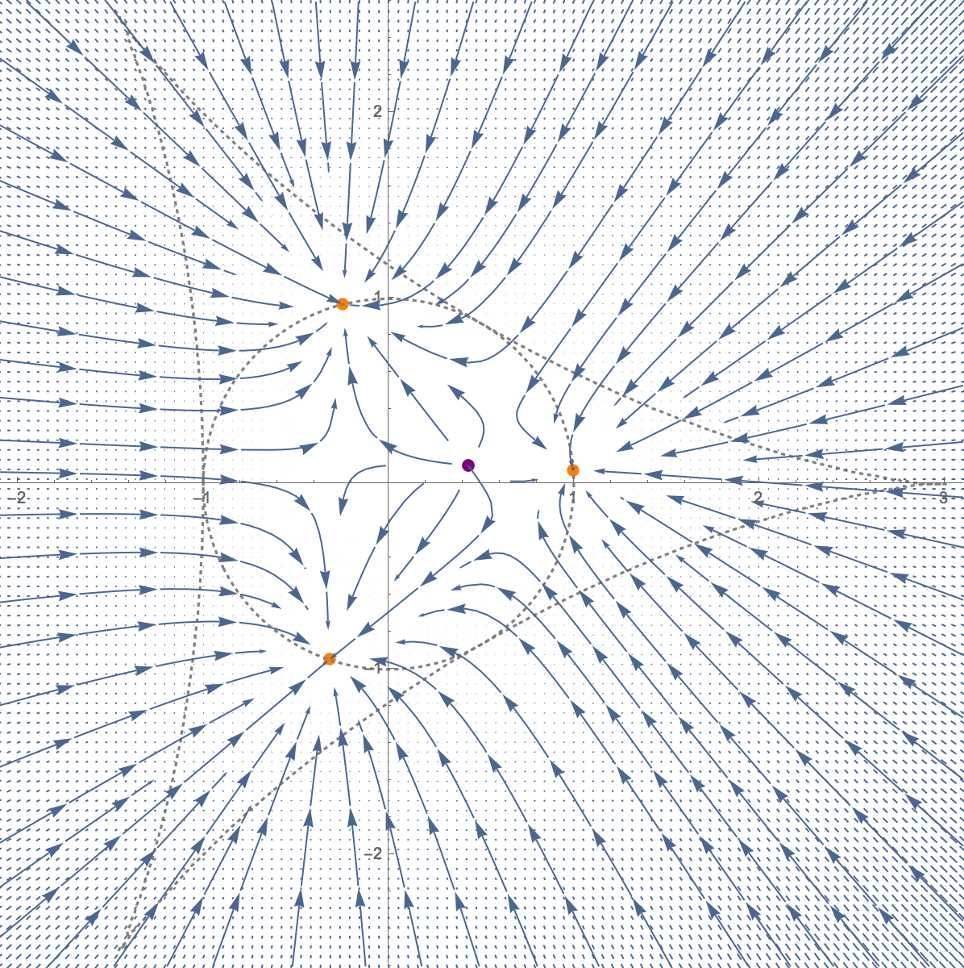
A Family of Space Curves
The vector field in the xy-plane
The orange dots are the control points (triangle vertices)
The purple dot is the orthocenter

Slide 111
A Curious Family of Birational Transformations
While working to simplify the formulas for x_{L} and y_{L} , a certain family (parameterized by x_{H} and y_{H}) of birational transformation popped up that not only simplifies these formulas, but that also have some interesting geometric properties
They are transformations between x, y and z², and quantities μ, ν and ξ ,
( x, y, z² ) ⟷ ( μ, ν, ξ )
where either set of variables can be expressed rationally in terms of the other set of
variables

Slide 112
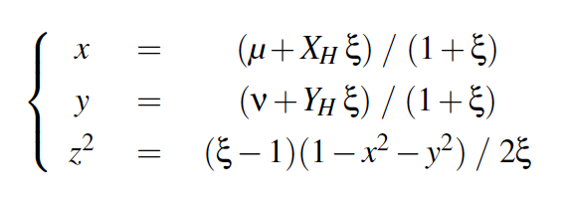
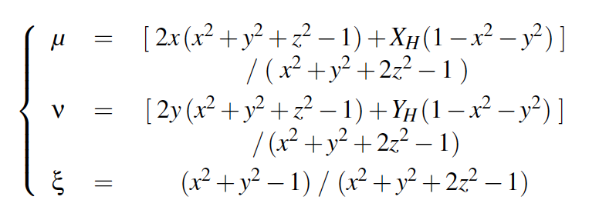
A Curious Family of Birational Transformations
(from Rieck 2018; the capital X and Y
here should be lowercase)

Slide 113
A Curious Family of Birational Transformations
Note that (x²+y²+z²-1) / z² = (1+ξ) / (1-ξ) and (x²+y²-1) / z² = 2 ξ / (1-ξ)
Consequently:
|ξ| > 1 ⇒ (x,y,z) is inside the unit sphere
-1 < ξ < 0 ⇒ (x,y,z) is outside the unit sphere but inside the danger cylinder
0 < ξ < 1 ⇒ (x,y,z) is outside the danger cylinder

Slide 114
A Curious Family of Birational Transformations
The simpler formulas for x_{L} and y_{L} are just these:
x_{L} = [ μ² - 2μ - ν² - (x_{H}² - 2x_{H} - 2y_{H}) ξ² ] / [ 1 - ξ² ]
y_{L} = [ 2(μ + 1) ν - 2(x_{H} + 1) y_{H} ξ² ] / [ 1 - ξ² ]
While that is somewhat interesting, more interesting perhaps is the fact that the special curves in xyz-space transform to curves in μνξ-space whose projections
onto the μν-plane are just rectangular hyperbolas (degree-two curves)

Slide 115
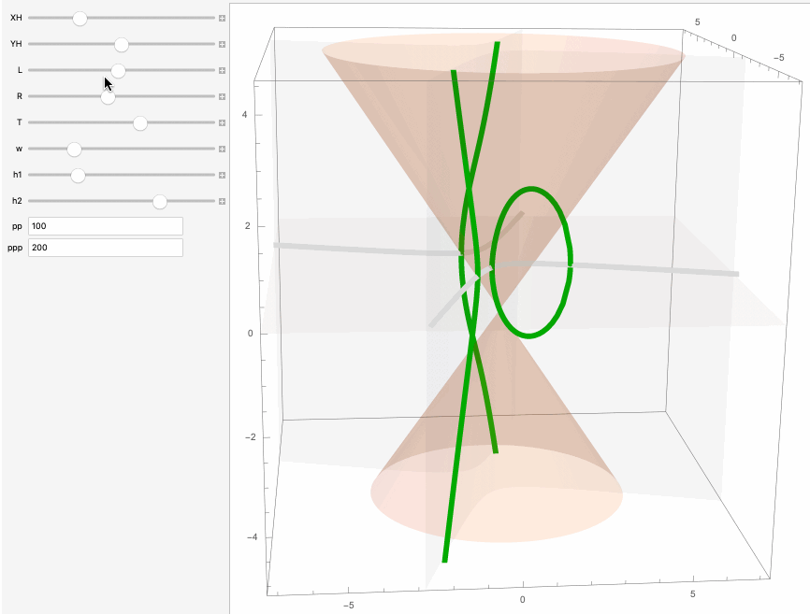
A Curious Family of Birational Transformations
The special space curves realized in μνξ-space
(Wait for animation)
These (green) curves in μνξ-space are simpler than the corresponding curves in xyz-space
The projections of these onto the μν-plane are rectangular hyperbolas (gray curves)

Slide 116
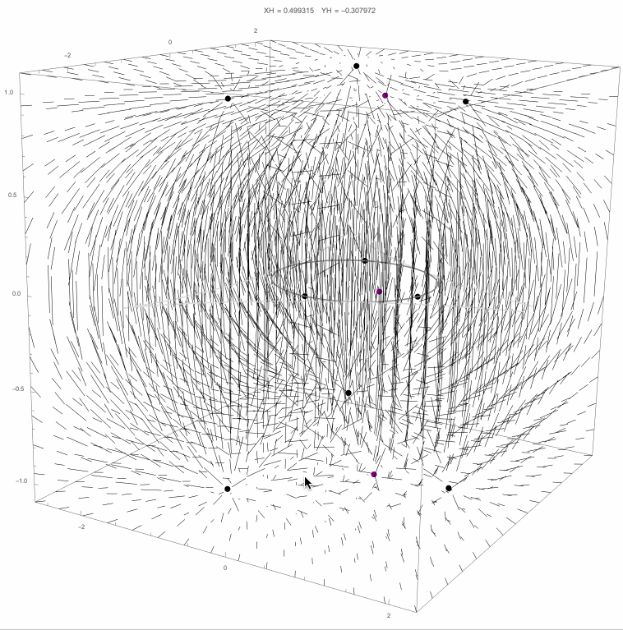
A Curious Family of Birational Transformations
The vector field in μνξ-space
(Wait for animation)
The vector field for the special μνξ-space curves is proportional to
( [(x_{H}-1)²-y_{H}²](μ+1) + 2(x_{H}+1)y_{H}ν – (μ+1) [(μ-1)² + ν²] ,
2(x_{H}+1)y_{H}(μ-1) + [y_{H}²-(x_{H}-1)²]ν – ν [ν² + (μ-1) (μ+3)] ,
(μ²+ ν²-1)(1-ξ²) / ξ )
This vector field vanishes at the points (μ, ν, ξ) =
(x_{H}, y_{H}, ±1), (2x₁-x_{H}, 2y₁-y_{H}, ±1), (2x₂-x_{H}, 2y₂-y_{H}, ±1) and (2x₃-x_{H}, 2y₃-y_{H},, ±1)
It is generally vertical when ξ = 0, and horizontal when ξ = ±1, and when μ² + ν² = 1

Slide 117
A Curious Family of Birational Transformations
A big surprise, quite a shock really, is that the special double toroids, DToroid_{A} , DToroid_{B} and DToroid_{C} , are transformed into elliptical double cones in μνξ-space
Also, the circumcircle expands (blows up) into a very similar double cone, while the rest of the danger cylinder collapses (blows down) to a circle
The bilinear transformation arose from an aspect of P3P that did not seem to involve toroids and double toroids, so why are these surfaces so profoundly affected?
It is not yet clear

Slide 118
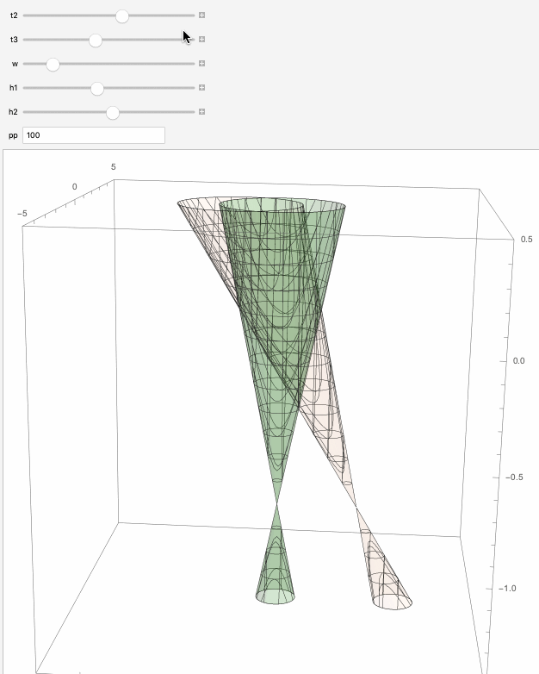
A Curious Family of Birational Transformations
A couple elliptical double cones in μνξ-space
(Wait for animation)
The green double cone is the transformation of the ΔABC’s circumcircle (which blows up in a sense)
The other double cone is the transformation of one of the three special double toroids (i.e. the rotatation of the circumcircle about one of the triangle ΔABC’s sidelines)
In the animation, the underlying triangle ΔABC is occasionally changed

Slide 119


A Curious Family of Birational Transformations
For the equilateral triangle case, here are portions of the elliptical double cones in μνξ-space that correspond to the blowup of the circumcircle (yellow) and the three special double toroids (red, green and blue)
All of these pass through the unit circle μ² + ν² = 1 in the μν-plane
All have their apices in the ξ = -1 plane
Rather mysterious.

Slide 120

A Curious Family of Birational Transformations
CS ⋃ CSDC in μνξ-space
The formula for CS ⋃ CSDC, i.e. the discriminant for Grunert’s system, also simplifies quite a bit when μνξ-coordinates are used
The formula is invariant under the substitution ξ ⟶ -ξ and perhaps there is a geometric reason
Here is what the surface looks like in μνξ-space when (x_{H}, y_{H}) = (0.3, 0.2)
It is of course symmetric about the μν-plane
Its intersection with the μν-plane is just the union of the standard deltoid and the unit circle

Slide 121
A Curious Family of Birational Transformations
A theorem in algebraic geometry says that any birational transformation between smooth complex projective varieties can be achieved through a sequence of blowups and blowdowns, though blowups and blowdowns are defined more generally here
Perhaps there is a nice decomposition for the birational transformations being investigated here

Slide 122
A Curious Family of Birational Transformations
As a step in this direction, perhaps, let us set W = z² / (x² + y² – 1)
This yields x = (μ + x_{H} ξ) / (1 + ξ) , y = (ν + y_{H} ξ) / (1 + ξ) , W = (1 – ξ) / 2ξ ,
μ = [ 2(1 + W) x – x_{H} ] / [1 + 2W] , ν = [ 2(1 + W) y – y_{H} ] / [1 + 2W] , ξ = 1 / [1 + 2W]
The birational transformation ( x, y, W ) ⟷ ( μ, ν, ξ ) seems pretty simple, and perhaps it has a nice geometric interpretation

Slide 123
A Curious Family of Birational Transformations
As an alternative to W, we could use instead Q = W / (1+W) = z² / (x² + y² + z² – 1)
This yields x = (μ + x_{H} ξ) / (1 + ξ) , y = (ν + y_{H} ξ) / (1 + ξ) , Q = (1 – ξ) / (1 + ξ) ,
μ = [ 2 x - x_{H} (1-Q) ] / (1+Q) , ν = [ 2 y - y_{H} (1-Q) ] / (1+Q) , ξ = (1-Q) / (1+Q)
Letting μ’ = μ + x_{H} ξ and ν’ = ν + y_{H} ξ , we have x = μ’ / (1 + ξ) , y = ν’ / (1 + ξ) ,
Q = (1- ξ) / (1+ξ) , μ’ = 2 x / (1+Q) , ν’ = 2 y / (1+Q) , ξ = (1-Q) / (1+Q)

Slide 124
A Curious Family of Birational Transformations
The birational transformation ( x, y, Q ) ⟷ ( μ’, ν’, ξ ) seems especially simple
Still, a good geometric sense of all this is pretty much lacking at the moment, and certain phenomena are currently mysterious
It has been observed for instance that any torus or double toroid obtained by (3D) rotating the unit circle in the xy-plane about any line in the xy-plane, transforms under (x, y, z) ⟶ ( μ, ν, ξ ) to an elliptical double cone -- no idea why

Slide 125
Some Closing Questions
Why does a deltoid curve occur in the limiting case as |z| goes to infinity?
Why does the deltoid curve formula occur in the “nice” way of writing the otherwise messy discriminant formula for Grunert’s system of equations?
Is there an intuitive geometric significance to the special xyz-space curves?
Why do these curves project onto circum-cubic curves with special properties?

Slide 126
Some Closing Questions
Is there an intuitive geometric significance for the transformation ( x, y, z² ) ⟷ ( μ, ν, ξ ) ?
Why do the special μνξ-space curves project onto rectangular hyperbolas?
Why do toroids and toruses generated by the unit circle in xyz-space transform into elliptic cones in μνξ-space?
Why is the equation for CS ⋃ CSDC, when expressed in μνξ-coordinates,
invariant under the substitution ξ ⟶ - ξ ?

Slide 127
References
Gao, X. S., Hou, X. R. and Tang, J. L., Complete solutions classification for the perspective-three-point problem, Pattern Anal. Mach. Intell. IEEE Trans., 25(8), 930-943 (2003)
Grunert, J. A., Das pothenotische problem in erweiterter gesalt nebst uber seine anwendungen in der geodasie, Grunerts Archiv fur Mathematik und Physik, 1, 238-248 (1841)
Haralick, R. M., Lee, C.-N., Ottenberg, K. and Nolle, N., Review and analysis of solutions of the three point perspective pose estimation problem, J. Computer Vision, 13(3), 331-356 (1994)
Hu, L., Wang, B. and Zhang, J., Singular points in the optical center distribution of P3P solutions, Mathematical Problems in Engineering, #147397 (2015)
Maienschein, T. D. and Rieck, M. Q., Angular coordinates and rational maps, J. Geom. & Graphics, 20(1), 41-62 (2016)
Rieck, M. Q., A fundamentally new view of the perspective 3-point pose problem, J. Math. Imaging and Vision, 48(3), 499-516 (2014)
Rieck, M. Q. Related solutions to the perspective three-point pose problem, J. Math. Imaging and Vision, 53(2), 225-232 (2015)
Rieck, M. Q., On the discriminant of Grunert's system of algebraic equations and related issues, J. Math. Imaging and Vision, 60(5), 737-762 (2018)
Wang, B., Hu, H. and Zhang, C., New insights on multi-solution distribution of the P3P problem, arXiv:1901.11464v1 (2019)
Wang, B., Hu, H. and Zhang, C., Companion surface of danger cylinder and its role in solution variation of P3P problem, arXiv:1906.08598v1 (2019)
Website: http://mqrieck.com/P3P/P3P_Solutions.html

Slide 128
Thank You
Questions?

