Slide 1
Elliptic Curves and the
Perspective 3-Point Problem
A talk for the 2019 MAA Iowa Section Meeting
Michael Q. Rieck, Ph. D.
Drake University

Slide 2
Soon after the invention of the camera, a mathematician named Johann August Grunert posed and solved a mathematical problem that became foundational to the area of “photogrammetry,” and later of use in the area of “camera tracking”
The problem has come to be known as the “Perspective 3-Point Pose Problem,” or the “Perspective 3-Point Problem,” or just the “P3P Problem”
The idea is simple: given a photograph that contains the images of three known points in space, is it possible to determine the location of the camera?
The three known points have come to be called the “control points,” and of course, the distances between these points is known
However, the distances from the camera to the control points are unknown, and determining these is the tricky part of the P3P problem
The triangle whose vertices are the control points is called the “control points triangle,” and the plane containing it is called the “control points plane”
A line connecting the camera position to a control point is called a “view line”

Slide 3
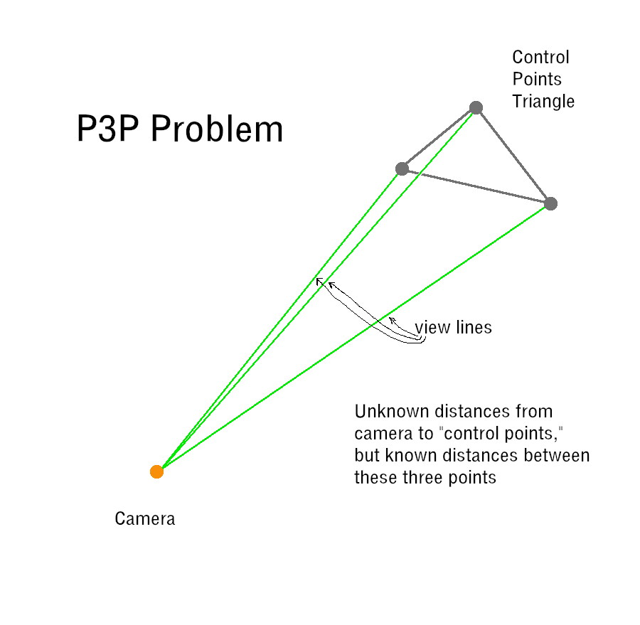

Slide 4
It is assumed that the angles between pairs of view lines are known
This is reasonable when dealing with a simple “pinhole camera” model
Using the Law of Cosines, Grunert approached the P3P Problem as a system of three quadratic equations in the three unknown distances
His solution, as well as a number of later solutions, reduces the system to a single polynomial equation in just one unknown, with coefficients that depend on the known parameters of the P3P Problem (triangle side lengths, etc.)
In Grunert’s case, the unknown is the square of the ratio of two of the unknown distances, and the polynomial has degree four, i.e. a quartic polynomial
Since a quartic polynomial can have up to four positive real roots, for given values of the P3P Problem parameters, there may be up to four solutions to the P3P Problem, i.e., up to four possible positions of the camera

Slide 5
In the 20th century, the P3P Problem was shown to be equivalent to finding the intersection of two quadratic curves in the real projective plane
This observation has been exploited in the solution methods of Finsterwalder, Grafarend, and more recently, Persson and Norberg
Wikipedia claims that the method of Persson and Norberg, which is known as “Lambda Twist,” “achieved state of the art performance in 2018 with a 50 fold increase in speed and a 400 fold decrease in numerical failures”
I was recently able to recast the P3P Problem as an equivalent problem involving four great circles on the unit sphere, x² + y² + z² = 1
This led me to develop a method that focuses first of determining the directions of the sidelines of the control points triangle, rather than the distance from the camera to the control points

Slide 6
My method is noticeably more accurate than Lambda Twist, by at least one order of magnitude, in most cases, but it is about 60% slower
I implemented C code for testing both methods, which is available at
github.com/mqrieck/EllipticCurveP3P
My student, Pawel Barnas, was helpful in developing test programs in Python that tested the C code I wrote; he ran tests and collected data too
The spherical interpretation of the problem is rather interesting in its own right, and my approach to solving it relies on a spherical analogue of a classical “slide puzzle” in the plane
Let us first look at this classical problem

Slide 7
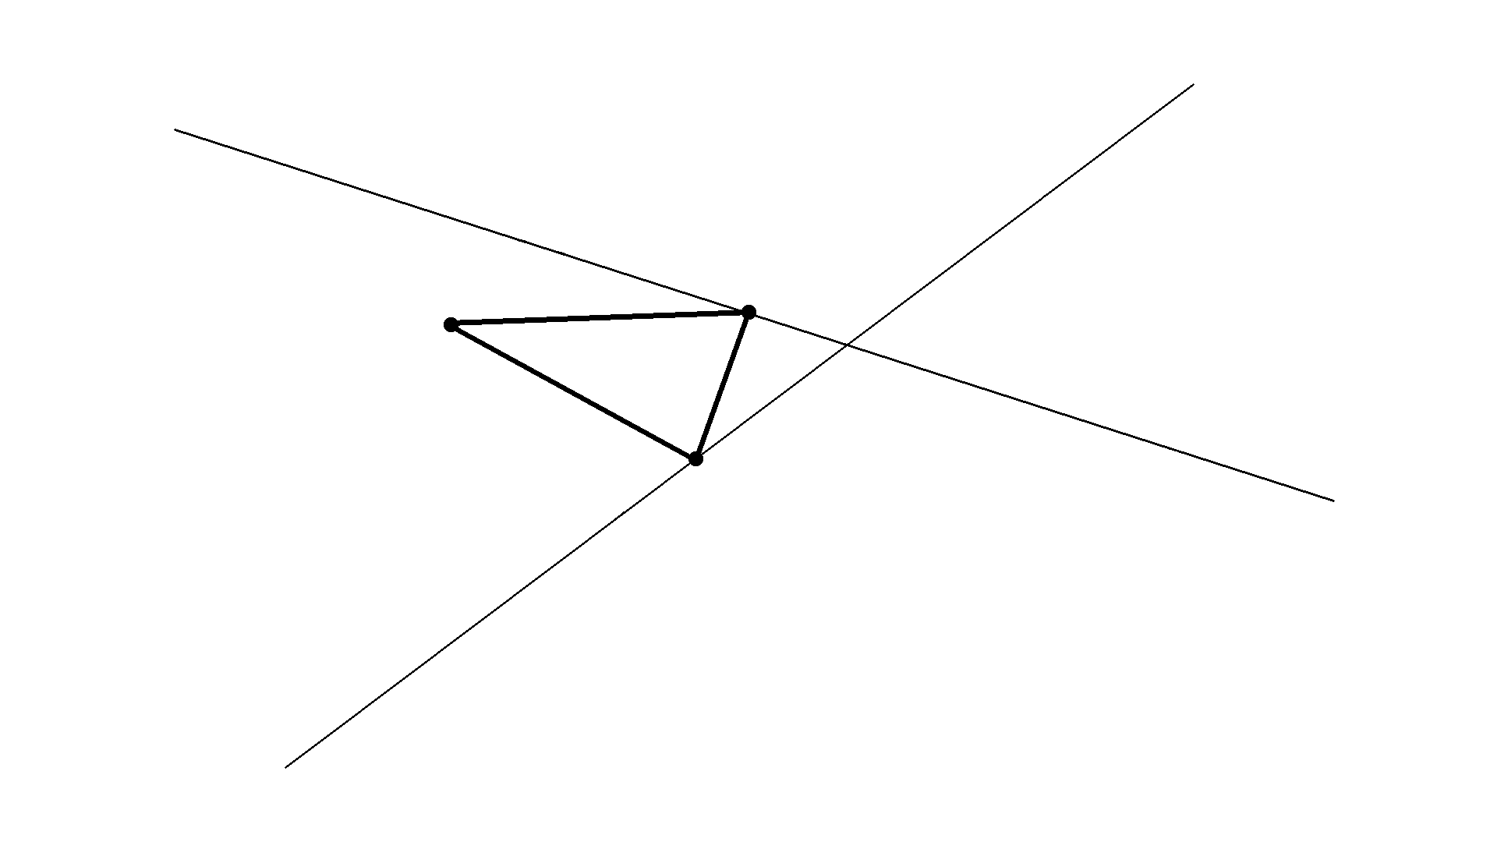
Problem: Assuming that a triangle is allowed to move around on the plane, but with two of its vertices constrained to stay on two different non-parallel lines, describe the curve followed by the third vertex
(Guesses ???)

Slide 8
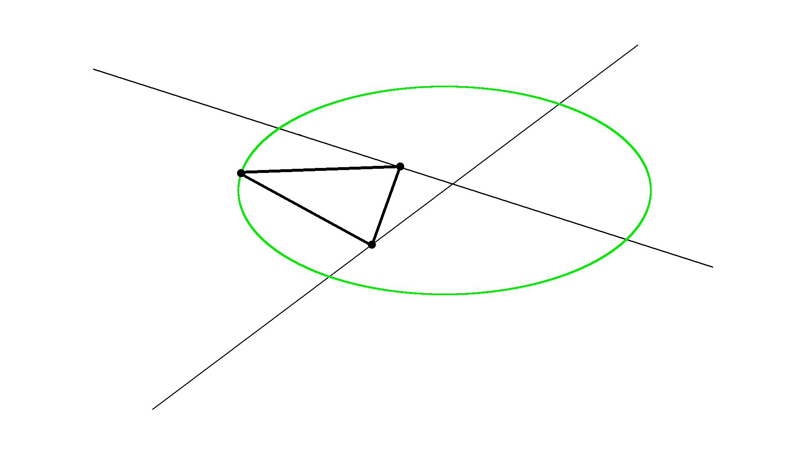
Solution: The third point will trace out an ellipse
Even if the triangle is degenerate (interior angles now being 0 or π), so we are now basically sliding a line segment, the curve traced will still be an ellipse
This is the basis of an ellipse-drawing tool known as the “Trammel of Archimedes”

Slide 9
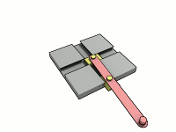
https://en.wikipedia.org/wiki/Trammel_of_Archimedes

Slide 10
In my spherical analogue, lines are replaced with great circles, and line segments are replaced with arcs of great circles
We will only need to be concerned with the spherical analogue of the triangle-sliding problem in the special case where the triangle is degenerate
Thus, the three moving points will lie on a moving great circle, but these points must maintain their separation distances from each other, as this great circle moves around the sphere
Two of these three points are also constrained to lie on fixed great circles
Again, we are interested in the path traced out by the third point while sliding the moving circle, subject to the two constraints
The resulting curve will no longer be described by a quadratic equation, but rather, it requires a quartic (fourth degree) equation
The next figure shows the setup, but does not show the curve traced by the third moving point

Slide 11
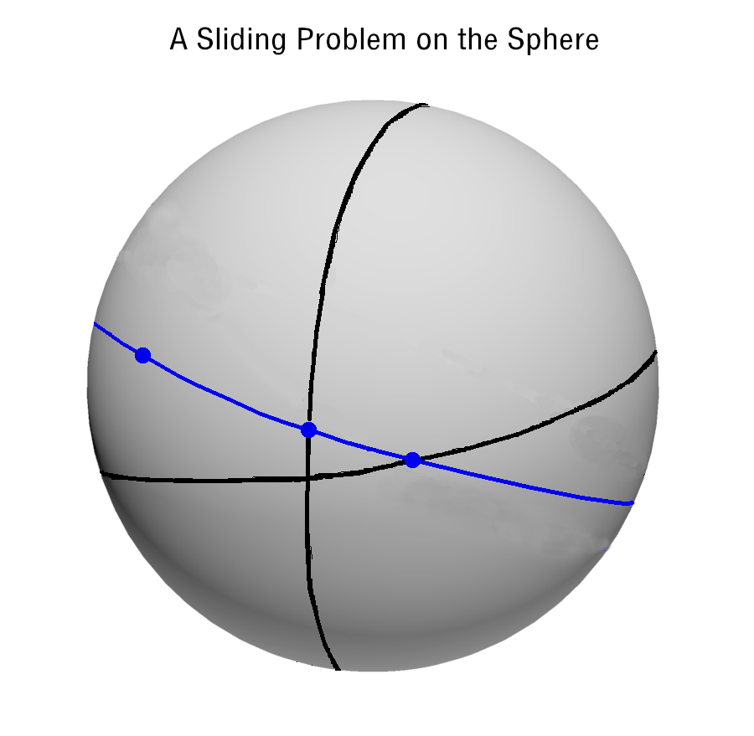

Slide 12
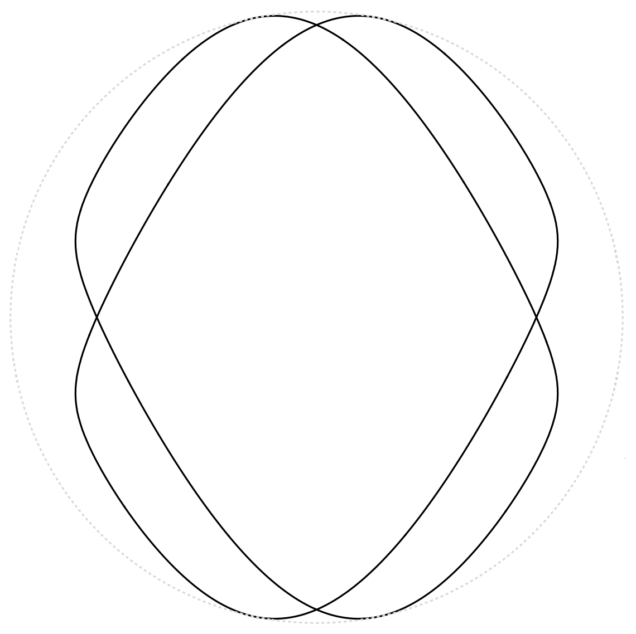
Here is the projection onto a plane of two of the possible quartic curves on the sphere:

Slide 13
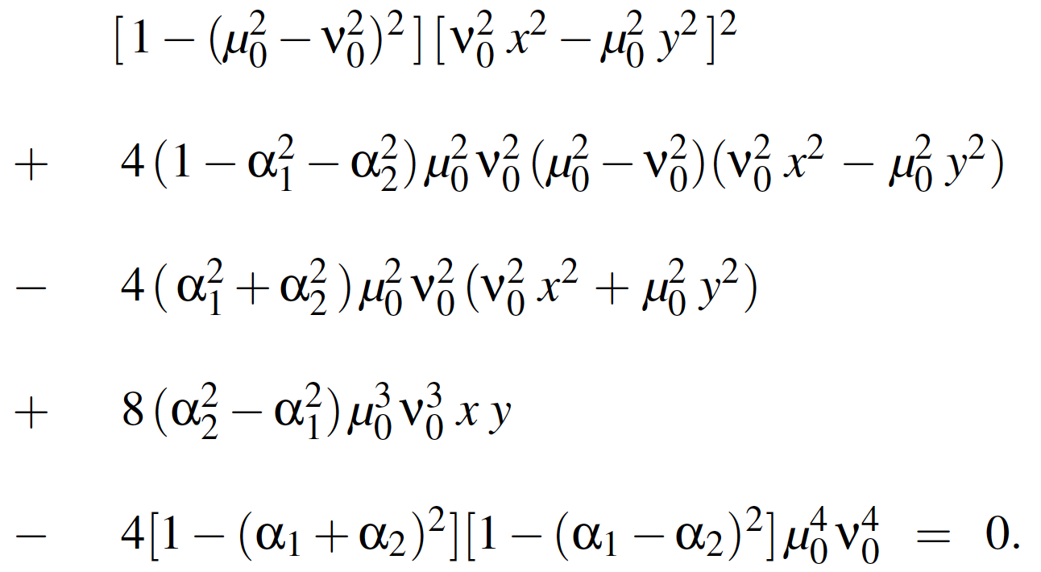
Without loss of generality, we can rotate the sphere and arrange for the quartic equation to only involve the x and y coordinates (not z) and some constant parameters that will not be explained here (unless asked):

Slide 14
The sliding great circle problem is then easily translated from a problem on the unit sphere to a problem in the real projective plane
Here we use the standard model of the real projective plane, identifying its “points” with the lines through the origin in 3-dimensional Cartesian space
Each such line intersects the unit sphere in two antipodal points, and so we may also identify such a pair of points on the sphere with a single “point” in the projective plane
Under this identification, great circles on the unit sphere are identified with “lines” in the projective plane
The quartic curve on the sphere that resulted from the sliding great circle problem then corresponds to a quartic curve in the projective plane
It can be shown that this curve has two singularities, where the curve is self-crossing
It can also be shown that it has “genus one” (definition omitted unless asked)

Slide 15
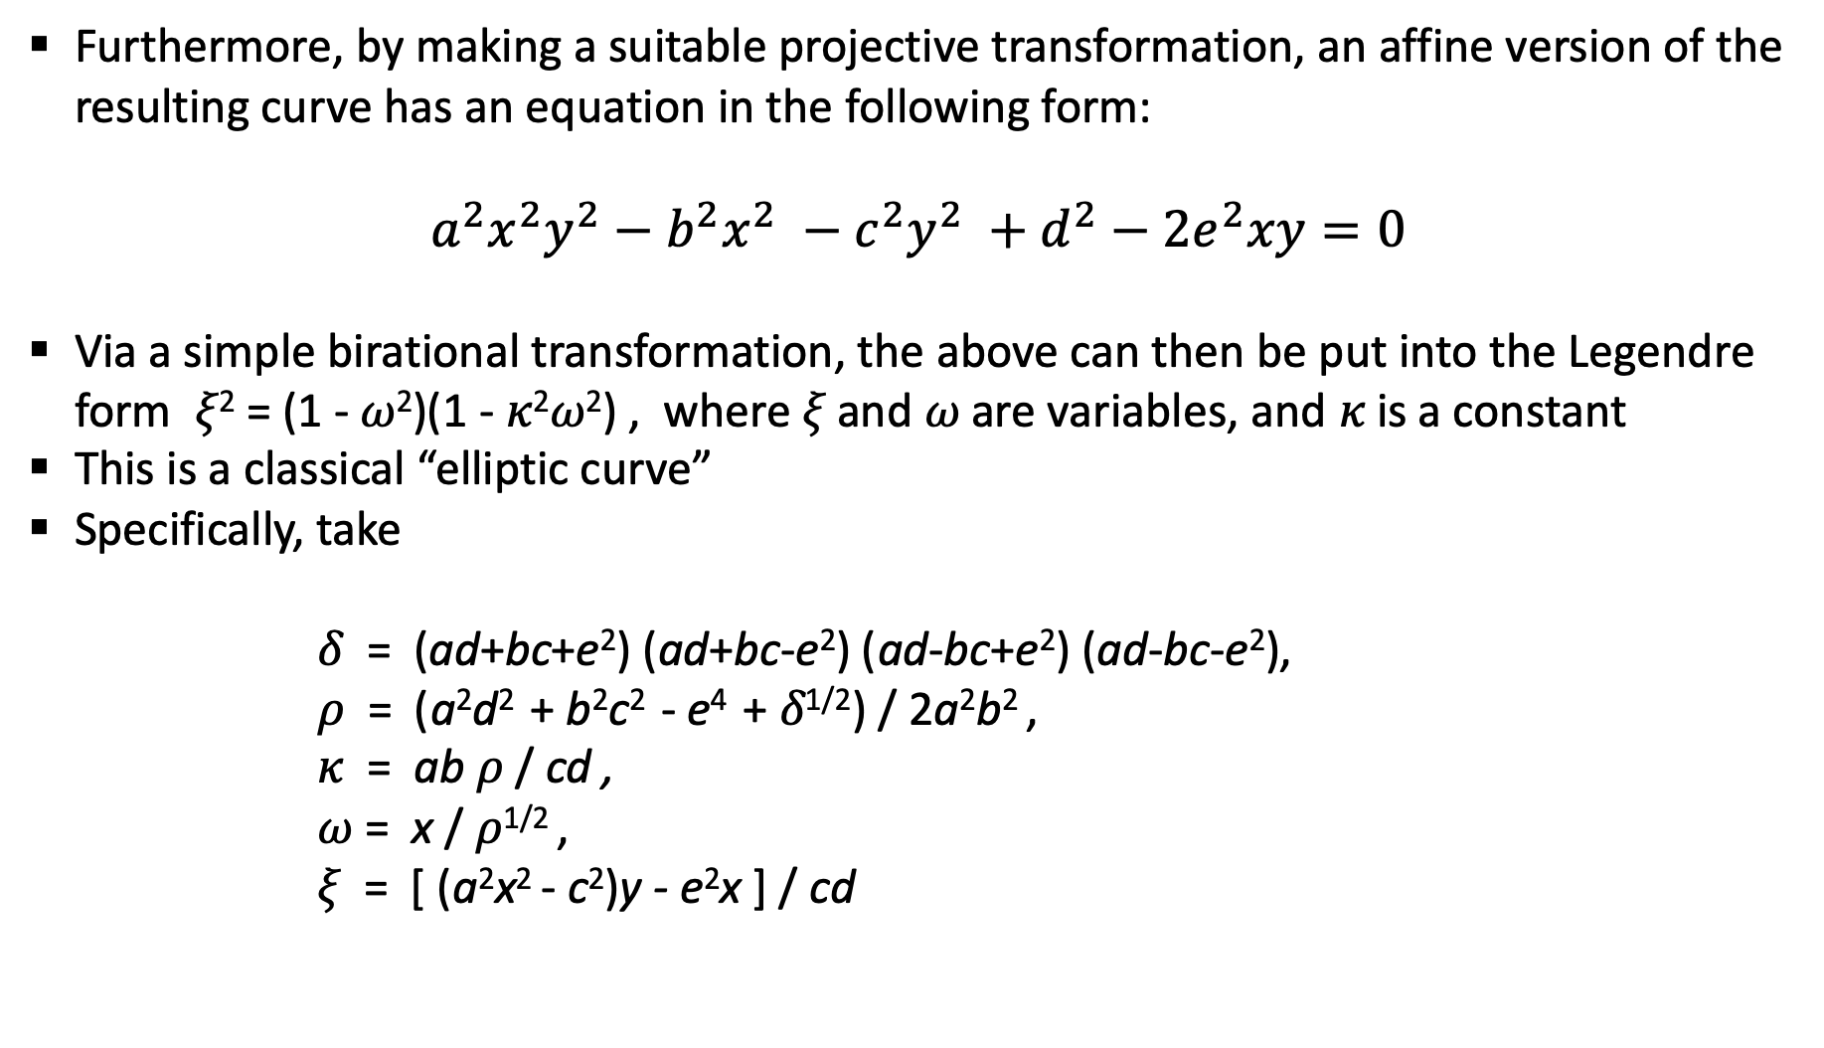
Furthermore, by making a suitable projective transformation, an affine version of the resulting curve has an equation in the following form:
$$a^{2}x^{2}y^{2}−b^{2}x^{2} −c^{2}y^{2} +d^{2}−2e^{2}xy=0$$
Via a simple birational transformation, the above can then be put into the Legendre form 𝜉² = (1 - 𝜔²)(1 - 𝜅²𝜔²) , where 𝜉 and 𝜔 are variables, and 𝜅 is a constant
This is a classical “elliptic curve”
Specifically, take
𝛿 = (ad+bc+e²) (ad+bc-e²) (ad-bc+e²) (ad-bc-e²),
𝜌 = (a²d² + b²c² - e⁴ + 𝛿^{1/2}) / 2a²b² ,
𝜅 = ab 𝜌 / cd ,
𝜔 = x / 𝜌^{1/2} ,
𝜉 = [ (a²x² - c²)y - e²x ] / cd

Slide 16
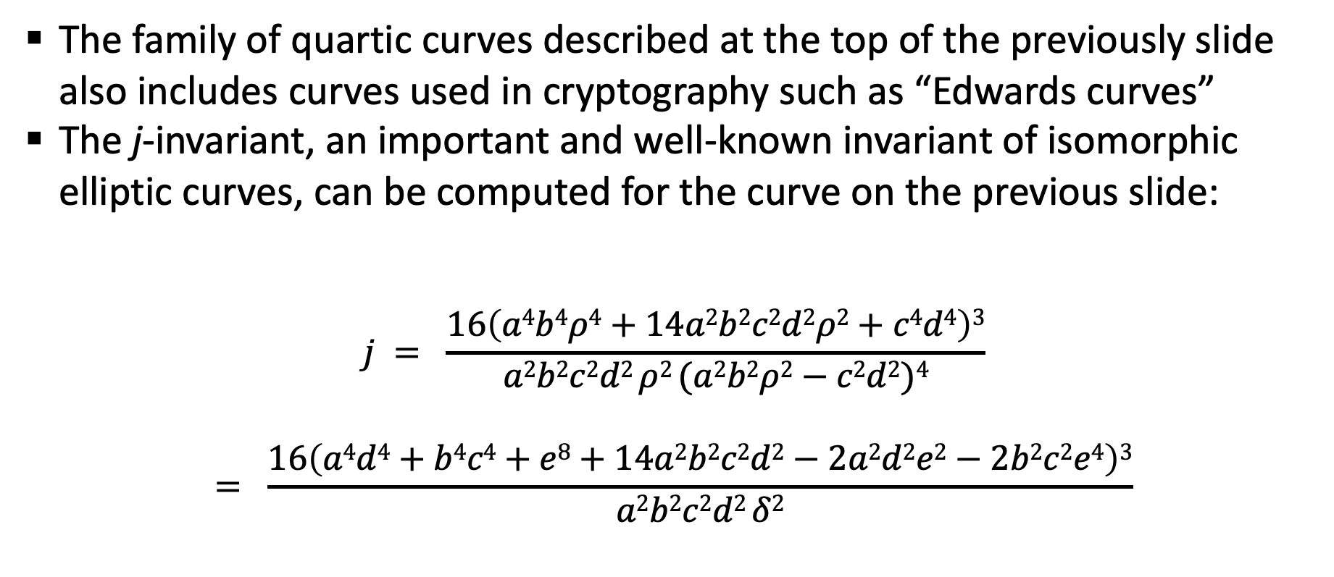
The family of quartic curves described at the top of the previously slide also includes curves used in cryptography such as “Edwards curves”
The j-invariant, an important and well-known invariant of isomorphic elliptic curves, can be computed for the curve on the previous slide:
$$j = \frac{16\left(a4b4ρ4+14a2b2c2d2ρ2+c4d4\right)3}{a2b2c2d2 ρ2 (a2b2ρ2−c2d2)4}$$
$$= \frac{16\left(a4d4+b4c4+e8+14a2b2c2d2−2a2d2e2−2b2c2e4\right)3}{a2b2c2d2 δ2}$$

Slide 17
The terminology “elliptic curve” is a little strange, and inconsistently used in the literature
It is not an ellipse! (The name is an unfortunate historical accident)
The most generous definition is an algebraic curve of genus one
The family of curves considered here fits this definition
In any case, these curves are birationally equivalent to non-singular cubic curves
Such non-singular cubic curves constitute a more restricted class of curves that is often used to give a more restricted definition for “elliptic curves”

Slide 18
There are even more restricted definitions
Often one is also required to specify a “rational point” on the curve, in order to impose an abelian group structure on the curve
Such additional structure will not be of concern here, though perhaps it should be!
Let us now return to the P3P problem, and work with a Cartesian coordinate system that places the camera at the origin, and that agrees with the actual distances

Slide 19
Locating the control points in this “camera-centric” coordinate system is sufficient for solving the P3P problem, where the determination of the camera’s position in physical space is the objective
The essential thing is to find the distances between the camera and the control points, after which, everything becomes simple
So, working in the camera-centric coordinate system, assume, w.l.o.g., that the view lines are known, a priori
It will be helpful to refer to any plane containing two view lines as a “containment plane,” and these are then also presumed to be known

Slide 21
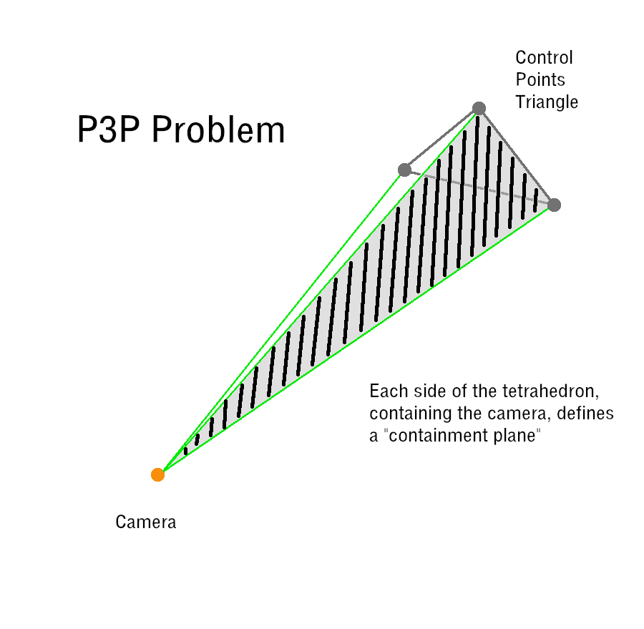

Slide 22
Of course, the distances between the control points are known, and so we may assume that the interior angles of the control points triangle are also known
Although the positions of the control points are unknown, we can imagine parallel translating the three sidelines of the triangle, so that the translated lines become incident with the origin (the camera position)
Accordingly, these three unknown lines will be called the “translated sidelines”

Slide 23
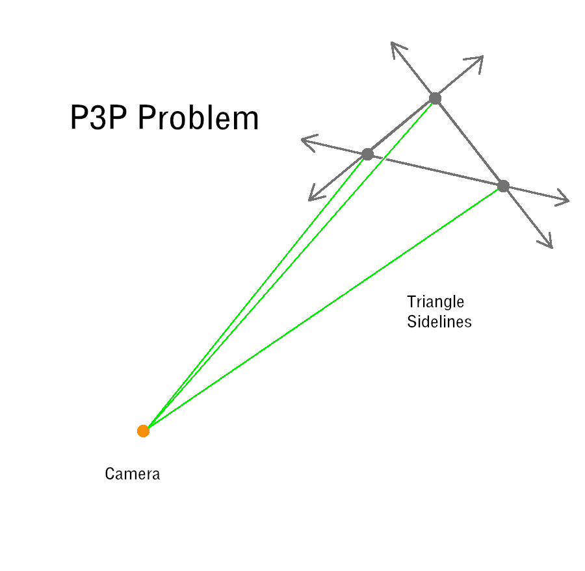

Slide 24
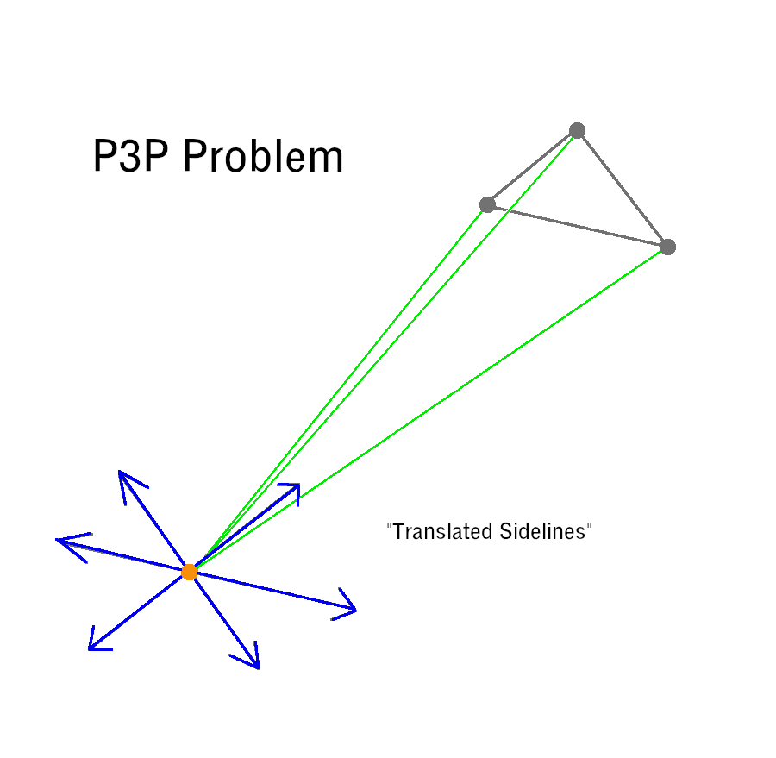

Slide 25
Restrict attention now to lines and planes that go through the origin
We have the three known view lines
We have the three unknown translated sidelines
We have the three known containment planes
Each containment plane contains two view lines and one translated sideline
We also have the unknown plane containing the translated sidelines
Now, notice what happens when these geometric objects are intersected with the unit sphere

Slide 26
Each view line corresponds to a pair of known antipodal points on the sphere (green points in the upcoming slides)
Any two of these pairs gives four points lying on the known great circle that corresponds to a known containment plane (black circles in upcoming slides)
Each translated sideline corresponds to a pair of unknown antipodal points on the sphere (blue points in upcoming slides)
These points, for all three translated sidelines, lie on an unknown great circle (blue circle) that corresponds to the plane containing the three translated triangle sidelines

Slide 27
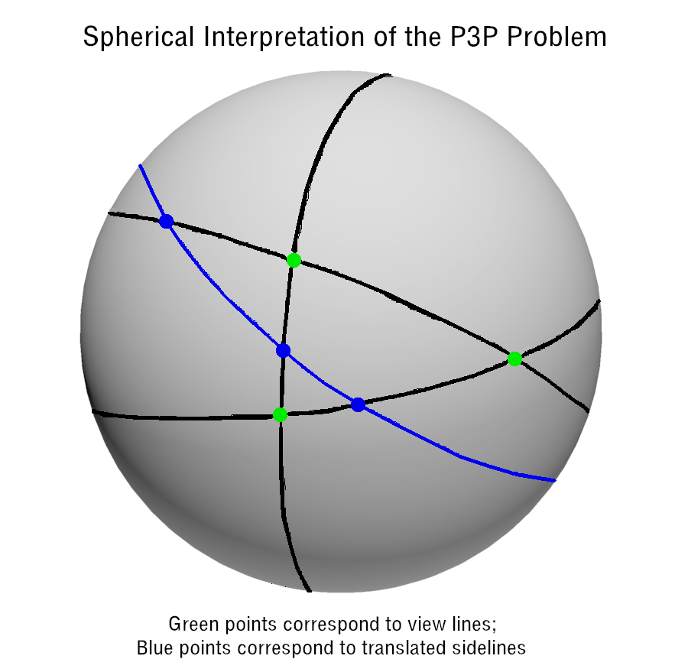

Slide 28
A fact that might not be obvious at first is that the distances between the blue points (corresponding to the translated sidelines) along the great circle containing these points, are actually known
Why?
These distances are just the angles between the sidelines of the control points triangle, i. e. the interior/exterior angles of this triangle
The upshot of all this is that the P3P problem can now be reformulated as follows

Slide 29
Given three fixed great circles on the unit sphere (the black circles), find three pairs of antipodal points (the blue dots) such that
each pair of points lies on a corresponding fixed great circle
all of these points also lie on a common great circle (the blue circle)
the distances between these points on this latter great circle have certain prescribed values

Slide 31
Solving this means identifying possible translated sidelines (for some P3P solution) and therefore also identifying the plane containing all of them
Such a plane is parallel to the plane containing the possible positions of the control points (for some P3P solution)
By solving a linear equation, it becomes easy to locate this latter plane, and thereby obtain one of the solutions to the P3P problem
Now, let us go back to solving the problem on the unit sphere
If we relax one of the constraints in the problem, by no longer requiring the third pair of antipodal points to lie on the third fixed great circle, then the (blue) great circle that contains the six (blue) points becomes free to slide around

Slide 32
Indeed, we are now looking at the sliding problem considered earlier, where the path of one of the points in the third pair of antipodal points was the issue
As already asserted, this path describes a certain quartic curve
So, we simply need to ask where this quartic curve intersects the third fixed great circle, and thereby solve the P3P problem

Slide 33
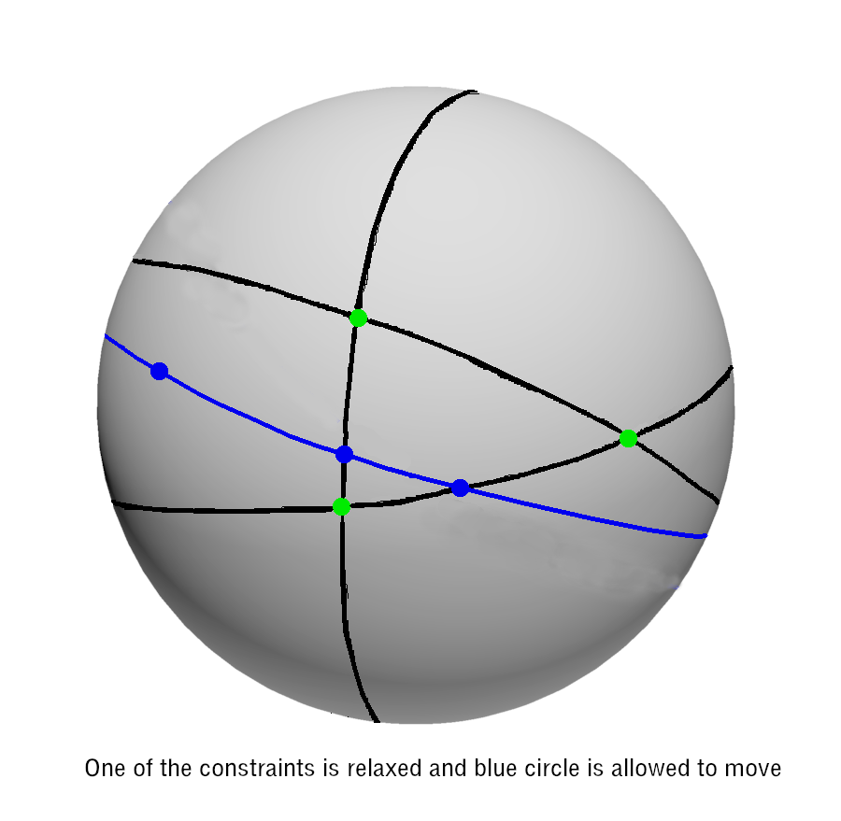

Slide 34
When this question is translated from the unit sphere to the real projective plane, we find that we are simply looking for the intersection of a (genus-one) quartic curve and a line!
That is easy to solve
This thinking in the projective plane serves as the basis for the P3P-solver algorithm that was implemented and tested against the Lambda Twist algorithm
I will close by briefly discussing the results of that testing
The “attack angle” made a big difference
By this, it is meant the angle between the line through the origin and the circumcenter of the triangle, and the line normal to the triangle, through its circumcenter

Slide 35
The simulations involved taking a given triangle with vertices on the unit circle in the xy-plane, randomly rotating it in 3 dimensions about the origin, randomly lifting it along the positive z direction, and then randomly rotating about the origin again
Then the vertices of the triangle, treated as control points, were observed from the origin, and the P3P-solver algorithms were applied to estimate the distances to the control points
The first rotation was restricted to produce a restricted range of attack angles
The lifting along the positive z direction was also restricted to a certain range of elevations

Slide 36
The data collected and reported in the next few slides are for two different triangles, an obtuse triangle and an acute triangle (fairly close to equilateral)
For each of the plots in these slides, ten million random trials were used
Average errors and their standard deviations, minimum and maximum errors, and execution times were recorded
As long as this attack angle was not close to a right angle, the method based on elliptic curves had an average error that was at least one order of magnitude better than that of the Lambda Twist method
The minimum error, taken over a large number of trials, was similarly better
The execution time was about 60 percent worse

Slide 37
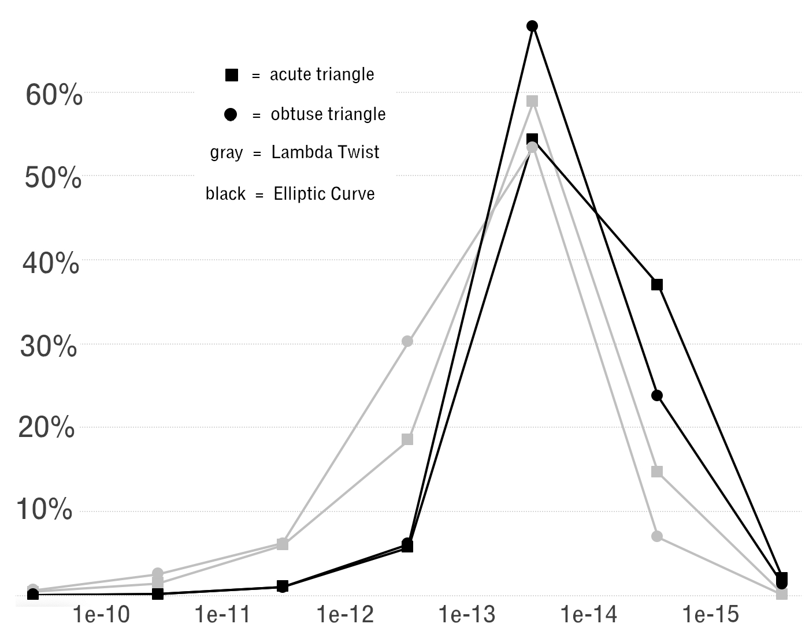
Average error distributions when attack angle was between 0 and 30 degrees, and elevation of triangle was between 10 and 20 (for two different triangles):

Slide 38
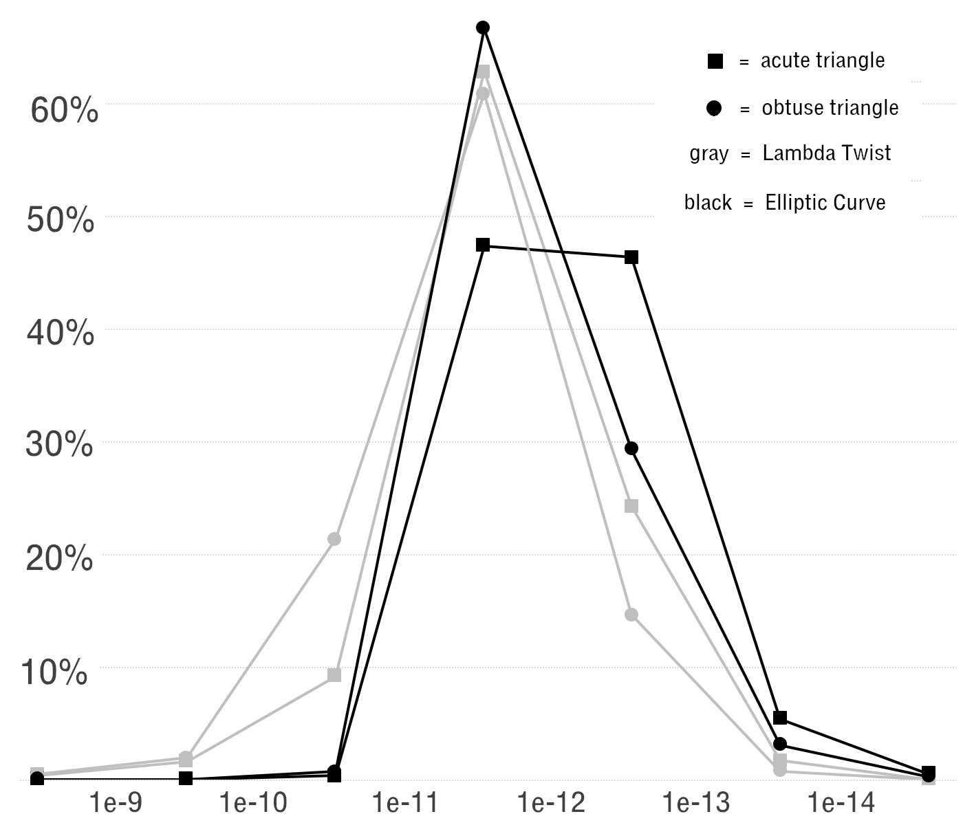
Average error distributions when attack angle was between 0 and 30 degrees, and elevation of triangle was between 100 and 200 (for two different triangles):

Slide 39
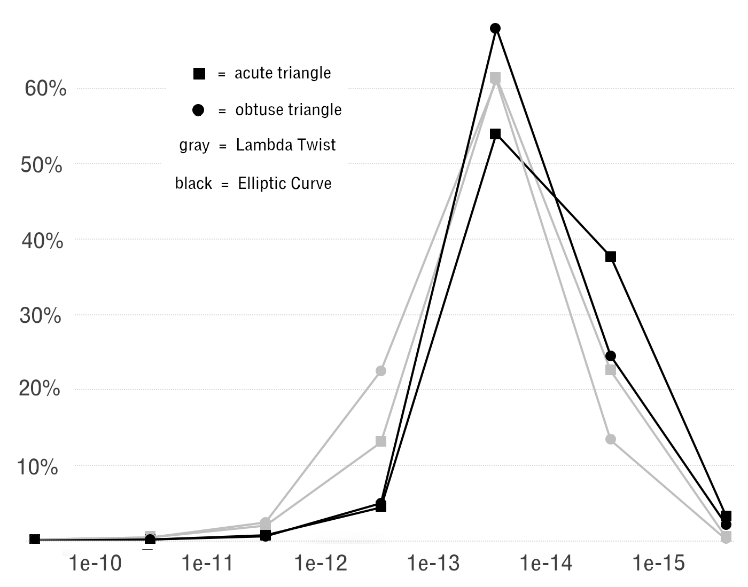
Average error distributions when attack angle was between 30 and 60 degrees, and elevation of triangle was between 10 and 20 (for two different triangles):

Slide 40
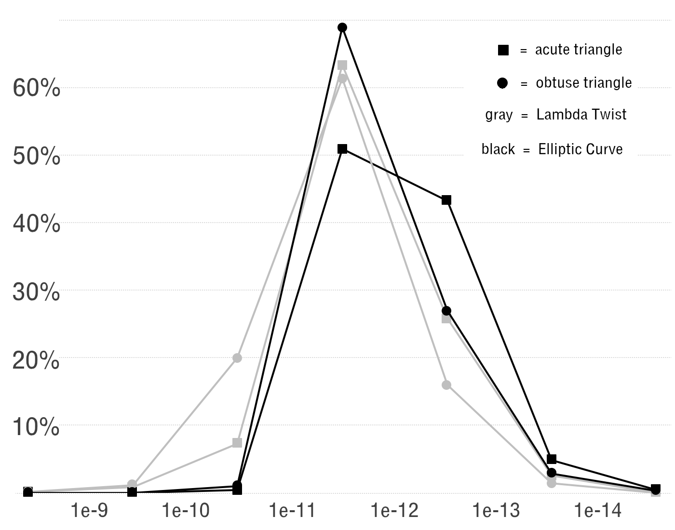
Average error distributions when attack angle was between 30 and 60 degrees, and elevation of triangle was between 100 and 200 (for two different triangles):

Slide 41
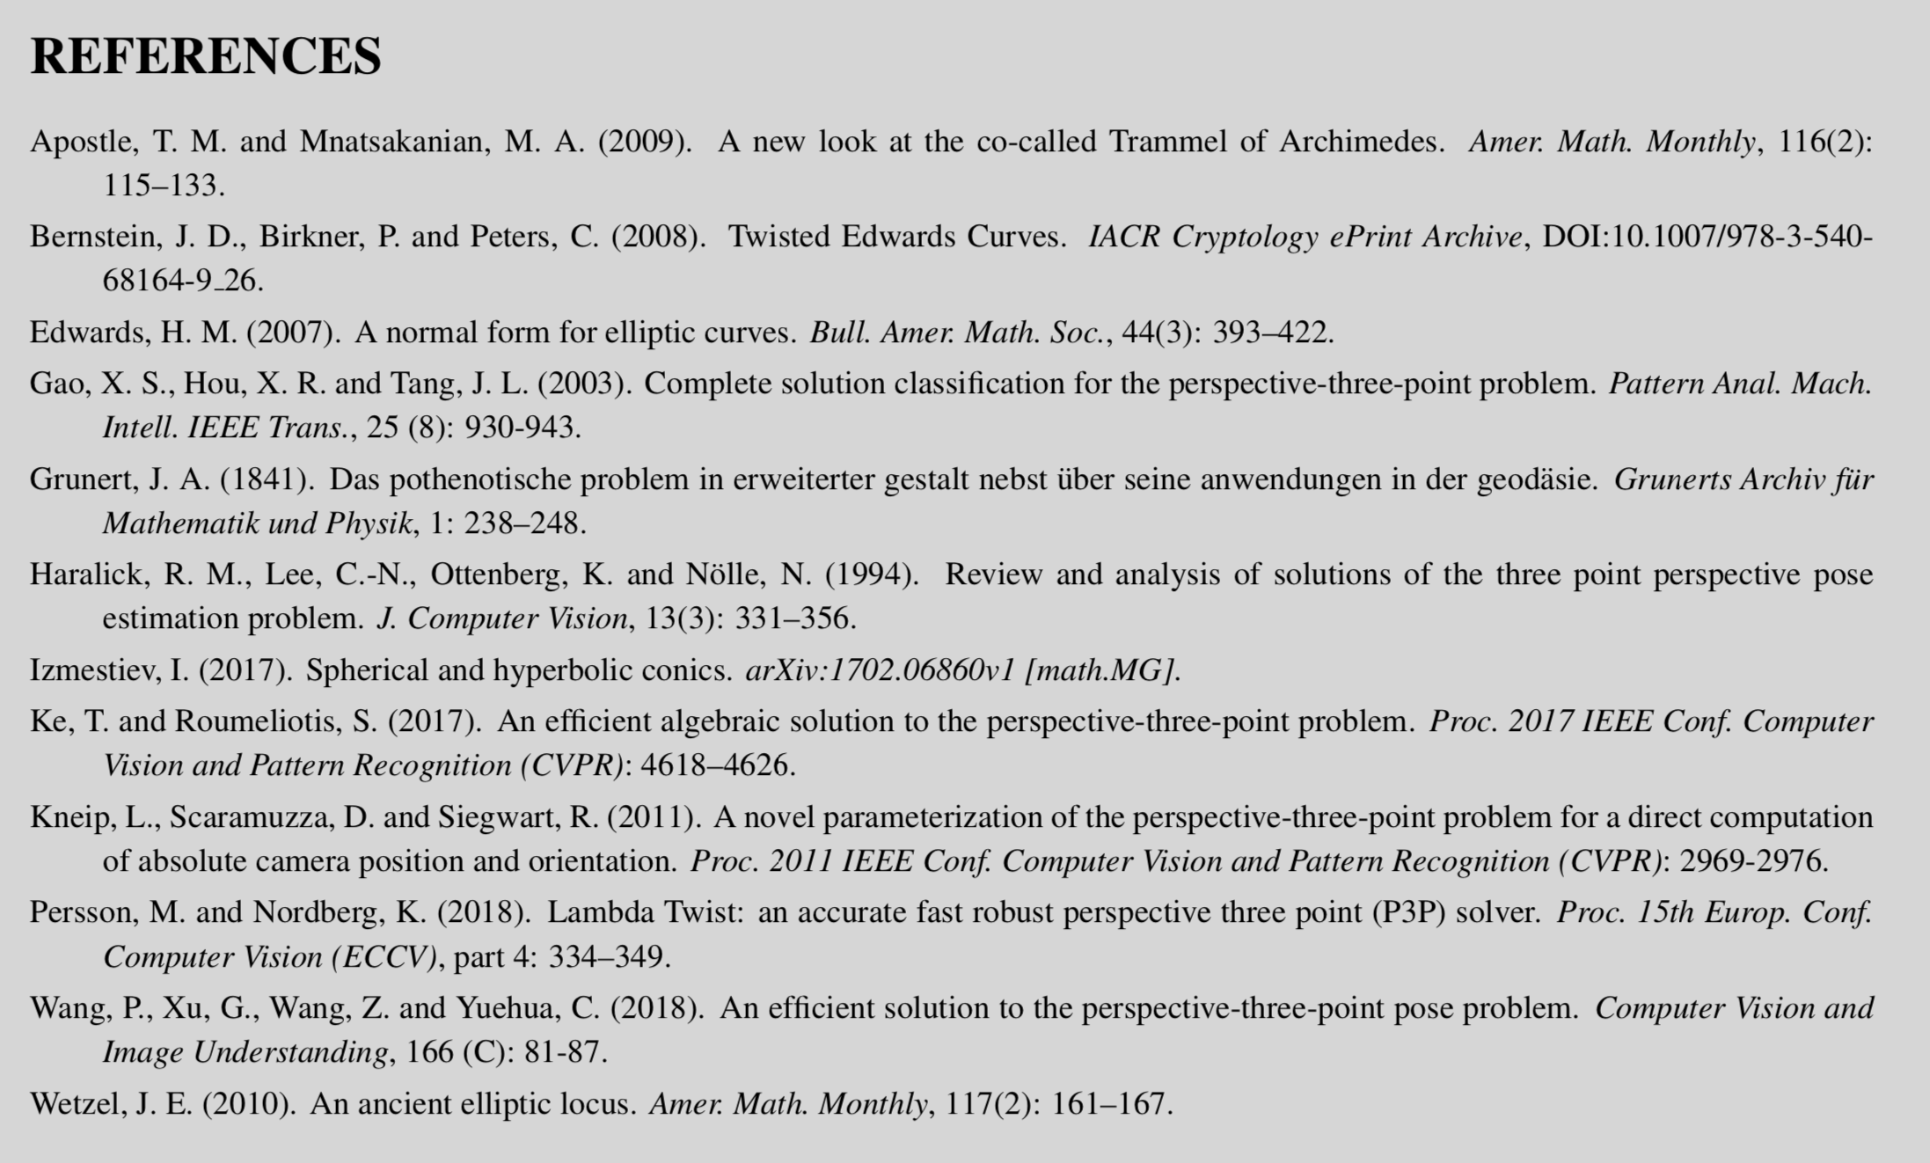

Slide 42
Thank You
Questions?

